Slide 1
Accelerated Sparse Linear Algebra: Emerging Challenges and Capabilities for Numerical Algorithms and Software
Michael A. Heroux
Director of Software Technology, Exascale Computing Project
Senior Scientist, Sandia National Laboratories
Numerical algorithms for highperformance
computational science
London, UK
April 9, 2019

Slide 2
The three technical areas in ECP have the necessary components to address these challenges and meet national goals
Performant mission and science applications @ scale
Foster application
development
Ease
of use
Diverse
architectures
HPC
leadership
Application Development (AD)
Software
Technology (ST)
Hardware
and Integration (HI)
Develop and enhance the predictive capability of applications critical to the DOE
Produce expanded and vertically integrated software stack to achieve full potential of exascale computing
Integrated delivery of ECP products on targeted systems at leading DOE computing facilities
25 applications ranging from national security, to energy, earth systems, economic security, materials, and data
80+ unique software products spanning programming models and run times, math libraries, data and visualization
6 vendors supported by PathForward focused on memory, node, connectivity advancements; deployment to facilities

Slide 3

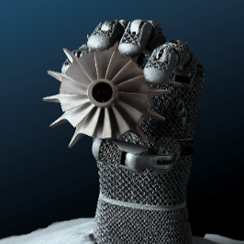
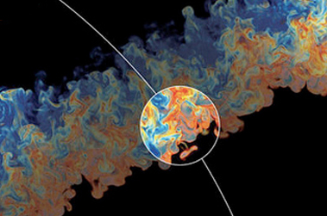
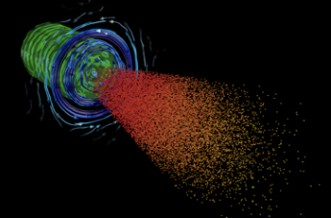
ECP’s 25 applications target national problems in DOE mission areas
National security
Energy security
Economic security
Scientific discovery
Earth system
Health care
Next-generation, stockpile stewardship codes
Reentry-vehicle- environment simulation
Multi-physics science simulations of high-energy density physics conditions
Turbine wind plant efficiency
Design and commercialization
of SMRs
Nuclear fission
and fusion reactor materials design
Subsurface use
for carbon capture, petroleum extraction, waste disposal
High-efficiency,
low-emission combustion engine and gas turbine design
Scale up of clean fossil fuel combustion
Biofuel catalyst design
Additive manufacturing
of qualifiable
metal parts
Urban planning
Reliable and
efficient planning
of the power grid
Seismic hazard
risk assessment
Cosmological probe of the standard model of particle physics
Validate fundamental laws of nature
Plasma wakefield accelerator design
Light source-enabled analysis of protein and molecular structure and design
Find, predict,
and control materials and properties
Predict and control stable ITER operational performance
Demystify origin of chemical elements
Accurate regional impact assessments in Earth system models
Stress-resistant crop analysis and catalytic conversion
of biomass-derived alcohols
Metagenomics
for analysis of biogeochemical cycles, climate change, environmental remediation
Accelerate
and translate
cancer research (partnership with NIH)
Notes:
25 ECP applications that address critical mission needs
3 are NNSA applications

Slide 4
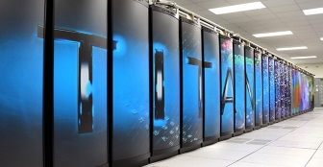
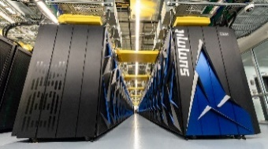

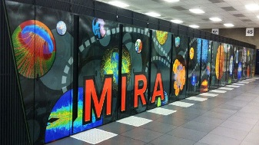
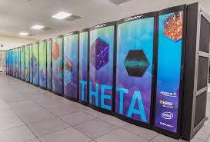
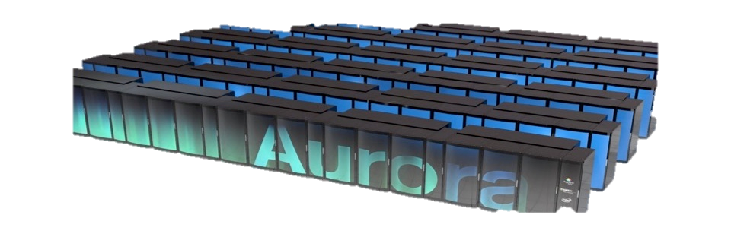
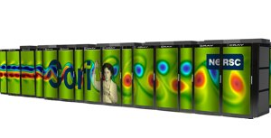
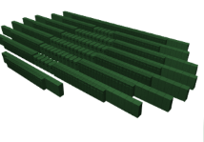
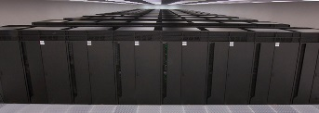
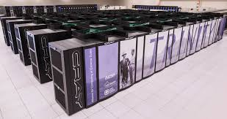
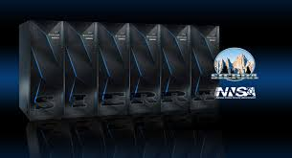


Department of Energy (DOE) Roadmap to Exascale Systems
An impressive, productive lineup of accelerated node systems supporting DOE’s mission
Pre-Exascale Systems [Aggregate Linpack (Rmax) = 323 PF]
First U.S. Exascale Systems
2012
2016
2018
2020
2021-2023
Titan (9)
Summit (1)
ORNL
Cray/AMD/NVIDIA
ORNL
TBD
ORNL
IBM/NVIDIA
Aurora
Mira (21)
Theta (24)
ANL
Intel/Cray
ANL
IBM BG/Q
ANL
Cray/Intel KNL
Cori (12)
NERSC-9
Perlmutter
LBNL
Cray/Intel Xeon/KNL
LBNL
Cray/AMD/NVIDIA
Sequoia (10)
LLNL
TBD
Trinity (6)
Sierra (2)
LLNL
IBM BG/Q
LLNL
IBM/NVIDIA
LANL/SNL
Cray/Intel Xeon/KNL
LANL/SNL
TBD
Notes:
Current pre-exascale systems (Rmax): 6.92 + 8.59 + 14.01 + 17.17 + 17.59 + 20.16 + 94.64 + 143.5

Slide 5
Common R&D activities/challenges that applications face
1) Porting to accelerator-based architectures
2) Exposing additional parallelism
3) Coupling codes to create new multiphysics capability
4) Adopting new mathematical approaches
5) Algorithmic or model improvements
6) Leveraging optimized libraries
Notes:
Add the specific apps you’re going to talk about to dark blue boxes (move, add/remove as needed, note that they’re set to appear as an animation)
Porting to accelerator-based architectures
e.g. ExaSMR, ExaSky, EQSIM
Exposing additional parallelism
e.g. QMCPACK, EXAALT, GAMESS
Coupling codes to create new multiphysics capability
e.g. Subsurface, EQSIM, WDMapp
Adopting new mathematical approaches
e.g. ExaStar, WarpX (both AMR and Lorentz)
Algorithmic or model improvements
e.g. E3SM-MMF, MFIX-Exa
Leveraging optimized libraries
e.g. Subsurface, ExaWind

Slide 6
The three technical areas in ECP have the necessary components to address these challenges and meet national goals
Performant mission and science applications @ scale
Foster application
development
Ease
of use
Diverse
architectures
HPC
leadership
Application Development (AD)
Software
Technology (ST)
Hardware
and Integration (HI)
Develop and enhance the predictive capability of applications critical to the DOE
Produce expanded and vertically integrated software stack to achieve full potential of exascale computing
Integrated delivery of ECP products on targeted systems at leading DOE computing facilities
25 applications ranging from national security, to energy, earth systems, economic security, materials, and data
80+ unique software products spanning programming models and run times, math libraries, data and visualization
6 vendors supported by PathForward focused on memory, node, connectivity advancements; deployment to facilities

Slide 7
ECP Software: productive, sustainable ecosystem
Extend current technologies to exascale where possible
Goal
Build a comprehensive, coherent software stack that enables application developers to productively write highly parallel applications that effectively target diverse exascale architectures
Perform R&D required for new approaches when necessary
Guide, and complement, and integrate with vendor efforts
Develop and deploy high-quality and robust software products

Slide 8
Trilinos Project Sketch

Slide 9
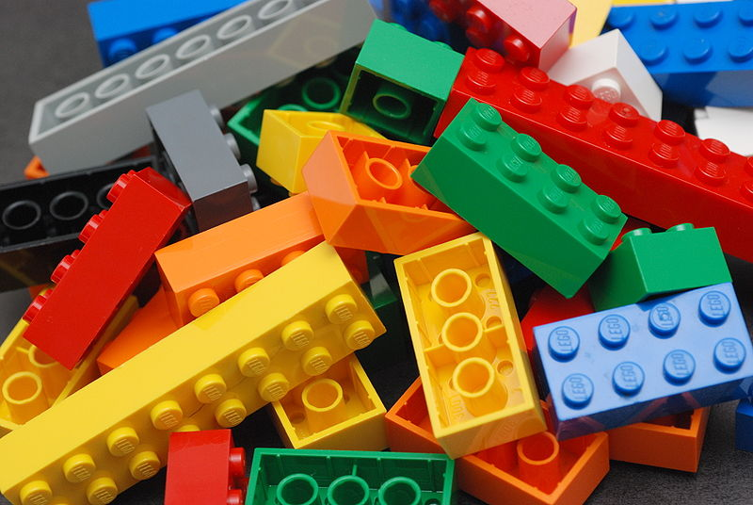

What is Trilinos?
Object-oriented software framework for…
Solving big complex science & engineering problems.
Large collection of reusable scientific capabilities.
More like LEGO™ bricks than Matlab™.
Notes:
Original of LEGO™ bricks picture:
https://secure.wikimedia.org/wikipedia/en/wiki/File:Lego_Color_Bricks.jpg
Accessed 12 Aug 2011. Author: Alan Chia. Licensed under a Creative Commons Attribution-Share Alike 2.0 Generic License.

Slide 10

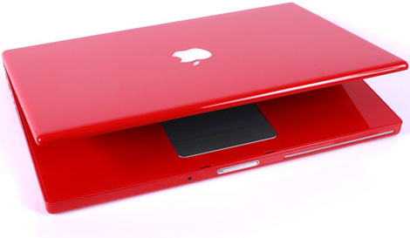
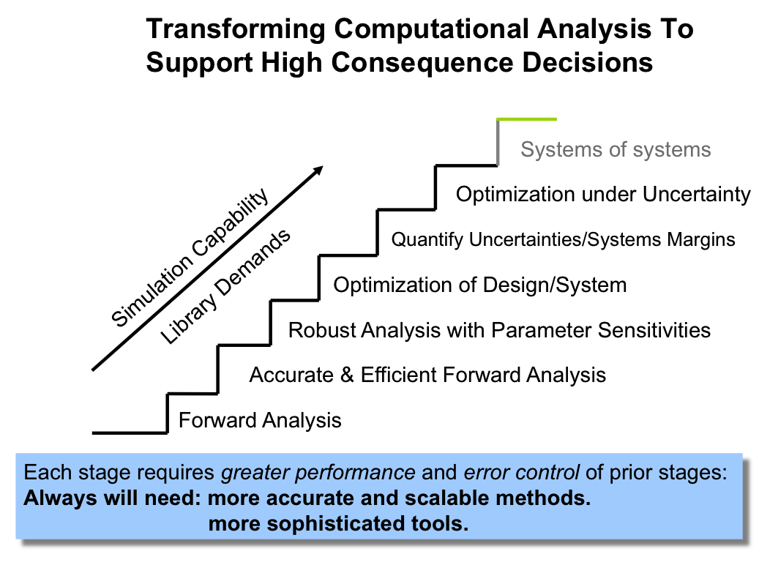
Optimal Kernels to Optimal Solutions:
Geometry, Meshing
Discretizations, Load Balancing.
Scalable Linear, Nonlinear, Eigen,
Transient, Optimization, UQ solvers.
Scalable I/O, GPU, Manycore
60+ Packages.
Distributions:
  GitHub repo.
  Cray LIBSCI, Linux
Thousands of Users.
Worldwide distribution.

Slide 11
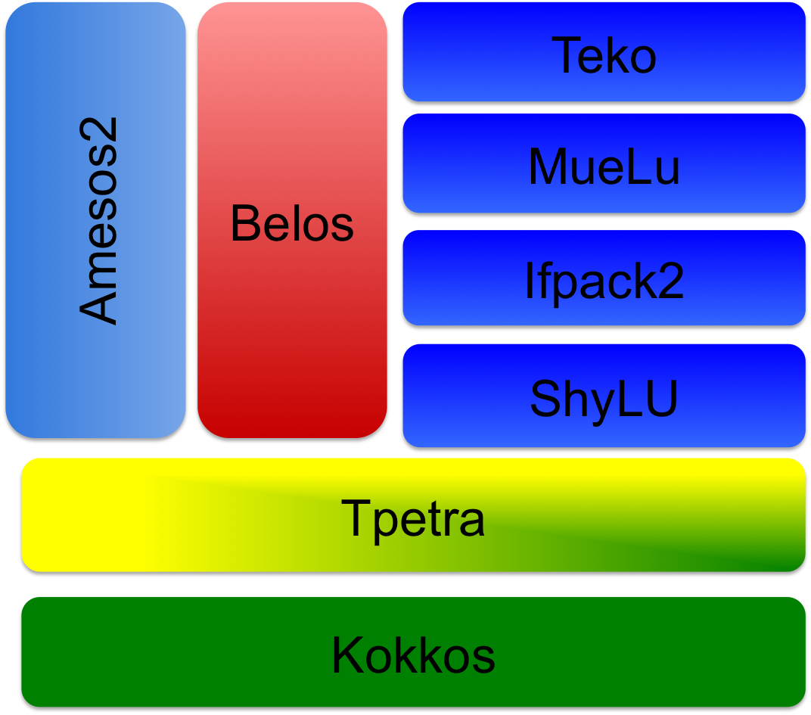
Trilinos linear solvers
Sparse linear algebra (Kokkos/KokkosKernels/Tpetra)
  Threaded construction, Sparse graphs, (block) sparse matrices, dense vectors, parallel solve kernels, parallel communication & redistribution
Iterative (Krylov) solvers (Belos)
  CG, GMRES, TFQMR, recycling methods
Kokkos
Kernels
Sparse direct solvers (Amesos2)
Algebraic iterative methods (Ifpack2)
  Jacobi, SOR, polynomial, incomplete factorizations, additive Schwarz
Shared-memory factorizations (ShyLU)
  LU, ILU(k), ILUt, IC(k), iterative ILU(k)
  Direct+iterative preconditioners
Segregated block solvers (Teko)
Algebraic multigrid (MueLu)
Notes:
1m

Slide 12
Trilinos Highlights
Huge library of algorithms
  Linear and nonlinear solvers, preconditioners, …
  Optimization, transients, sensitivities, uncertainty, …
Solid support for multicore & hybrid CPU/GPU
  Built into the new Tpetra linear algebra objects
  Unified intranode programming model: Kokkos
  Spreading into the whole stack:
    Multigrid, sparse factorizations, element assembly…
Support for mixed and arbitrary precisions
  Don’t have to rebuild Trilinos to use it.
  Enables production use of mixed prec, any data type with +,-,*,/
Support for flexible 2D sparse partitioning
  Useful for graph analytics, other data science apps.
Notes:
After this slide, show an animation of the “layers” of a scientific / engineering application.

Slide 13
FloatShadowDouble ScalarType
Templates enable
new analysis
capabilities
Example: Float with
“shadow” double.
class FloatShadowDouble {
public:
FloatShadowDouble( ) {
f = 0.0f;
d = 0.0; }
FloatShadowDouble( const FloatShadowDouble & fd) {
f = fd.f;
d = fd.d; }
…
inline FloatShadowDouble operator+= (const FloatShadowDouble & fd ) {
f += fd.f;
d += fd.d;
return *this; }
…
inline std::ostream& operator<<(std::ostream& os, const FloatShadowDouble& fd) {
os << fd.f << "f " << fd.d << "d";
return os;}

Slide 14
FloatShadowDouble Usage
Sample usage:
#include “FloatShadowDouble.hpp”
Tpetra::Vector< …, FloatShadowDouble, …> x, y;
Tpetra::CisMatrix<…, FloatShadowDouble, …> A;
A.apply(x, y); // Single precision, but double results also computed, available
Initial Residual = 455.194f 455.194d
Iteration = 15 Residual = 5.07328f 5.07618d
Iteration = 30 Residual = 0.00147f 0.00138d
Iteration = 45 Residual = 5.14891e-06f 2.09624e-06d
Iteration = 60 Residual = 4.03386e-09f 7.91927e-10d
Personal experience: Tend to use higher precision (e.g., double-double) vs. lower.
Also a good use of modern nodes: 2X storage, 10X operations.

Slide 15
Three Trilinos Subtopics
The Drudgery – Scalable non-solver code
Kokkos – Performance portability layer
KokkosKernels – On-node scalable linear algebra

Slide 16
Pattern for parallel dynamic allocation
Pattern:
  Count / estimate allocation size; may use Kokkos parallel_scan
  Allocate; use Kokkos::View for best data layout & first touch
  Fill: parallel_reduce over error codes; if you run out of space, keep going, count how much more you need, & return to (2)
  Compute (e.g., solve the linear system) using filled data structures
Compare to Fill, Setup, Solve sparse linear algebra use pattern
Semantics change: Running out of memory not an error!
  Always return: Either no side effects, or correct result
  Callers must expect failure & protect against infinite loops
  Generalizes to other kinds of failures, even fault tolerance
Thread-scalable execution of mundane code is ”straightforward” but hard work.

Slide 17
Trilinos Performance Portability
Kokkos

Slide 18
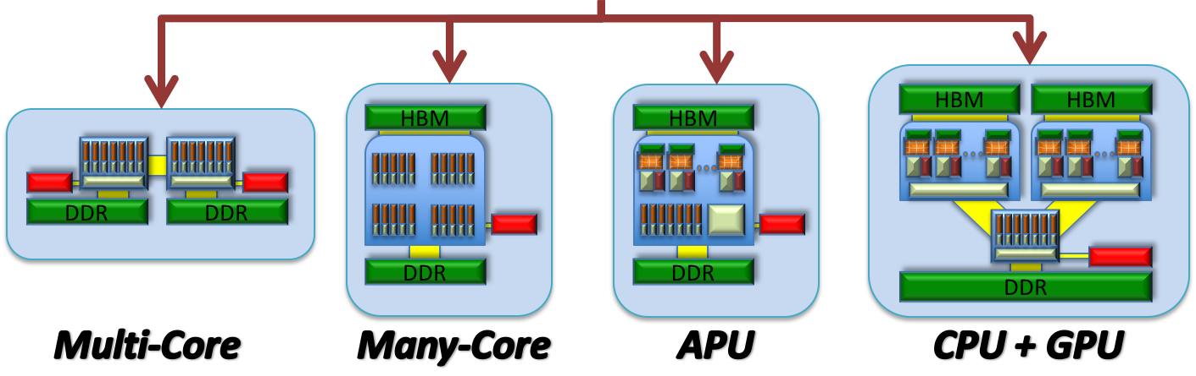
The Kokkos EcoSystem
Science and Engineering Applications
Kokkos Tools
Kokkos Support
Trilinos
Documentation
Kokkos EcoSystem
Debugging
Kokkos Kernels
Tutorials
Profiling
Linear Algebra Kernels
Graph Kernels
Bootcamps
Kokkos Core
App support
Tuning
Parallel
Execution
Parallel Data Structures

Slide 19
Kokkos Basic Execution Patterns
#include <Kokkos_Core.hpp>
#include <cstdio>
int main(int argc, char* argv[]) {
// Initialize Kokkos analogous to MPI_Init()
// Takes arguments which set hardware resources (number of threads, GPU Id)
Kokkos::initialize(argc, argv);
// A parallel_for executes the body in parallel over the index space, here a simple range 0<=i<10
// It takes an execution policy (here an implicit range as an int) and a functor or lambda
// The lambda operator has one argument, and index_type (here a simple int for a range)
Kokkos::parallel_for(10,[=](int i){
printf(”Hello %i\n",i);
});
// A parallel_reduce executes the body in parallel over the index space, here a simple range 0<=i<10 and
// performs a reduction over the values given to the second argument
// It takes an execution policy (here an implicit range as an int); a functor or lambda; and a return value
double sum = 0;
Kokkos::parallel_reduce(10,[=](int i, int& lsum) {
lsum += i;
},sum);
printf("Result %lf\n",sum);
// A parallel_scan executes the body in parallel over the index space, here a simple range 0<=i<10 and
// Performs a scan operation over the values given to the second argument
// If final == true lsum contains the prefix sum.
double sum = 0;
Kokkos::parallel_scan(10,[=](int i, int& lsum, bool final) {
if(final) printf(”ScanValue %i\n",lsum);
lsum += i;
});
Kokkos::finalize();
}

Slide 20
Why a Performance Portability Layer
10 LOC / hour ~ 20k LOC / year
Optimistic estimate: 10% of an application needs to get rewritten for adoption of Shared Memory Parallel Programming Model
Typical Apps: 300k – 600k Lines
  Uintah: 500k, QMCPack: 400k, LAMMPS: 600k; QuantumEspresso: 400k
  Typical App Port thus 2-3 Man-Years
  Sandia maintains a couple dozen of those
Large Scientific Libraries
  E3SM: 1,000k Lines x 10% => 5 Person-Years
  Trilinos: 4,000k Lines x 10% => 20 Person-Years
Sandia alone: 50-80 Person-Years

Slide 21
Why a Performance Portability Layer
Example: Architecture Change NVIDIA Pascal to Volta
  Warps can arbitrarily, permanently diverge, and branches can now interleave
  Took 2 man months to fix in Kokkos for just 3 code positions
  Without abstraction: ~400 places in Trilinos (excluding Kokkos) would need fixes
Timeline for Architectures:
  In Bold: requires new approach for performance for the first time
2012
2016
2018
2021
IBM BGQ (Sequoia, Mira)
Intel KNL
(Trinity, )
NVIDIA Volta (Summit, Sierra)
Intel A21?
NVIDIA Kepler (Titan)
AMD GPU?
ARM (Astra)
NVIDIA GPU?
1 Decade of HPC will have seen 4-5 different paradigms!

Slide 22
Kokkos Collaborations
DOE: SNL, ORNL, LANL, PNNL, NREL, LBL, ANL
Europe: Bristol, Jülich, CEA, Cambridge, CSCS, Max Planck
Vendors:
  AMD: Strong engagement on Kokkos backend for AMD GPUs
  NVIDIA: Collaboration on C++ Proposals and Early Evaluation of NVSHMEM
  ARM: Preparation for ARM HPC deployments
  Intel: Working on ECP PathForward Architecture Backend for Kokkos
C++ Standards Committee:
  Represent HPC, replace Kokkos:: with std::
OpenMP 4.5/5.0
RAJA: Joint backends project – Exciting outcome of ECP.

Slide 23
KokkosKernels

Slide 24
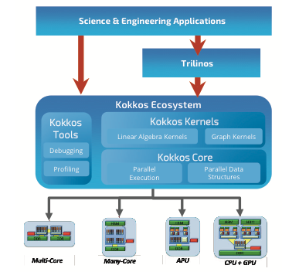
KokkosKernels Goals
KokkosKernels provides math kernels for
dense and sparse linear algebra as well as
graph computations. It has multiple aims:
Portable BLAS, Sparse and Graph kernels
Generic implementations for various scalar types and data layouts
Access to major vendor optimized math libraries
Expand the scope of BLAS to hierarchical implementations.

Slide 25
Capabilities: BLAS
BLAS-1 functions are available as multi-vector variants.
abs(y,x) y[i] = |x[i]|
axpy(alpha,x,y) y[i] += alpha * x[i]
axpby(alpha,x,beta,y) y[i] = beta * y + alpha * x[i]
dot(x,y) dot = SUM_i ( x[i] * y[i] )
fill(x,alpha) x[i] = alpha
mult(gamma,y,alpha,A,x) y[i] = gamma * y[i] + alpha * A[i] * x[i]
nrm1(x) nrm1 = SUM_i( |x[i]| )
nrm2(x) nrm2 = sqrt ( SUM_i( |x[i]| * |x[i]| ))
nrm2w(x,w) nrm2w = sqrt ( SUM_i( (|x[i]|/|w[i]|)^2 ))
nrminf(x) nrminf = MAX_i( |x[i]| )
scal(y,alpha,x) y[i] = alpha * x[i]
sum(x) sum = SUM_i( x[i] )
update(a,x,b,y,g,z) y[i] = g * y[i] + b * y[i] + a * x[i]
gemv(t,alph,A,x,bet,y) y[i] = bet*y[i] + alph*SUM_j(A[i,j]*x[j])
gemm(tA,tB,alph,A,B,bet,C) C[i,j]=bet*C[i,j]+alph*SUM_k(A[i,k]*B[k,j])

Slide 26
Other Capabilities
Sparse
CSR-Sparse Matrix Class providing fundamental capabilities
SPMV: Sparse Matrix Vector Multiply
SpGEMM: Sparse Matrix Matrix Multiply; separate symbolic and numeric phase
GS: Gauss-Seidel Method using graph coloring: symbolic, numeric, solve phases
Batched BLAS
DGEMM
DTRSM
DGETRF
Graph
Distance-1 and Distance-2 graph coloring
Triangle enumeration for graph analytics

Slide 27
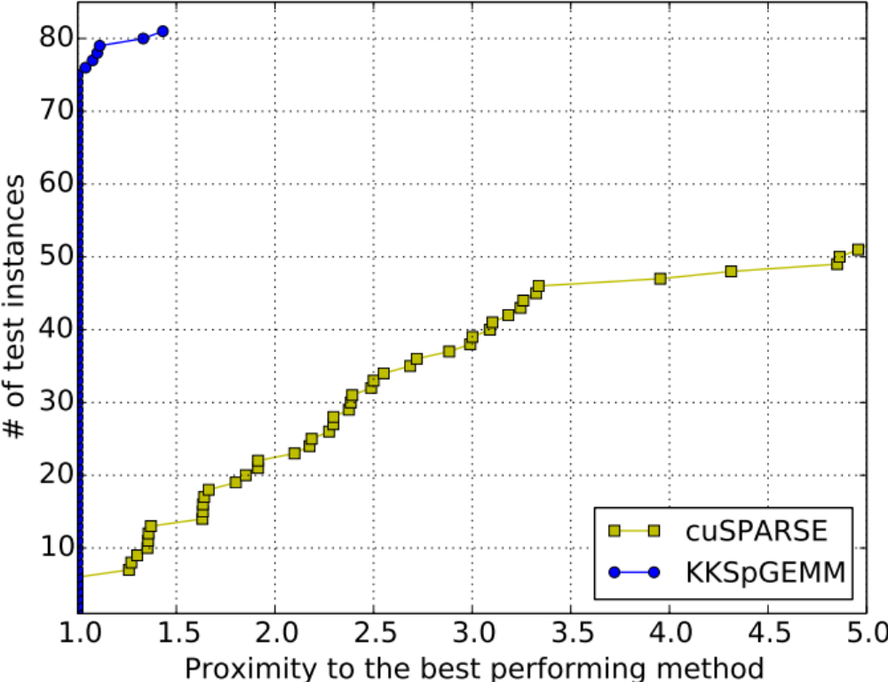
Sparse Matrix – Sparse Matrix Multiply
The most expensive part of the multigrid setup
It is also in GraphBLAS standard, as it can be used to represent various graph analytics problems: Triangle counting, Jaccard, Clustering
A portable SpGEMM method: KKSpGEMM
  Separates symbolic and numeric computations
  Compression to reduce memory use and #ops
Geometric mean of GFLOPs for
81 instances:
P100 | Power8 | KNL
5.98 | 5.23 | 3.90

Slide 28
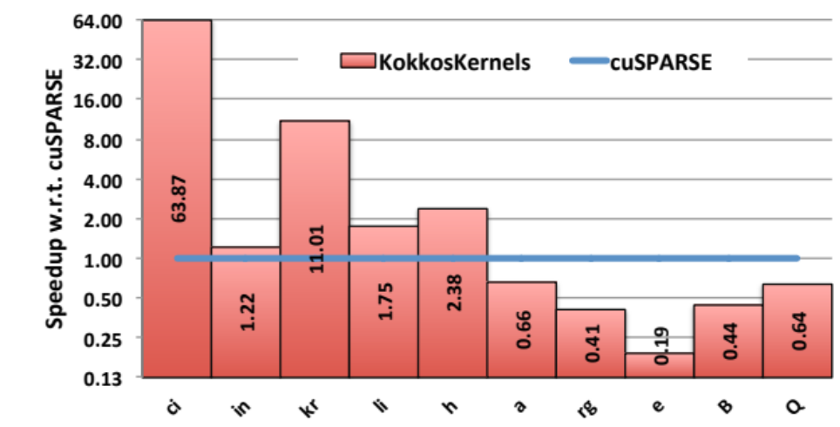
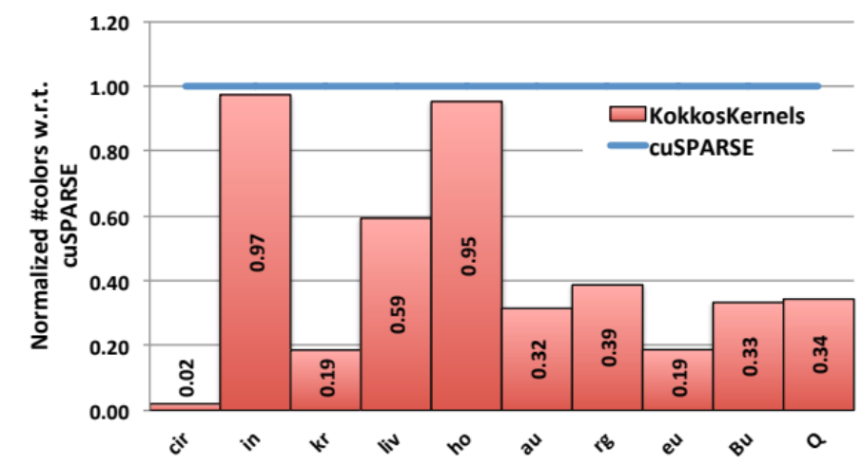
Graph Coloring and Multi-threaded Gauss-Seidel
Goal: Identify independent data that can be processed in parallel.
Performance: Better quality (4x on average) and run time (1.5x speedup ) w.r.t cuSPARSE.
Enables parallelization of preconditioners: Gauss Seidel: 136x on K20 GPUs w.r.t. serial SNB

Slide 29
Future Work: Context-Aware BLAS
Hierarchical Hardware requires hierarchy of function support
Idea: Provide BLAS / SparseBLAS interface with hardware handles
Example use-case: each CUDA block or KNL tile runs its own independent CG-Solve
In contrast to batched BLAS no lockstep execution
Device Level
Kernel uses whole GPU or all threads in the process
Equivalent to current BLAS libraries
Team Level
Kernel uses a CUDA block or all threads sharing a common L2 cache
Utilization of local scratch important
Kernel uses a single warp or thread
Vectorization can be exploited
Extremely fast synchronization possible
Thread Level
Serial Level
Serial implementations
Potentially as elemental functions allowing outer level vectorization

Slide 30
Resilience and Meta-computation

Slide 31
Our Luxury in Life (wrt FT/Resilience)
The privilege to think of a computer as a reliable, digital machine.
Conjecture: This privilege will persist through Exascale.
Reason: Vendors will not give us a unreliable system until we are ready to use one, and we will not be ready by 2023.

Slide 32
Take away message
If we want unreliable systems,
we must work harder on resilience.

Slide 33
Four Resilience Programming Models
Relaxed Bulk Synchronous (rBSP)
Skeptical Programming. (SP)
Local-Failure, Local-Recovery (LFLR)
Selective (Un)reliability (SU/R)
Toward Resilient Algorithms and Applications
Michael A. Heroux arXiv:1402.3809v2 [cs.MS]
https://arxiv.org/abs/1402.3809

Slide 34
Skeptical Programming
I might not have a reliable digital machine
Evaluating the Impact of SDC in Numerical Methods
J. Elliott, M. Hoemmen, F. Mueller, SC’13

Slide 35
What is Needed for Skeptical Programming?
Skepticism.
Meta-knowledge:
  Algorithms,
  Mathematics,
  Problem domain.
Nothing else, at least to get started.
FEM ideas:
  Invariant subspaces.
  Conservation principles.
  More generally:
    pre-conditions, post-conditions, invariants.
Note: These same ideas are useful for the Artifact Evaluation Appendix, used by SC18 Tech Papers Program.

Slide 36
Supercomputing Reproducibility Initiative
Two appendices:
  Artifact description (AD).
    Blue print for setting up your computational experiment.
    Makes it easier to rerun computations in future.
    AD appendix is mandatory for SC19 paper submissions.
  Artifact Evaluation (AE).
    Targets ”boutique” environments.
    Improves trustworthiness when re-running hard, impossible.
Details:
  https://collegeville.github.io/sc-reproducibility/
Meta-Data
Meta-Computation

Slide 37
Reproducibility and Supercomputing
  Scenario:
  You compute a “hero” calculation using 10M node-hours on Summit and submit your results for publication. During the review process, a referee questions the validity of your results. What options are feasible:
  The reviewer re-runs your code on a laptop or cluster.
  The reviewer re-runs your code on Mira.
  You re-run your code on Mira.
  Your results are rejected.
  Your results are accepted, but with risk.
One Approach to improve trustworthiness: Meta-computations.

Slide 38
Meta-computations to Improve Trustworthiness
Focus of Artifact Evaluation (AE) Appendix for Supercomputing Conference
Synthetic operators with known:
  Spectrum (Huge diagonals).
  Rank (by constructions).
Invariant subspaces:
  Example: Positional/rotational invariance (structures).
Conservation principles:
  Example: Flux through a finite volume.
General:
  Pre-conditions, post-conditions, invariants.

Slide 39
Toward a Common Scientific Software ecosystem

Slide 40
Common R&D activities/challenges that applications face
1) Porting to accelerator-based architectures
2) Exposing additional parallelism
3) Coupling codes to create new multiphysics capability
4) Adopting new mathematical approaches
5) Algorithmic or model improvements
6) Leveraging optimized libraries
Notes:
Add the specific apps you’re going to talk about to dark blue boxes (move, add/remove as needed, note that they’re set to appear as an animation)
Porting to accelerator-based architectures
e.g. ExaSMR, ExaSky, EQSIM
Exposing additional parallelism
e.g. QMCPACK, EXAALT, GAMESS
Coupling codes to create new multiphysics capability
e.g. Subsurface, EQSIM, WDMapp
Adopting new mathematical approaches
e.g. ExaStar, WarpX (both AMR and Lorentz)
Algorithmic or model improvements
e.g. E3SM-MMF, MFIX-Exa
Leveraging optimized libraries
e.g. Subsurface, ExaWind

Slide 41
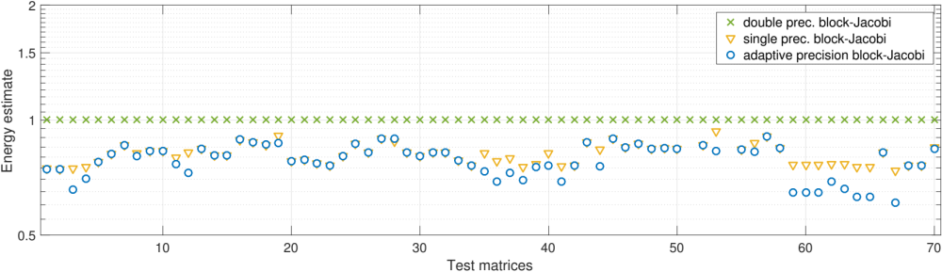
Customized Precision Block-Jacobi Preconditioning
Modular Precision Idea:
All computations use double precision!
Store distinct blocks in different formats
Use single precision as standard storage format
Where necessary: switch to double
For well-conditioned blocks use half precision
> 10⁶
Store block in double precision
Estimate conditioning
of diagonal block
Store block in single precision
Store block in half precision
< 10¹
Anzt, Dongarra, Flegar, Higham, Quintana-Orti. ” Adaptive Precision in Block-Jacobi Preconditioning for Iterative Sparse Linear System Solvers”. CCPE, 2018.

Slide 42
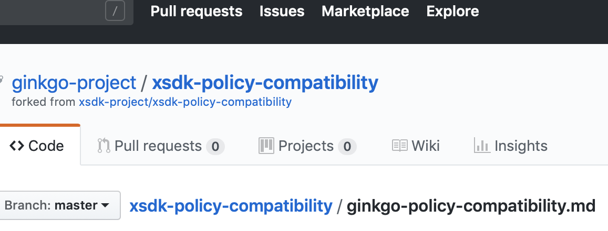
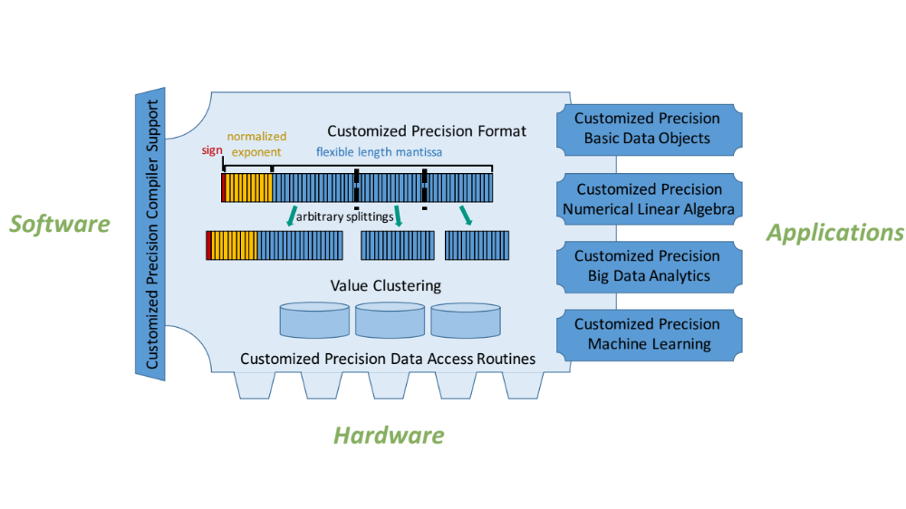

Ginkgo – Hartwig Anzt et. al.
Radically decoupling arithmetic precision from memory precision.
Using customized precisions for memory operations.
Dynamically adapt the accuracy to the algorithm properties.
Speedup of up to 1.3x for Jacobi iterations
and PageRank algorithm^{1,2}.
Adaptive precision block-Jacobi preconditioning³.
Creating a Modular Precision Ecosystem
inside .
Applications
Software
https://github.com/ginkgo-project/ginkgo
¹Grützmacher, Anzt. “A Customized Precision Format for decoupling Arithmetic
Format and Storage Format”. HeteroPar workshop 2018.
²Grützmacher, Anzt, Scheidegger, Quintana-Orti : ” High-Performance GPU Implementation of PageRank with Reduced Precision based on Mantissa Segmentation”. IA3 workshop at SC2018.
³Anzt, Dongarra, Flegar, Higham, Quintana-Orti. ” Adaptive Precision in Block-Jacobi Preconditioning for Iterative Sparse Linear System Solvers”. CCPE, 2018.

Slide 43
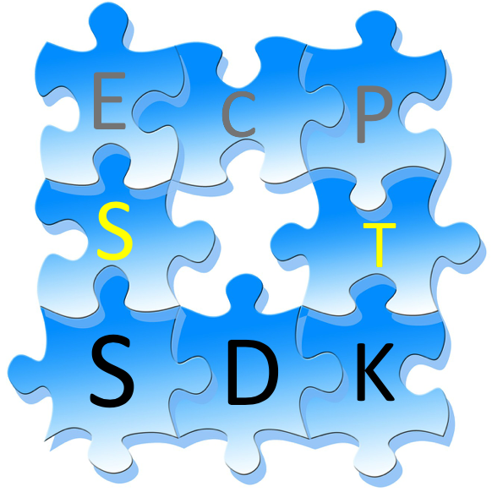
Software Development Kits are a key delivery vehicle for ECP
A collection of related software products (called packages) where coordination across package teams will improve usability and practices and foster community growth among teams that develop similar and complementary capabilities
Attributes
  Domain scope: Collection makes functional sense
  Interaction model: How packages interact; compatible, complementary, interoperable
  Community policies: Value statements; serve as criteria for membership
  Meta-infrastructure: Encapsulates, invokes build of all packages (Spack), shared test suites
  Coordinated plans: Inter-package planning. Does not replace autonomous package planning
  Community outreach: Coordinated, combined tutorials, documentation, best practices
Overarching goal: Unity in essentials, otherwise diversity

Slide 44
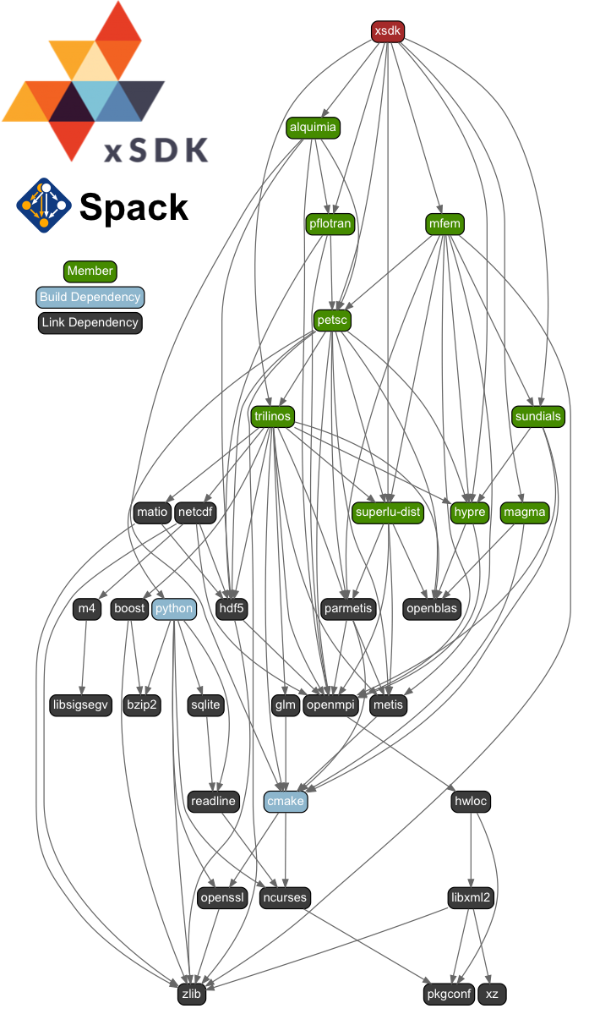
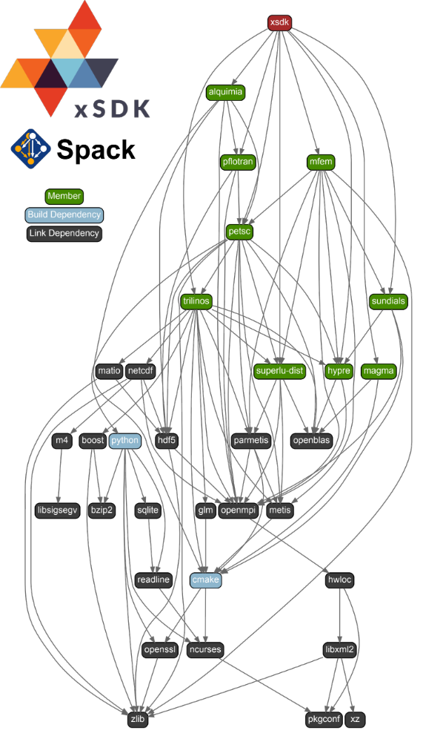
Software Development Kit Motivation
The exascale software ecosystem will be comprised of a wide array of software, all of which are expected to be used by DOE applications.
The software must be:
  interoperable
  sustainable
  maintainable
  adaptable
  portable
  scalable
  deployed at DOE computing facilities
Provides intermediate coordination points to better manage complexity
Without these qualities:
  Value will be diminished
  Scientific productivity will suffer

Slide 45
SDK “Horizontal” Grouping:
Key Quality Improvement
Driver
PETSc
Trilinos
SuperLU Version X
SuperLU Version Y
Horizonal (vs Vertical) Coupling
  Common substrate
  Similar function and purpose
    e.g., compiler frameworks, math libraries
  Potential benefit from common Community Policies
    Best practices in software design and development and customer support
  Used together, but not in the long vertical dependency chain sense
  Support for (and design of) common interfaces
    Commonly an aspiration, not yet reality
Horizontal grouping:
Assures X=Y.
Protects against regressions.
Transforms code coupling from heroic effort to turnkey.

Slide 46
ECP ST SDK community policies: Important team building, quality improvement, membership criteria.
SDK Community Policy Strategy
Review and revise xSDK community policies and categorize
  Generally applicable
  In what context the policy is applicable
Allow each SDK latitude in customizing appropriate community policies
Establish baseline policies in FY19 Q2, continually refine
Recommended policies: encouraged, not required:
R1. Have a public repository.
R2. Possible to run test suite under valgrind in order
to test for memory corruption issues.
R3. Adopt and document consistent system for error
conditions/exceptions.
R4. Free all system resources it has acquired as soon
as they are no longer needed.
R5. Provide a mechanism to export ordered list of
library dependencies.
xSDK member package: An xSDK-compatible package, that uses or can be used by another package in the xSDK, and the connecting interface is regularly tested for regressions.
xSDK compatible package: Must satisfy mandatory xSDK policies:
M1. Support xSDK community GNU Autoconf or CMake options.
M2. Provide a comprehensive test suite.
M3. Employ user-provided MPI communicator.
M4. Give best effort at portability to key architectures.
M5. Provide a documented, reliable way to contact the development team.
…
https://xsdk.info/policies
Prior to defining and complying with these policies, a user could not correctly, much less easily, build hypre, PETSc, SuperLU and Trilinos in a single executable: a basic requirement for some ECP app multi-scale/multi-physics efforts.
Initially the xSDK team did not have sufficient common understanding to jointly define community policies.
Notes:
Mention the need to learn to communicate prior to being able to define the policies. When the team first came together…

Slide 47


xSDK-0.3.0: Dec 2017… (that was then..)
https://xsdk.info
Multiphysics Application C
xSDK functionality, Dec 2017
Tested on key machines at ALCF, NERSC, OLCF, also Linux, Mac OS X
Notation: A B:
A can use B to provide functionality on behalf of A
Application A
Application B
Alquimia
PETSc
SUNDIALS
HDF5
hypre
PFLOTRAN
BLAS
MFEM
More domain components
SuperLU
Trilinos
More contributed libraries
More external software
MAGMA
July 2018:
Revisions of xSDK
Community Policies
https://xsdk.info/policies
Domain components
Reacting flow, etc.
Reusable.
Libraries
Solvers, etc.
Interoperable.
Frameworks & tools
Doc generators.
Test, build framework.
SW engineering
Productivity tools.
Models, processes.
Extreme-Scale Scientific Software Development Kit (xSDK)

Slide 48
xSDK Version 0.4.0: December 2018 (this is now)
https://xsdk.info
Multiphysics Application C
xSDK functionality, Dec 2018
Tested on key machines at ALCF, NERSC, OLCF, also Linux, Mac OS X
Each xSDK member package uses or can be used with one or more xSDK packages, and the connecting interface is regularly tested for regressions.
Application A
Application B
Alquimia
SLEPc
hypre
AMReX
Omega_h
HDF5
deal.II
SUNDIALS
PUMI
PFLOTRAN
PETSc
PHIST
BLAS
SuperLU
Trilinos
MFEM
MAGMA
More libraries
More domain components
More external software
STRUMPACK
DTK
Tasmanian
PLASMA
December 2018
17 math libraries
2 domain components
16 mandatory xSDK community policies
Spack xSDK installer
Impact: Improved code quality, usability, access, sustainability
Foundation for work on performance portability, deeper levels of package interoperability
Domain components
Reacting flow, etc.
Reusable.
Libraries
Solvers, etc.
Interoperable.
Frameworks & tools
Doc generators.
Test, build framework.
SW engineering
Productivity tools.
Models, processes.
Extreme-Scale Scientific Software Development Kit (xSDK)

Slide 49
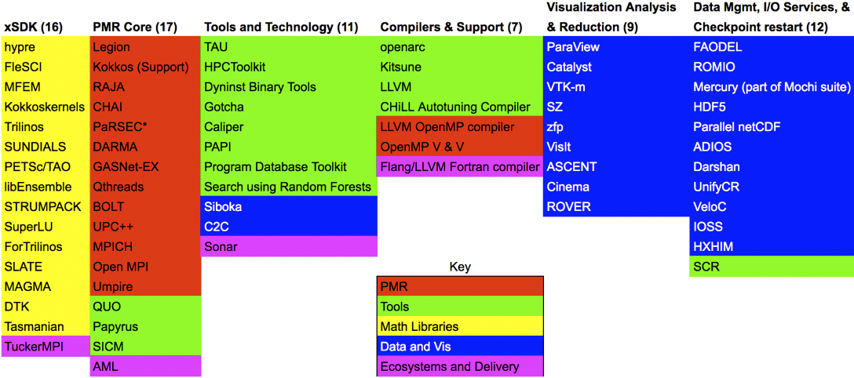
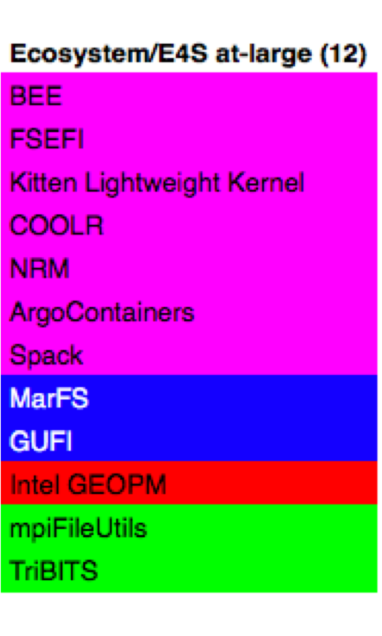
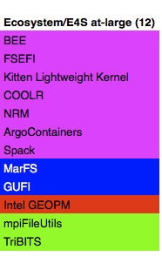
The planned ECP ST SDKs will span all technology areas

Slide 50
SDK Summary
SDKs will help reduce complexity of delivery:
  Hierarchical build targets.
  Distribution of software integration responsibilities.
New Effort: Started in April 2018, fully established in August 2018.
Extending the SDK approach to all ECP ST domains.
  SDKs create a horizontal coupling of software products, teams.
  Create opportunities for better, faster, cheaper – pick all three.
First concrete effort: Spack target to build all packages in an SDK.
  Decide on good groupings.
  Not necessarily trivial: Version compatibility issues, Coordination of common dependencies.
Longer term:
  Establish community policies, enhance best practices sharing.
  Provide a mechanism for shared infrastructure, testing, training, etc.
  Enable community expansion beyond ECP.

Slide 51

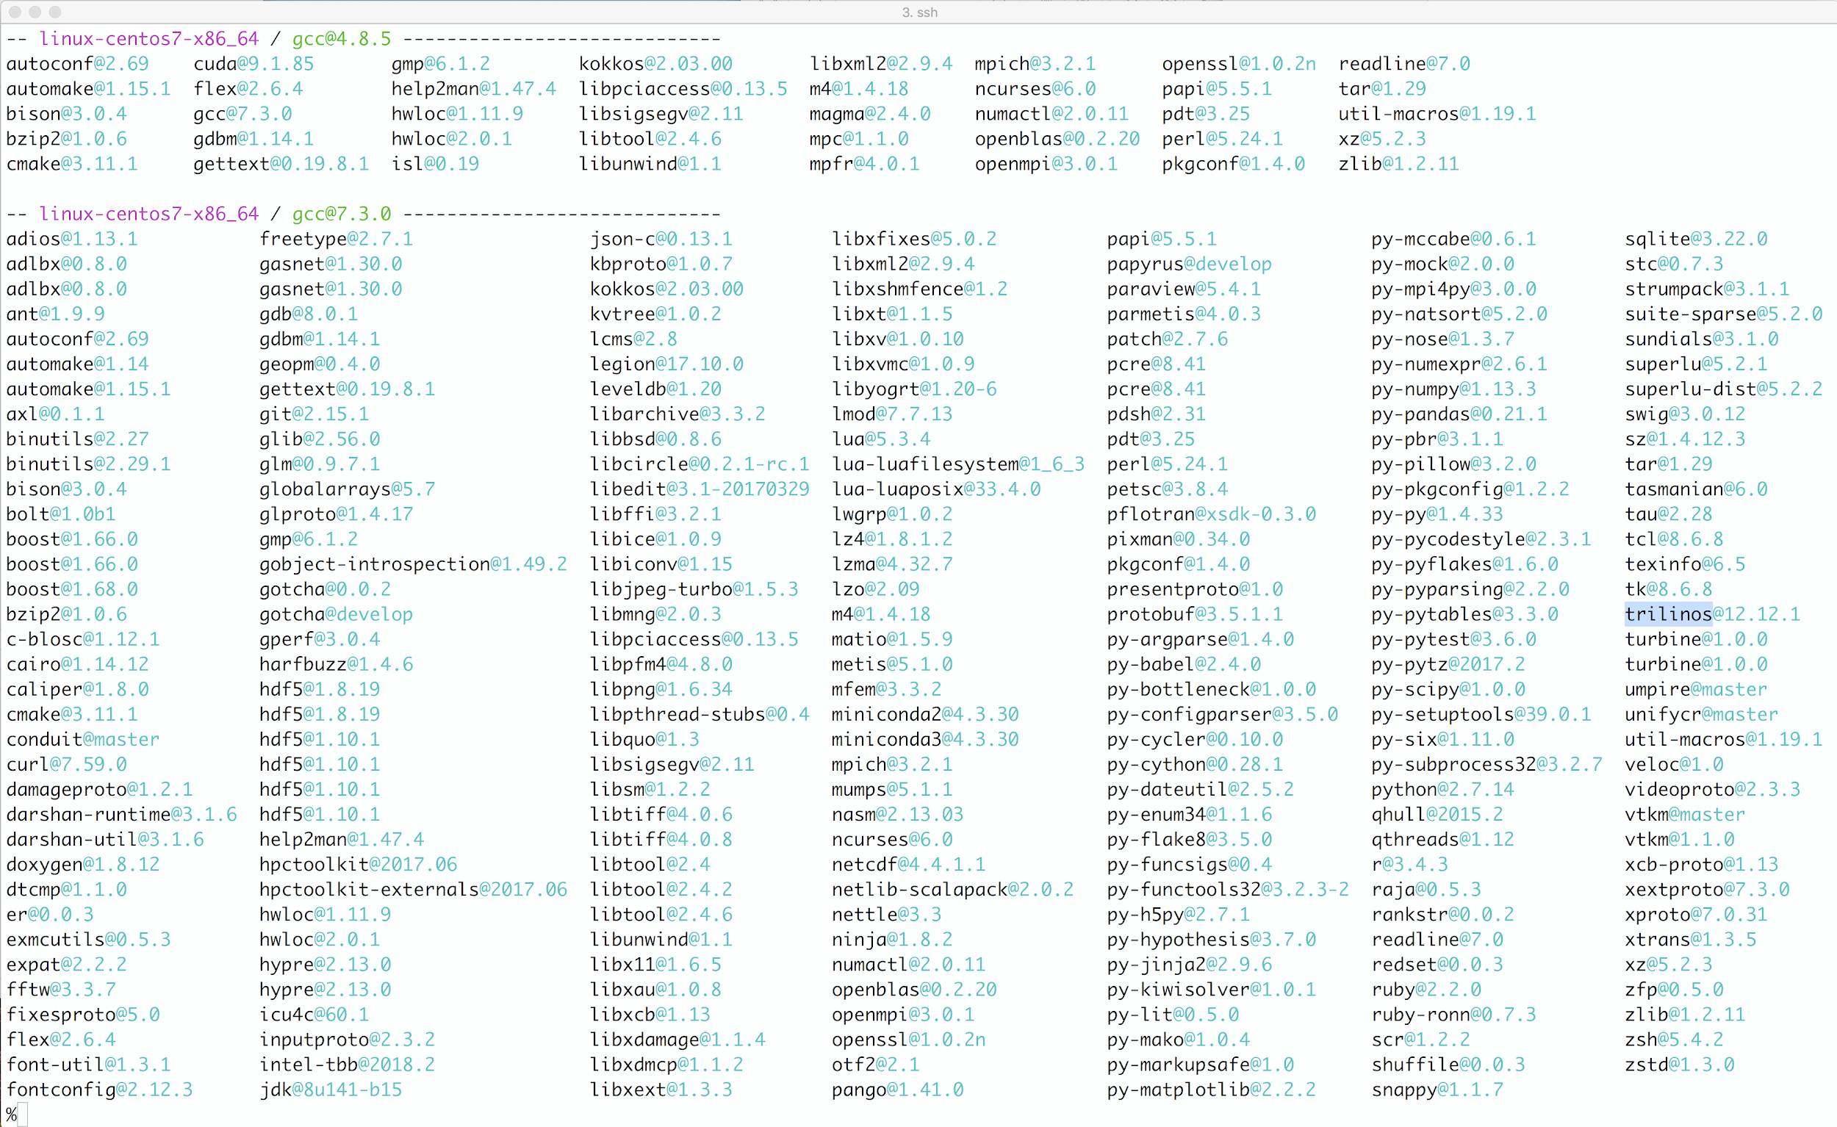
Extreme-Scale Scientific Software Stack – E4S
E4S: A Spack-based distribution of ECP ST and related and dependent software tested for interoperability and portability to multiple architectures
Provides distinction between SDK usability / general quality / community and deployment / testing goals
Will leverage and enhance SDK interoperability thrust
Oct: E4S 0.1 - 24 full, 24 partial release products
Jan: E4S 0.2 - 37 full, 10 partial release products
Current primary focus: Facilities deployment
e4s.io
Lead: Sameer Shende
(U Oregon)
Packages installed using Spack
Notes:
SDK effort is key to improving interoperability and sustainability of E4S

Slide 52
Final take away points
Development for accelerated sparse solvers in full swing.
  Critical mass of sparse solver code exists, continues to grow.
Intra-node parallelism is still biggest challenge:
  Kokkos provides vehicle for reasoning and implementing on-node parallel.
  Eventual goal: Search and replace Kokkos:: with std::
  Node-parallel algorithms are already available.
  Fully node parallel execution is hard work.

Slide 53
Take away points, cont.
Resilience will be an issue, really.
  But only as we are ready to adapt algorithms and codes.
  The longer we delay, the more likely a future system is installed but never accepted.
Already is:
  Performance variability is result.
  Delays in system delivery, others.
Checkpoint/restart will continue to improve:
  NVRAM, Compression
  Moving away from this model is very expensive.
Embedded soft error detection/correction could be useful:
  Skeptical programming (meta-computations).
  Prepares for emerging reproducible requirements in publications.

Slide 54
Take away points, cont.
The US Exascale Computing Project is enabling an new scale of scientific software collaboration and integration.
The xSDK is an example:
  Aggregate coordination, interoperability, testing, distribution.
  Established community policies enable rapid growth.
Addition of 5 other SDKs hold promise for other areas.
The Extreme-scale Scientific Software Stack (E4S):
  From-source builds using Spack.
  Containerized versions (Docker, Singularity, Shifter, CharlieCloud)
  Intended to enable international collaborations on open source SW.

Slide 55
