Slide 1

Post-K: the first ‘exascale’ supercomputer for convergence of HPC and big data/AI
Satoshi Matsuoka
Director, Riken Center for Computational Science /
Professor, Tokyo Institute of Technology
Numerical Numerical algorithms for high-performance computational science
The Royal Society, London, UK
20190409

Slide 2
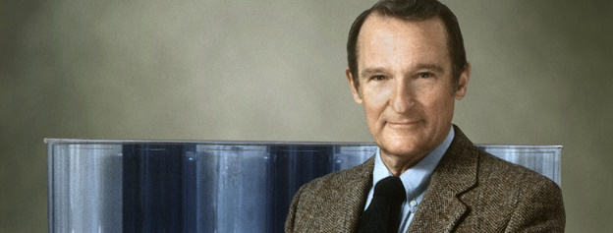
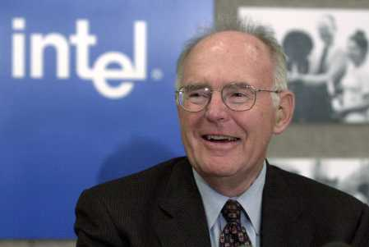
What we have heard in this meeting so far:
“It’s the Bandwidth”
Future FLOPS acceleration via reduced precision (end of Moore’s law)
Customized HW co-design to increase data throughput now feasible
David Keyes : “Convert dense matrices to sparse via SVD, H-Matrices etc., achieve order of magnitude speedup with new algorithms”
Kathy Yelick: “Many biology application speedup via new algorithms that require system bandwidth”
Rick Stevens: “Opportunities for AI speedup with sparsity and vastly reduced precision”
John Shalf: “Post-Moore near-term speedup not “by device but w/ architecture customization optimizing system bandwidth e.g. FFT”
NUMERICAL ALGORITHMS & APPS MUST COPE WITH THE TREND

Slide 3
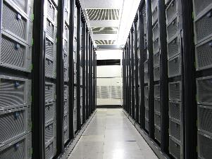

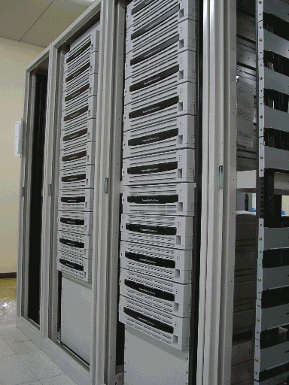
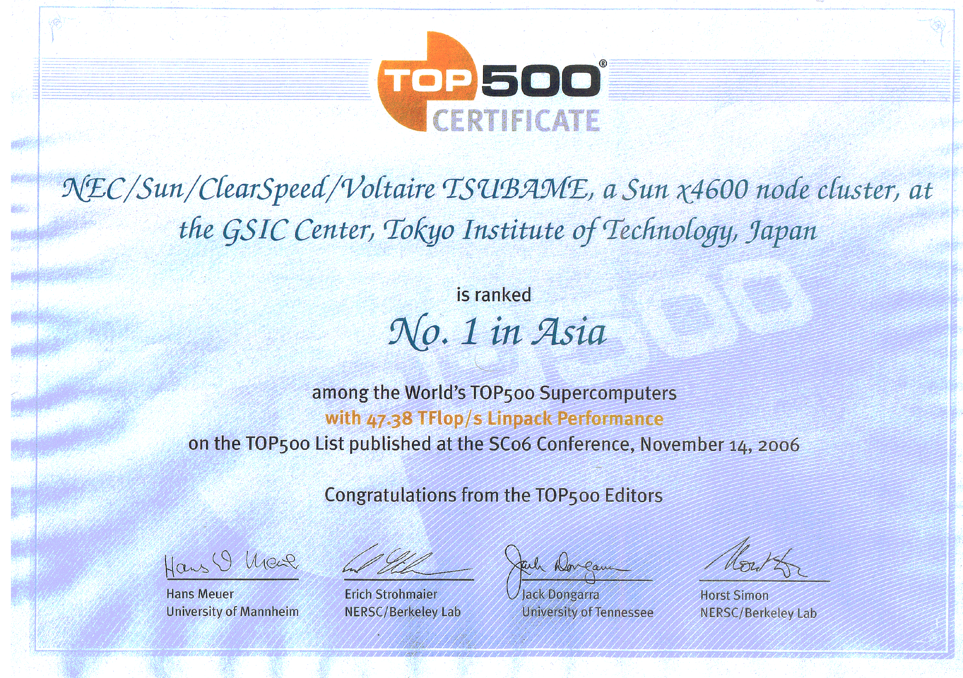
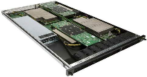
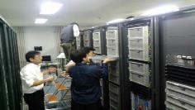

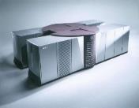
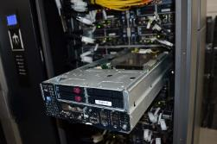
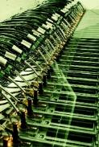
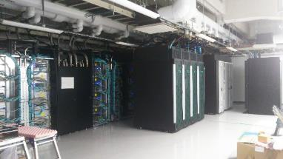
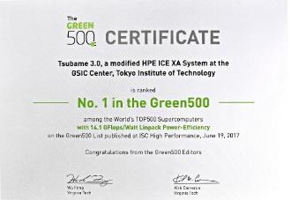
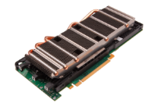
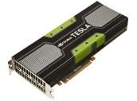
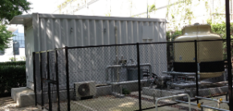

Tokyo Tech. TSUBAME Supercomputing History
World’s Leading Supercomputer. x100,000 speedup in 17 years developing world-leading use of massively parallel, many-core technology
TSUBAME3.0
2000
Matsuoka
GSIC
Appointment
2006 TSUBAME1.0
80 TeraFlops
No.1 Asia, No.7 World
10,000 cores
2008 TSUBAME1.2
170 TeraFlops
Word’s first GPU
Supercomputer
2000
128 Gigaflops
Custom
Supercomputer
32 cores
2002 “TSUBAME0”
1.3 TeraFlops
First “TeraScale”
JP Univ. Supercomputer
800 cores
2010 TSUBAME2.0
2.4 Petarlops No1 World
No.1 Production Green
ACM Gordon Bell Prize
General Purpose CPU & Many Core Processor (GPU), Advaned Optical Networks, Non-Volatile Memory, Efficient Power Control and Cooling
2013 TSUBAME2.5
41１8 GPUs Upgraded
5.7 Petaflps, No.2 Japan
AI Flops 17.1 Petaflops
2013 TSUBAME-KFC
TSUBAME3 Prototype
Oil Immersive Cooling
Green World No.1
2015 AI Prototype Upgrade (KFC/DL)
2017 TSUBAME3.0, > 10 million cores
12.1 Petaflops (AI Flops 47.2 Petaflops)
Green World No1
HPC and Big Data / AI Convergence
Notes:
【機密性○】
3
【機密性○】
3
【機密性○】
3

Slide 4
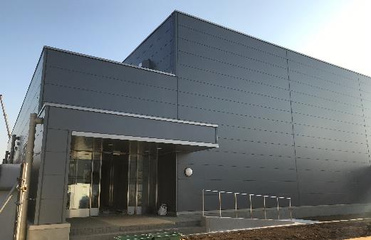
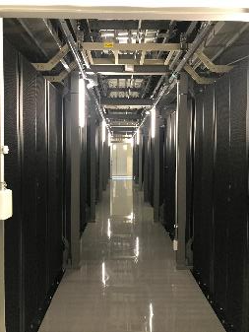
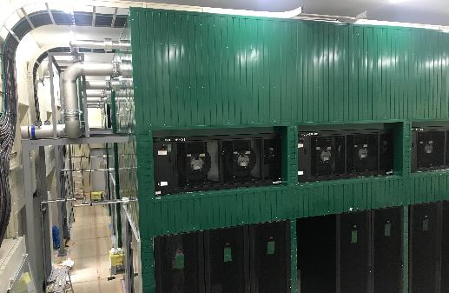
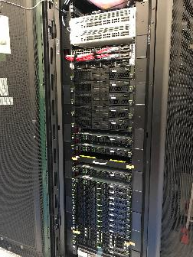
ABCI: AI Supercomputer to Serve Academic & Industry AI research in Japan, hosted by AIRC-AIST (2018)
Commoditizing TSUBAME3 supercomputer technologies to the Cloud
(17 AI-Petaflops, 70kW/rack, free cooling)
4332 Volta GPUs + 2166 Skylake CPUs
0.55 AI-Exaflops, 37 DFP Petaflops
~2 Petabytes NVMe, 20 Petabytes HDD
DNN training optimized Infiniband EDR
New IDC single floor, inexpensive & fast build, hard concrete floor with 2 tons/m² weight tolerance
Racks
  144 racks max.
  ABCI 43 racks for compute & storage
Power capacity
  3.25 MW max.
  ABCI 2.3MW max.
Water-Air Hybrid Wam Water “Free” Cooling
  70KW/rack. PUE < 1.1
  Total: 3.2MW min. (summer)
  32 Celsius Free cooling even at ~39 Celsius external temperature with high humidity
ABCI IDC built in 7 months, operation Aug. 2018

Slide 5
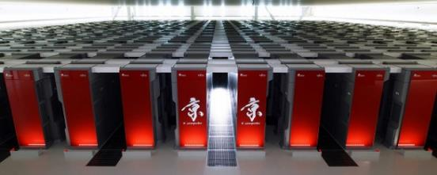
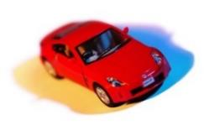
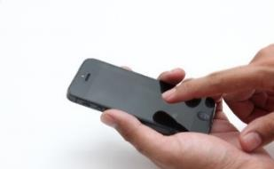

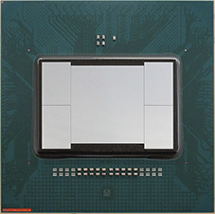
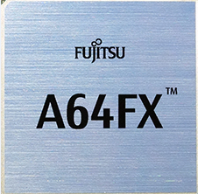
Post-K: The Game Changer (2020)
Heritage of the K-Computer, HP in simulation via extensive Co-Design
          High performance: up to x100 performance of K in real applications
          Multitudes of Scientific Breakthroughs via Post-K application programs
          Simultaneous high performance and ease-of-programming
2. New Technology Innovations of Post-K
High Performance, esp. via high memory BW
Performance boost by “factors” c.f. mainstream CPUs in many HPC & Society5.0 apps via BW & Vector acceleration
Very Green e.g. extreme power efficiency
Ultra Power efficient design & various power control knobs
Arm Global Ecosystem & SVE contribution
  Top CPU in ARM Ecosystem of 21 billion chips/year, SVE co-design and world’s first implementation by Fujitsu
High Perf. on Society5.0 apps incl. AI
  Architectural features for high perf on Society 5.0 apps based on Big Data, AI/ML, CAE/EDA, Blockchain security, etc.
Global leadership not just in the machine & apps, but as cutting edge IT
5
ARM: Massive ecosystem from embedded to HPC
Technology not just limited to Post-K, but into societal IT infrastructures e.g. Clouds

Slide 6
Arm64fx & Post-K (to be renamed) are:
Fujitsu-Riken design A64fx ARM v8.2 (SVE), 48/52 core CPU
  HPC Optimized: Extremely high package high memory BW (1TByte/s), on-die Tofu-D network BW (~400Gbps), high SVE FLOPS (~3Teraflops), various AI support (FP16, INT8, etc.)
  Gen purpose CPU – Linux, Windows (Word), other SCs/Clouds
  Extremely power efficient – > 10x power/perf efficiency for CFD benchmark over current mainstream x86 CPU
Largest and fastest supercomputer to be ever built circa 2020
  > 150,000 nodes, superseding LLNL Sequoia
  > 150 PetaByte/s memory BW
  Tofu-D 6D Torus NW, 60 Petabps injection BW (10x global IDC traffic)
  25~30PB NVMe L1 storage
  ~10,000 endpoint 100Gbps I/O network into Lustre
  The first ‘exascale’ machine (not exa64bitflops but in apps perf.)

Slide 7

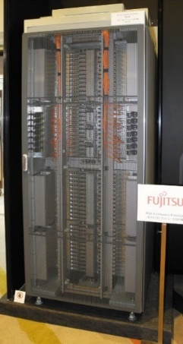
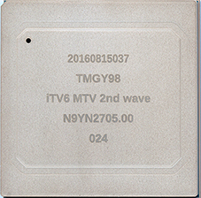

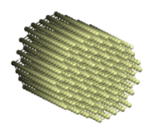
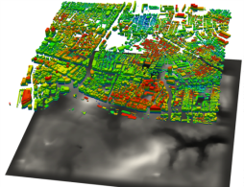
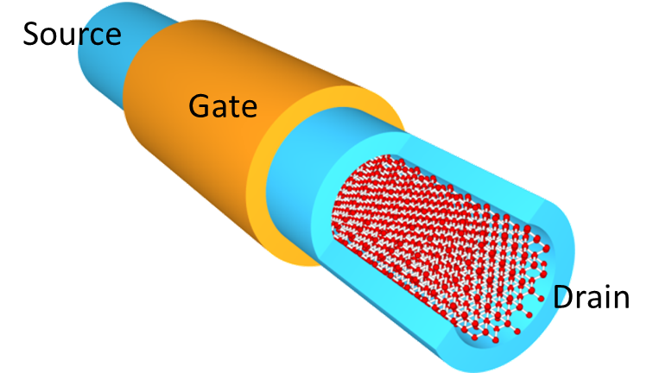
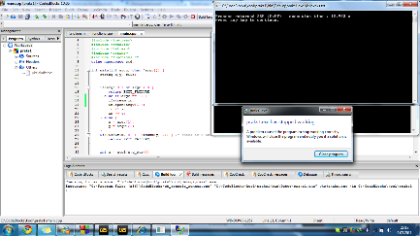
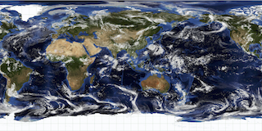
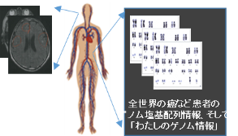
Co-Design Activities in Post-K
Multiple Activities since 2011
Science by Computing
Science of Computing
・9 Priority App Areas: High Concern to General Public: Medical/Pharma, Environment/Disaster, Energy, Manufacturing, …
A64fx
For the
Post-K
supercomputer
Select representatives from 100s of applications signifying various computational characteristics
Design systems with parameters that consider various application characteristics
7
Extremely tight collabrations between the Co-Design apps centers, Riken, and Fujitsu, etc.
Chose 9 representative apps as “target application” scenario
Achieve up to x100 speedup c.f. K-Computer
Also ease-of-programming, broad SW ecosystem, very low power, …

Slide 8
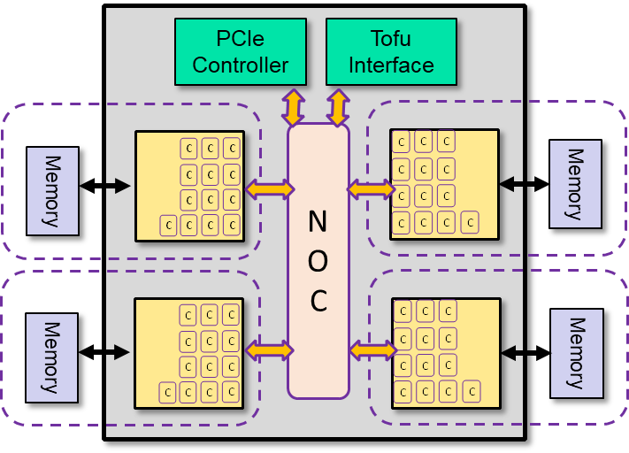
Post K A64fx Processor is…
an Many-Core ARM CPU…
  48 compute cores + 2 or 4 assistant (OS) cores
  Brand new core design
  Near Xeon-Class Integer performance core
  ARM V8 --- 64bit ARM ecosystem
  Tofu-D + PCIe 3 external connection
…but also an accelerated GPU-like processor
  SVE 512 bit vector extensions (ARM & Fujitsu)
    Integer (1, 2, 4, 8 bytes) + Float (16, 32, 64 bytes)
  Cache + scratchpad-like local memory (sector cache)
  HBM2 on package memory – Massive Mem BW (Bytes/DPF ~0.4)
    Streaming memory access, strided access, scatter/gather etc.
  Intra-chip barrier synch. and other memory enhancing features
GPU-like High performance in HPC, AI/Big Data, Auto Driving…

Slide 9
A64FX: Spec Summary
Arm SVE, high performance and high efficiency
  DP performance 2.7+ TFLOPS, >90%@DGEMM
  Memory BW 1024 GB/s, >80%@STREAM Triad
 | A64FX
ISA (Base, extension) | Armv8.2-A, SVE
Process technology | 7 nm
Peak DP performance | > 2.7+ TFLOPS
SIMD width | 512-bit
# of cores | 48 + 4
Memory capacity | 32 GiB (HBM2 x4)
Memory peak bandwidth | 1024 GB/s
PCIe | Gen3 16 lanes
High speed interconnect | TofuD integrated
12x compute cores
1x assistant core
PCle
Controller
Tofu
Interface
CMG
CMG
HBM2
C
N
O
C
C
HBM2
CMG
CMG
HBM2
C
C
HBM2
CMG：Core Memory Group NOC：Network on Chip

Slide 10
A64FX technologies: Scalable architecture
Core Memory Group (CMG)
  12 compute cores for computing and
  an assistant core for OS daemon, I/O, etc.
  Shared L2 cache
  Dedicated memory controller
Four CMGs maintain cache coherence w/ on-chip directory
  Threads binding within a CMG allows linear speed up of cores' performance
CMG configuration
A64FX chip configuration
core
core
core
core
core
core
core
Tofu
controller
PCIe
controller
core
core
core
core
core
core
X-Bar connection
Network
on
chip
HBM2
CMG
CMG
HBM2
L2 cache 8MiB 16-way
Memory
controller
HBM2
CMG
CMG
HBM2
HBM2
Network
on chip

Slide 11
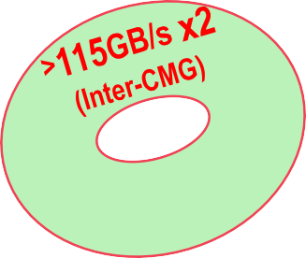
High Bandwidth
Extremely high bandwidth in caches and memory
  A64FX has out-of-order mechanisms in cores, caches and memory controllers. It maximizes the capability of each layer’s bandwidth
CMG
12x Computing Cores + 1x Assistant Core
Core
Core Core Core
Performance
>2.7TFLOPS
L1 Cache
>11.0TB/s (BF ratio = 4)
512-bit wide SIMD
2x FMAs
>230
GB/s
>115
GB/s
L1D 64KiB, 4way
L2 Cache
>3.6TB/s (BF ratio = 1.3)
>115
GB/s
>57
GB/s
L2 Cache 8MiB, 16way
256
Memory
1024GB/s (BF ratio =~0.37)
GB/s
_{HHB}H_{BM}B_{M2}M₂₈2_{8G}8_{Gi}G_{BiB}iB
HBM2 8GiB

Slide 12
A64FX: L1D cache uncompromised BW
128B/cycle sustained BW even for unaligned SIMD load
“Combined Gather” doubles gather (indirect) load’s data throughput, when target elements are within a “128-byte aligned block” for a pair of two regs, even & odd
L1D$
Read data0
64B/cycle
Read port0
Read data1
64B/cycle
Read port1
128B
Mem.
0
1
3
2
6
7
5
4
flow-1
flow-4
flow-3
flow-2
Regs
0
1
2
3
4
5
6
7
8B
Maximizes BW to 32 bytes/cyc.

Slide 13
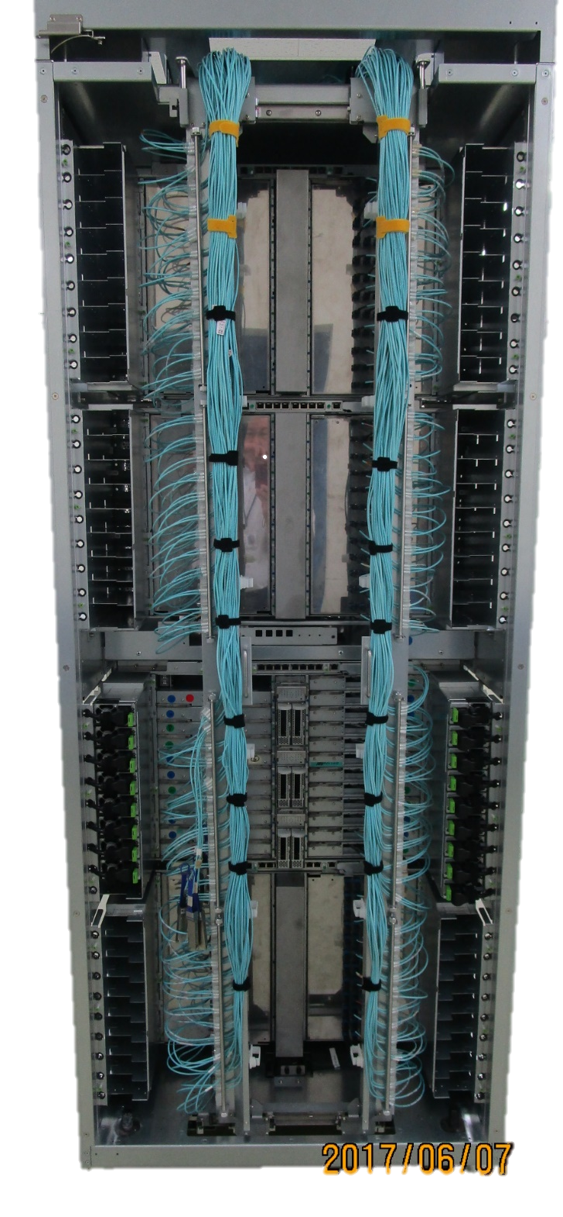
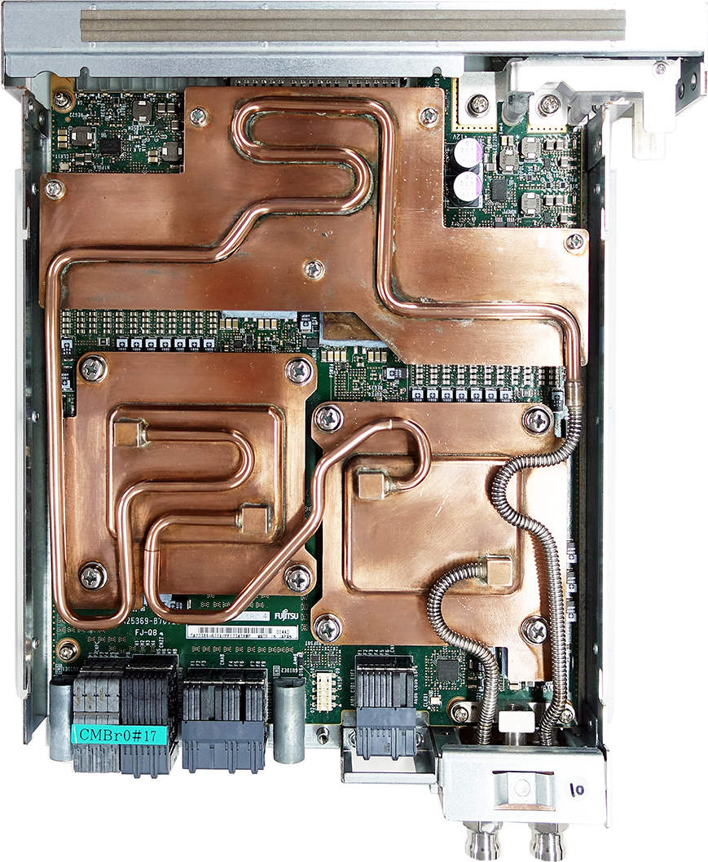
Post-K Chassis, PCB (w/DLC), and CPU Package
230 mm
60 mm
280 mm
60 mm
CPU Package
B0 Chip now in full Production Manufacturing Apr. 2019
  W 800㎜
  D1400㎜
  H2000㎜
  384 nodes
CMU

Slide 14
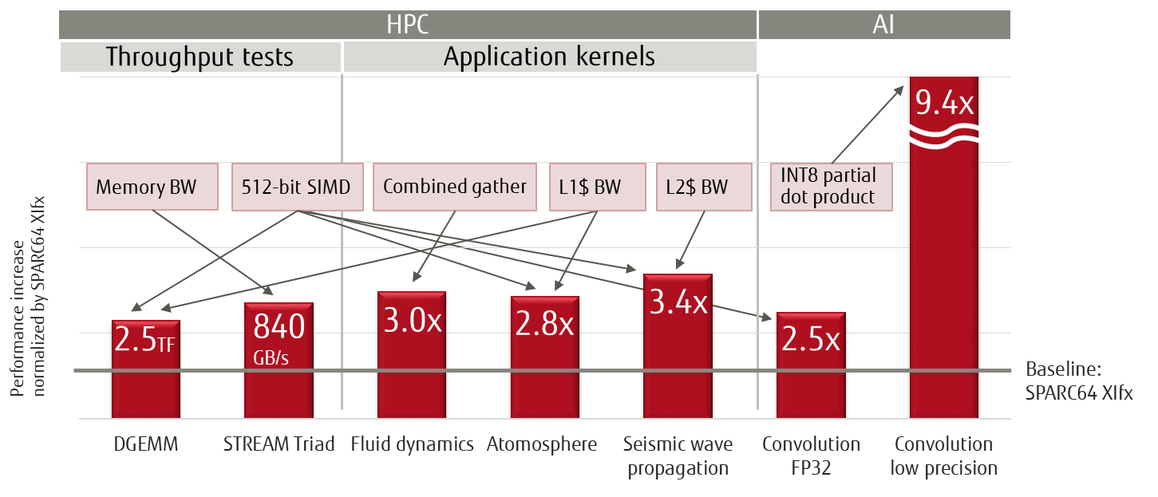
Preliminary performance evaluation results
Over 2.5x faster in HPC & AI benchmarks than SPARC64 XIfx
= ~2x Haswell Xeon

Slide 15
NAS Parallel Benchmark of FX100
[Slide by Ikuo Miyoshi, Fujitsu, SSKen2015]
■ OpenMP版を用いてノードあたり演算性能を評価
FX10に 対 す る ノ ー ド あ た り 性 能 向 上 比
9
8
7
6
5
4
3
2
1
0
性能向上比
Note: Haswell:
1 node = 2 chips 32 threads&cores
FX100: 1 node =
1 chip
32 threads&cores
MG
SP
FT
LU
IS
BT
CG
EP
MG
SP
FT
LU
IS
BT
CG
EP
多重格子法
スカラ五重 離散3次元 ガウス 対角ソルバ フーリエ変換 ザイデル法
整数ソート
ブロック三重 CG法 対角ソルバ カーネル
驚異的並列
FX10(16スレッド) FX100(32スレッド) Haswell(32スレッド) †
† エラーバーはCPU周波数を1.9GHzに固定しない場合の性能を表す
FX100は、FX10比平均3.9倍、Haswell比平均1.3倍のノードあたり演算性能
使用コード: NAS Parallel Benchmarks Ver. 3.3.1 OpenMP版 クラスC

Slide 16
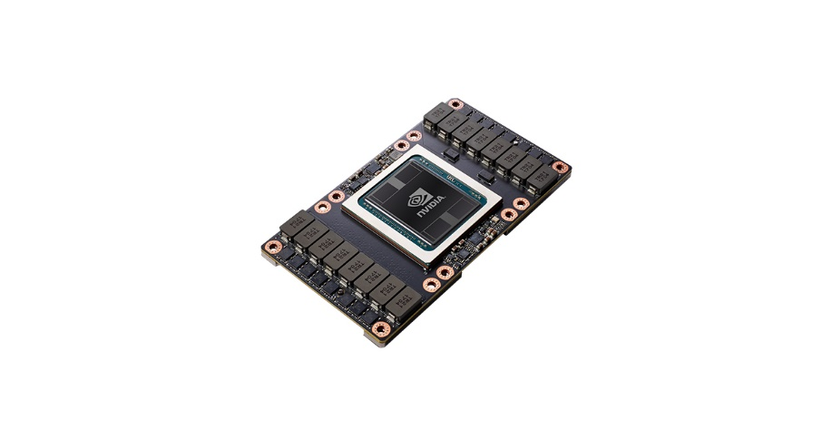
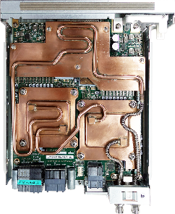
“Iso-power” Comparsion with the Best GPU
 | NVIDIA Volta v100 | Fujitsu A64fx (2 A0 chip nodes)
Power | 400 W (incl. CPUs, HCAs DGX-1) | “similar”
Vectorized MACC Formats | FP 64/32/16, INT 32(?) | FP 64/32/16, INT 32/16/8 w/INT32 MACC
Multi-node Linpack | 5.9 TF / chip (DGX-1) | > 5.3 TF / 2 chip blade
Flops/W Linpack | 15.1 GFlops/W (DGX-2) | > 15 Glops/W
Stream Triad | 855 GB/s | 1.68 TB / s
Memory Capacity | 16 / 32 GB | 64 GB (32 x 2)
AI Performance | 125 (peak) / ~95 (measured) Tflops FP16 Tensor Cores | ~48 TOPS (INT8 MACC peak)
Price | ~$11,000 (SXM2 32GB board only) ~$13,000 (DGX-1, per 16GB GPU) | Talk to Fujitsu ☺

Slide 17
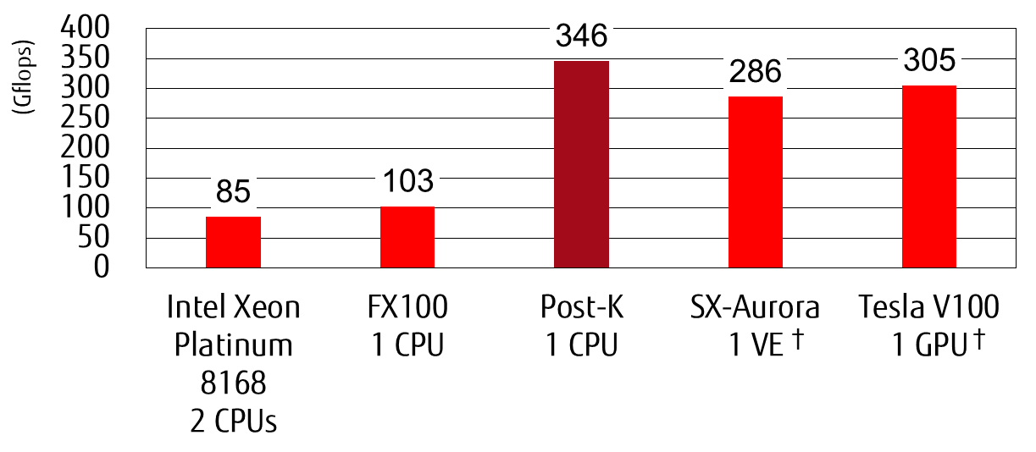
Post-K performance evaluation
Himeno Benchmark (Fortran90)
† “Performance evaluation of a vector supercomputer SX-aurora TSUBASA”,
SC18, https://dl.acm.org/citation.cfm?id=3291728

Slide 18
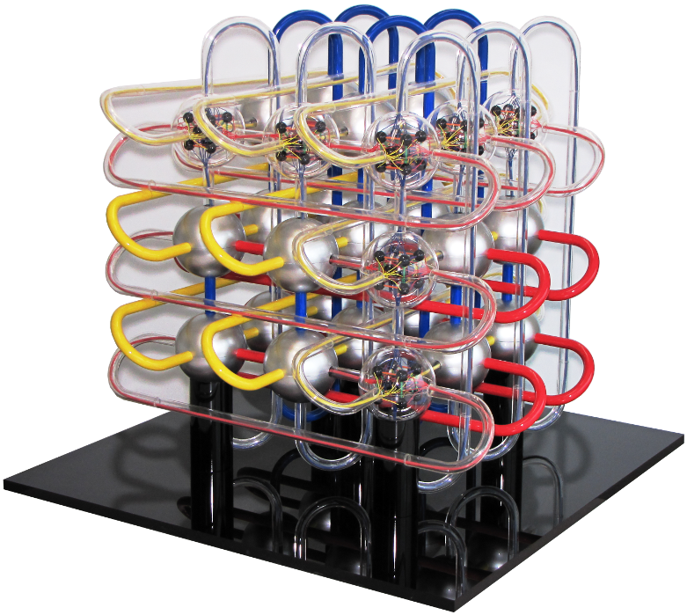
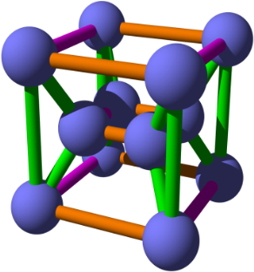
TOFU-D 6D Mesh/Torus Network
Six coordinate axes: X, Y, Z, A, B, C
  X, Y, Z: the size varies according to the system configuration
  A, B, C: the size is fixed to 2×3×2
Tofu stands for “torus fusion”: (X, Y, Z)×(A, B, C)
X×Y×Z×2×3×2
Z
B
C
X
Y
A

Slide 19
A64FX: Tofu interconnect D
Integrated w/ rich resources
  Increased TNIs achieves higher injection BW & flexible comm. patterns
  Increased barrier resources allow flexible collective comm. algorithms
Memory bypassing achieves low latency
  Direct descriptor & cache injection
HBM2
HBM2
A64FX
CMG
CMG
c
c
PCle
c
c
c
c
c
c
c
c
 | TofuD spec
Port bandwidth | 6.8 GB/s
Injection bandwidth | 40.8 GB/s
 | Measured
Put throughput | 38.1 GB/s
Ping-pong latency | 0.49~0.54 µs
c
c
c
c
c
c
c
c
TNI0
Tofu Network Router
2 lanes × 10 ports
c
c
c
c
c
c
c
c
TNI1
NOC
TNI2
TNI3
c
c
c
c
c
c
c
c
c
c
TNI4
c
c
c
c
c
c
c
c
TNI5
c
c
c
c
c
c
c
c
CMG
CMG
TofuD
HBM2
HBM2

Slide 20
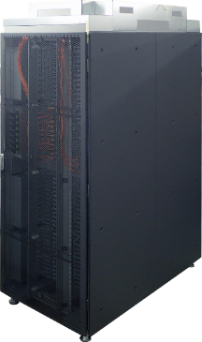
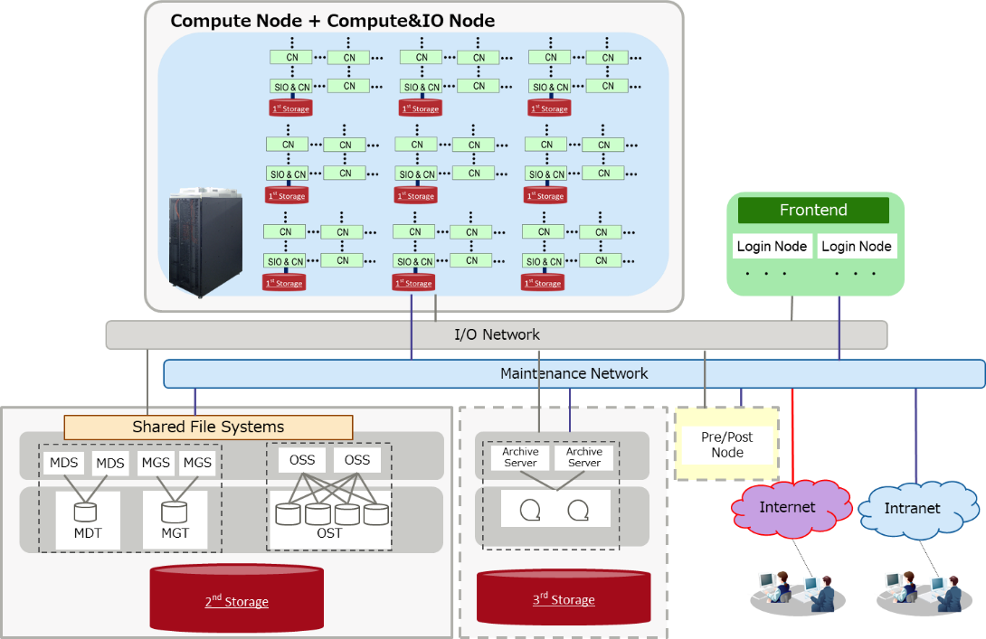
Overview of Post-K System & Storage
3-level hierarchical storage
  1st Layer: GFS Cache + Temp FS (25~30 PB NVMe)
  2nd Layer: Lustre-based GFS (a few hundred PB HDD)
  3rd Layer: Off-site Cloud Storage
Full Machine Spec
  >150,000 nodes
  ~8 million High Perf. Arm v8.2 Cores
  > 150PB/s memory BW
  Tofu-D 10x Global IDC traffic @ 60Pbps
  ~10,000 I/O fabric endpoints
  > 400 racks
  ~40 MegaWatts Machine+IDC
  PUE ~ 1.1 High Pressure DLC
  NRE pays off: ~= 15~30 million
  state-of-the art competing CPU
  Cores for HPC workloads
  (both dense and sparse problems)

Slide 21
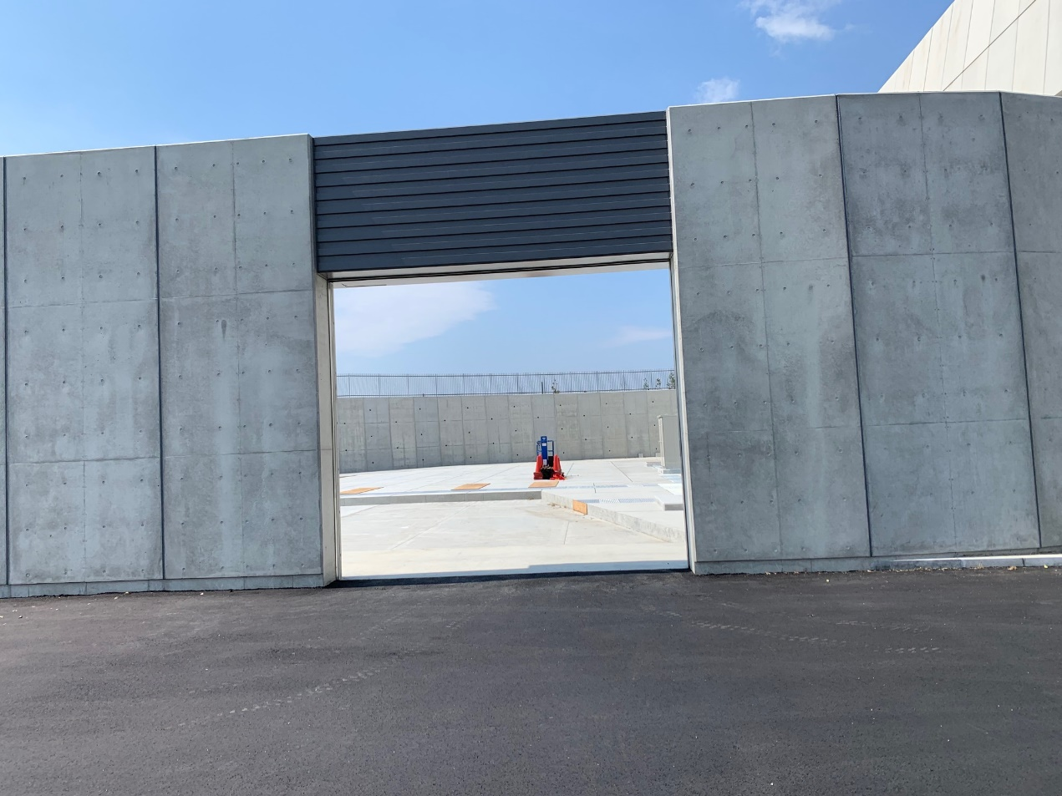
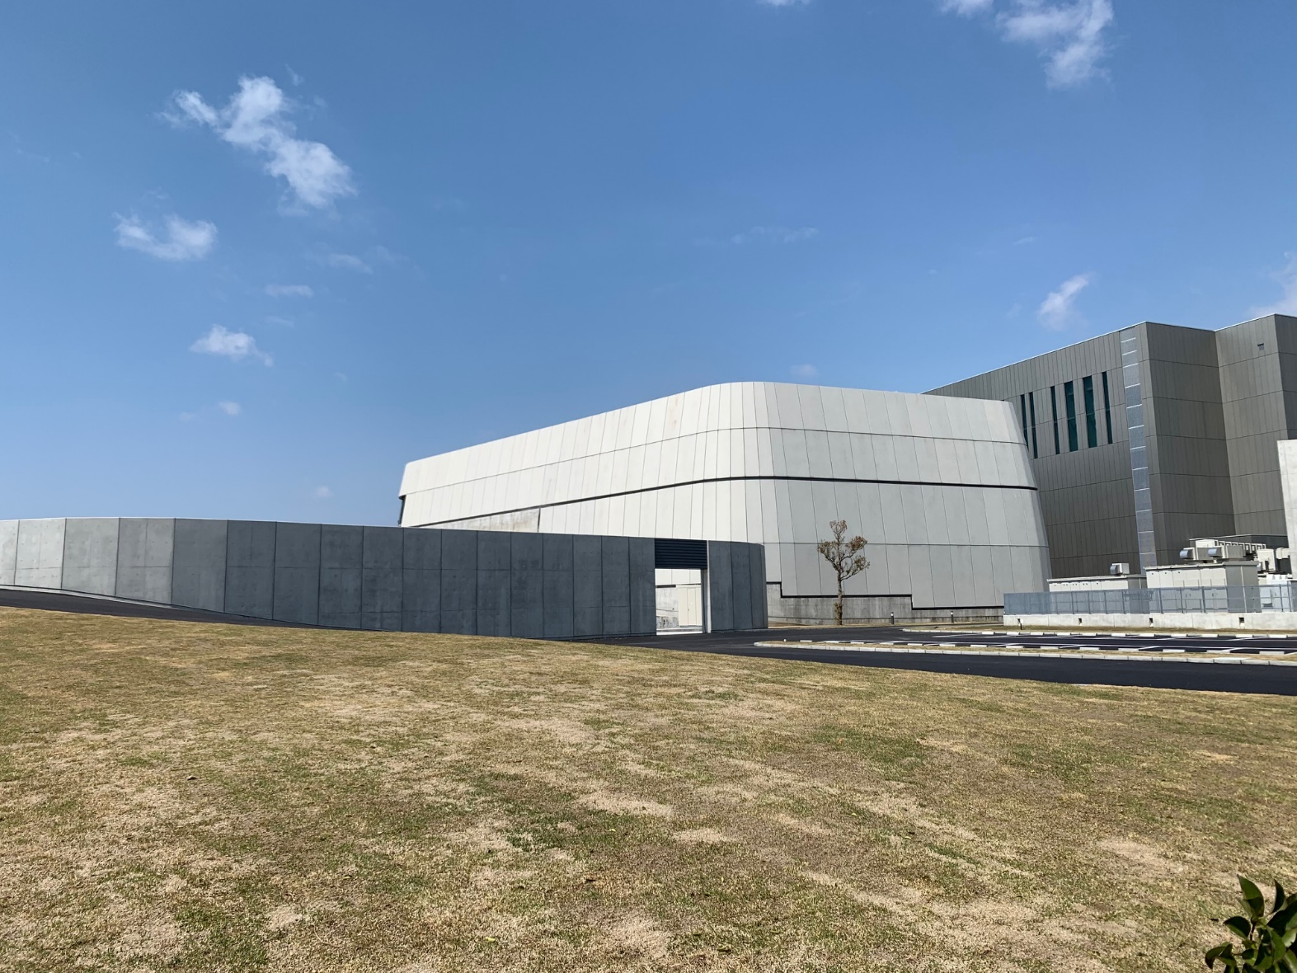
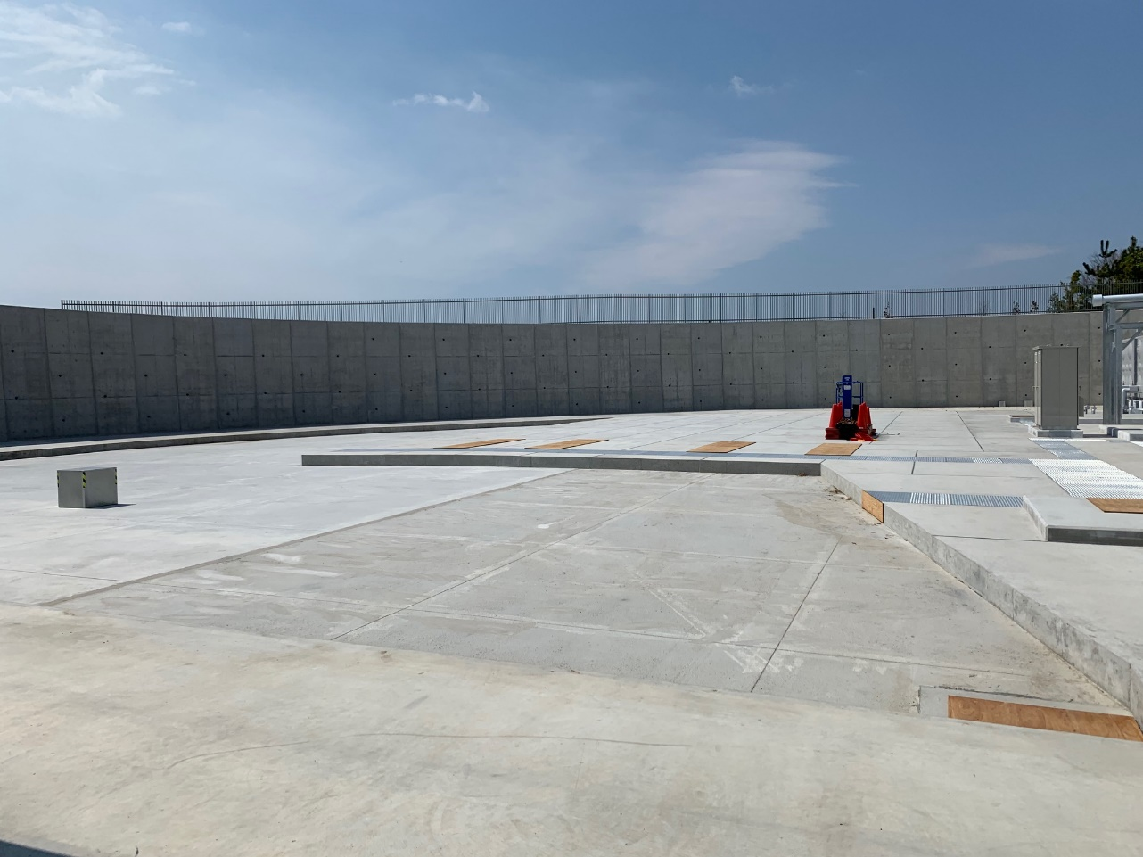
Prepping the 40+MW
Facility (actual photo)

Slide 22
Convergence of equation based modeling and data analytics on HPC resources [Ichimura, Fujita, et. al., the Univ. of Tokyo]
Equation based modeling and data analytics have different characteristics
  Equation based modeling: Highly precise, but costly
  Data analytics: Fast inferencing, but accuracy not as high
More efficient computation is expected by using both methods to complement each other on HPC resources
  We have been conducting research on this topic focused on earthquake simulation problems
  In SC17 best poster [1], we used data generated by equation based modeling for data analytics training
  In SC18 Gordon Bell Prize Finalist paper [2], we trained artificial neural network to accelerate equation based modeling
[1] Tsuyoshi Ichimura, et al., AI with Super-Computed Data for Monte Carlo Earthquake Hazard Classification, SC17 Research Poster
[2] Tsuyoshi Ichimura, et al., A Fast Scalable Implicit Solver for Nonlinear Time-Evolution Earthquake City Problem on Low-Ordered Unstructured Finite Elements with Artificial Intelligence and Transprecision Computing, Proceedings of SC18

Slide 23
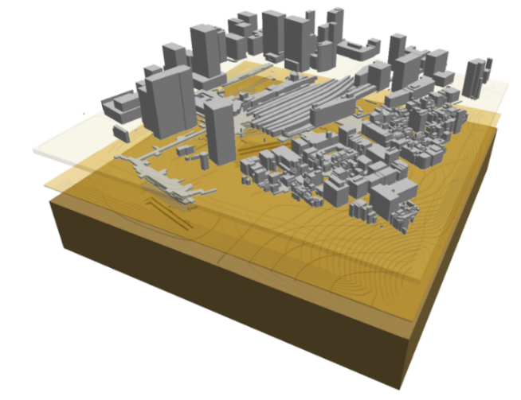
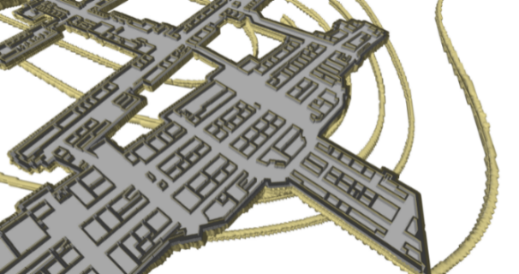
Example of using data analytics to accelerate equation based modeling
Target: Solve A x = f in unstructured implicit finite-element urban earthquake simulation
Difficulty in using data analytics in solver
  Data analytics results are not always accurate
  We need to design solver algorithm that enables robust and cost effective use of data analytics
Use information of underlying governing equation
  Extract parts with bad convergence using artificial neural network and extensively solve extracted part in preconditioner
  Same solution obtained with less compute cost
  Other FLOPS reducing algorithmic innovations (while maximized on BW)
Whole city model
Extracted part by AI (about 1/10 of model)

Slide 24
Performance of data analytics enhanced solver on K computer/Summit
FLOP count of data analytics enhanced solver decreased by 5.56-times from PCGE (standard solver; Conjugate Gradient solver with block Jacobi preconditioning), and 1.32 times from a non data analytics enhanced SC14 solver
Fast and scalable on both CPU based K computer and GPU accelerated Summit
Weak scaling on K computer
Weak scaling on Summit
(17.2% of FP64 peak)
(14.7% of FP64 peak)
■Data analytics enhanced solver
■ SC14 solver
■ Standard solver (PCGE)

Slide 25
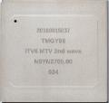
Massive Scale Deep Learning on Post-K
Post-K Processor
◆High perf FP16&Int8
◆High mem BW for convolution
◆Built-in scalable Tofu network
Unprecedened DL scalability
High Performance and Ultra-Scalable Network
for massive scaling model & data parallelism
High Performance DNN Convolution
CPU
For the
Post-K
supercomputer
CPU
CPU
CPU
For the
Post-K
supercomputer
For the
Post-K
supercomputer
For the
Post-K
supercomputer
TOFU Network w/high injection BW for fast
reduction
Low Precision ALU + High Memory Bandwidth + Advanced Combining of Convolution Algorithms (FFT+Winograd+GEMM)
Unprecedented Scalability of Data/
Notes:
京：中性能高精度演算
GPUは高い、かつ、大規模にスケールするネットワークが弱い（最新で16ネットワーク）

Slide 26


A64FX technologies: Core performance
High calc. throughput of Fujitsu’s original CPU core w/ SVE
  512-bit wide SIMD x 2 pipelines and new integer functions
  8 bit inference => training possible?
INT8 partial dot product
8bit
8bit
8bit
8bit
A0 | A1 | A2 | A3
X X X X
B0 | B1 | B2 | B3
C
32bit

Slide 27


Selecting the Optimal Convolution Kernel
NEW! Micro Batching: Tokyo Tech. and ETH [Oyama, Tan, Hoefler & Matsuoka, IEEE Cluster 2019]
  Use the “micro-batch” technique to select the best convolution kernel
    Direct, GEMM, FFT, Winograd
    Optimize both speed and memory size
  On high-end GPUs, in many cases Winograd or FFT chosen over GEMM
    They are faster but use more memory
  Currently implemented as cuDNN wrapper, applicable to all frameworks
  For Post-K, (1) Winograd/FFT are selected more often, and (2) performance could be similar to GPUs in such cases (with work…)

Slide 28
4 Layers of Parallelism in DNN Training
Hyper Parameter Search
  Searching optimal network configs & parameters
  Parallel search, massive parallelism required
Data Parallelism
  Copy the network to compute nodes, feed different batch data, average => network reduction bound
  TOFU: Extremely strong reduction, x6 EDR Infiniband
Model Parallelism (domain decomposition)
  Split and parallelize the layer calculations in propagation
  Low latency required (bad for GPU) -> strong latency tolerant cores + low latency TOFU network
Intra-Chip ILP, Vector and other low level Parallelism
  Parallelize the convolution operations etc.
  SVE FP16+INT8 vectorization support + extremely high memory bandwidth w/HBM2
Post-K could become world’s biggest & fastest platform for DNN training!
Inter-Node
Massive amount of total parallelism, only possible via supercomputing
Intra-Node

Slide 29




Predicting Statistics of Asynchronous SGD Parameters for a Large-Scale Distributed Deep Learning System on GPU Supercomputers
Background
In large-scale Asynchronous Stochastic Gradient Descent (ASGD), mini-batch size and gradient staleness tend to be large and unpredictable, which increase the error of trained DNN
Proposal
We propose a empirical performance model for an ASGD deep learning system SPRINT which considers probability distribution of mini-batch size and staleness
Mini-batch size
Staleness
Objective function E
4 nodes
Mini-batch size
8 nodes
Predicted
Staleness=0
16 nodes
Measured
-ηΣ_{i} ∇E_{i}
W^{(t)}
Twice asynchronous updates within gradient computation
W^{(t+3)}
Predicted
W^{(t+1)}
W^{(t+1)}
W^{(t+2)}
-ηΣ_{i} ∇E_{i}
Staleness=2
Measured
DNN parameters space
(N_{Subbatch}: # of samples per one GPU iteration)
Yosuke Oyama, Akihiro Nomura, Ikuro Sato, Hiroki Nishimura, Yukimasa Tamatsu, and Satoshi Matsuoka, "Predicting Statistics of Asynchronous SGD Parameters for a Large-Scale Distributed Deep Learning System on GPU Supercomputers", in proceedings of 2016 IEEE International Conference on Big Data (IEEE BigData 2016), Washington D.C., Dec. 5-8, 2016

Slide 30





Interconnect Performance as important as GPU Performance to accelerate DL
ASGD DL system SPRINT (by DENSO IT Lab) and DL speedup prediction
with performance model
  Data measured on T2 and KFC
  (both FDR) fitted to formulas
  Allreduce time ($∈$ TGPU) dep. on
  #nodes and #DL_parameters
Other approaches == similar improvements:
  Cuda-Aware CNTK optimizes communication pipeline ➔ 15%—23% speedup
  (Banerjee et al. “Re-designing CNTK Deep Learning Framework on Modern GPU Enabled Clusters”)
  Reduced precision (FP[16|8|1]) to minimize msg. size w/ no or minor accuracy loss
K80+
FDR
Fig. 4: Oyama et al. “Predicting Statistics of Asynchronous SGD Parameters for a
Large-Scale Distributed Deep Learning System on GPU Supercomputers

Slide 31

TOFU Allreduce Throughput test on K Computer
Allreduce (& Bcast,
Barrier, Reduce)
nearly independent
of #nodes ✅
>340 TByte/s (for
400MB msg size) ✅
Per 256MiB FP32
MPI_SUM allreduce:
384 nodes: 83.3ms; 3072: 85.3ms;
18k: 87.4ms; 55k: 66.6|100.9ms (200|300MB)
🇽 Full-K IMB crashed: “Tofu interconnect detected MRQ overflow.” in n-to-1 OP
Achieves theoretical algorithmic maximum w.r.t. injection BW on any machine scale (up to 88,000 nodes), log(n) increase in time

Slide 32









Training ImageNet in Minutes
Rio Yokota, Kazuki Osawa,Yohei Tsuji,Yuichiro Ueno, Hiroki Naganuma, Shun Iwase, Kaku Linsho, Satoshi Matsuoka
Tokyo Institute of Technology/Riken
+ Akira Naruse (NVIDIA)
 | #GPU | time
Facebook | 512 | 30 min
Preferred Networks | 1024 | 15 min
UC Berkeley | 2048 | 14 min
Tencent | 2048 | 6.6 min
Sony (ABCI) | ~3000 | 3.7 min
Google (TPU/GCC) | 1024 | 2.2 min
TokyoTech/NVIDIA/Riken (ABCI) | 4096 | ? min
TSUBAME3.0
ABCI
Source Ben-nun & Hoefler https://arxiv.org/pdf/1802.09941.pdf

Slide 33




Second Order Optimization allowing very large batch sizes for data parallelism
Approximation via Kronecker Factorization (K-FAC) allowing dramatically reducing compute cost

Slide 34


Status: Reduced cost of second order optimization to x1.8 of SGD, now almost zero
Experiments have shown that optimization performance is not compromised even for extremely large batch sizes (BS) → Extreme scaling is possible
Goal: Aim for 100,000 node scalability on Post-K, (10 model x 10,000 data) parallel
※ ImageNet 1 million / Resnet

Slide 35








ImageNet/ResNet-50 Training in 224 Seconds (world record)
Yoshiki Tanaka, Hisahiro Suganuma, Hiroaki Mikami, Pongsakorn U-chupala, Yuichi Kageyama Sony Corporation
Successfully trained ImageNet/ResNet-50 in 224 seconds with Neural Network
Libraries developed by Sony without significant accuracy loss on ABCI
Fujitsu Lab
2048 GPUs on ABCI
74.7 seconds
Batch size 81,920
Issues of Large-scale Distributed DNN training with a massive GPU cluster
Issue 1
Communication overhead of gradient
synchronization among GPUs
Issue 2
Accuracy loss with large mini-batch training
Tokyo Tech/Riken/NVIDIA
IEEE CVPR 2019 (to appear)
Batch size 131,072 on 4096 GPUs
on ABCI
Google 2.2min
Approach
2D-Torus topology comprises of multiple
rings in horizontal and vertical orientations
Approach
Increase batch size in response to the progress on DNN training
Smaller batch size for sharper loss landscape
Larger batch size for
flatter loss landscape

Slide 36

20 year Eras towards of End of Moore’s Law
20-year
Moore-Dennard
Single Core
ILP-Vector
Killer-Micro Era
1980s~2004 Dennard scaling, perf+ = single thread+ = transistor & freq+ = power+
2004~2015 feature scaling, perf+ = transistor+ = core#+, constant power
2015~2025 all above gets harder
2025~ post-Moore, constant feature&power = flat performance
3-5nm and beyond 2025-
Constant Transistor Power
20 year
Post-Dennard
Many-Core Era
20-year
Next-Gen
Post-Moore era
Need to realize the next 20-year era of supercomputing

Slide 37
The “curse of constant transistor power”
- Ignorance of this is like ignoring global warming -
Systems people have been telling the algorithm people that “FLOPS will be free, bandwidth is important, so devise algorithms under that assumption”
This is breaking down w/exascale in 2020…
When Moore’s Law ends in 2025-2030, constant transistor power (esp. for logic) = FLOPS will no longer be free!
So algorithms that simply increase arithmetic intensity will no longer scale beyond that point
Like countering global warming – need disruptive change in computing – in HW-SW-Alg-Apps etc. for the next 20 year era

Slide 38
“Double-precision FPUs in High-Performance
Computing: an Embarrassment of Riches?”
[Donke et. al. 2019 IPDPS2019]
- Save power
  Motivation
  Less FP64 units?
  Resulting Research Questions
  Q1: How much do HPC workloads actually depend on FP64 instructions?
  Q2: How well do our HPC workloads utilize the FP64 units?
  Q3: Are our architectures well- or ill-balanced: more FP63, FP32, INT, Memory?
  … and …
  Q4: How can we actually verify our hypothesis, that we need less FP64 and
  should invest $ and chip area in more/faster FP32/16/… units and/or
  memory/inteconnect)?
- Free chip area
(ex: FP16)
- Less divergence of “HPC-capable”
CPUs from mainstream processors

Slide 39

Methodology – CPU Architectures
  Two very similar CPUs w/ large difference in FP64 units
  Intel dropped 1 DP unit for 2x SP and 4x VNNI (similar to Nvidia’s TensorCore)
  Vector Neural Network Instruction (VNNI) supports SP floating point and mixed precision integers (16-bit input/32-bit output) ops
  KNM: 2.6x higher SP peak performance and 35% lower DP peak perf.
  (Figure source: https://www.servethehome.com/intel-knights-mill-for-machine-learning/)

Slide 40
HPC Applications – ECP and Post-K Miniapp
ECP Proxyapps | Person | Type Proxyapp | Language
AMG | Haoyu | Algebraic multigrid solver | C
CANDLE | Haoyu | Deep Learning and Simulation | Python
CoMD | Haoyu | Molecular dynamics algorithms | C
Laghos | Tsuji | Compressible gas dynamics | C++
MACSio | Tsuji | Scalable I/O Proxy Application | C
miniAMR | Tsuji | Structured Adaptive Mesh Refinement (3D stencil) | C
miniFE | Tsuchikawa | Computation of element-operators | C++
miniTri | Tsuchikawa | Calculates a specific number (k) for all triangles in the graph. | C++
Nekbone | Tsuchikawa | Solves a Helmholtz equation in a box. | Fortran
SW4lite | Yashima | testing performance optimizations in a few important numerical kernels of SW4 (3-D seismic modeling,) | C
SWFFT | Yashima | The Hardware Accelerated Cosmology Code (HACC) | C/C++
XSBench | Yashima | Computational kernel of the Monte Carlo neutronics | C
Post-K Miniapps | Person | Type Miniapp | Language
CCS QCD | Matsumura | QCD | Fortran/C
FFVC-MINI | Tsuji | 3D unsteady thermal flow of the incompressible fluid | C++/Fortran
NICAM-DC-MINI | Haoyu | Baroclinic wave test | Fortran
mVMC-MINI | Matsumura | Monte Carlo | C
NGS Analyzer-MINI | Yashima | Genome analysis tool | C
MODYLAS-MINI | Matsumura | MD | Fortran
NTChem-MINI | Matsumura | Molecular electronic structure calculation (MatMult by BLAS) | Fortran
FFB-MINI | Haoyu | CFD, FEM | Fortran
Fortran
C
C++
Python
Traditional
Modern

Slide 41

Results – Performance (solver only)
  Only 3 apps MINOR slowdown from missing DP
  6 proxy-apps faster on 2-socket Broadwell

Slide 42
FLOPS to Bytes Data Centric Processor
Electrical Engineering and Computer Sciences
32
Linpack (Top500)
16
8
4
2
w/out ILP
1
1/2
Target 2028 Post-Moore Processor
Lower FLOPS compensated by lower precision
x10 memory BW c.f. HBM2
Efficient data movement
BERKELEY PAR LAB
Actural Performance
TeraFlop/s
>80% of apps
# speedup apps becomes ZERO
FLOPS only improvement
x10 perf
c.f. Post-K
Post-K Chip (HBM2, 1TB/s memory BW)
X100 c.f. current Processor
Intel Xeon(Skylake & future)
100~130GB/s memory BW
Simple Many Core w/standard memory
Chin TaihuLight, Tianhe-2A, PEZY (low memory BW)
End of FLOPS-centric processor design
/
x10 perf c.f. Xeon
flop:DRAM byte ratio
1/4
1_{/8}
1_{/4}
1_{/2}
1
2
4
8
16
32
64

Slide 43

2025-2028 Post-Moore
FLOPS-to-BYTES x100 Speedup Architecture
Medium Bandwith
2.5D DRAM
>64GBytes Capacity
~3TB/s Bandwidth
High Capacity
Flash NVM
>1 TBytes Capacity
Photonic Network
VCSEL-based
Multi-Port High Injection
1Tbps x 12 = 12Tbps
3 nm UV fabrication
NVM/Flash
Low Latency 3D SRAM
>8GBytes Capacity
>10TB/s Bandwidth
NVM/Flash
NVM/Flash
2.5D DRAM
3D SRAM
2.5D DRAM
3D SRAM
2.5D DRAM
3D SRAM
VCSEL Optical Launch Pad
VCSEL Optical Launch Pad
SRAM
2.5D DRAM
Dataflow+Scalar Processor
Neuromorphic Accelerator
TSV Interposer
TSV Interposer
Organic Substrate
General purpose processor: Heterogeneous reconfigurable dataflow + scalar many-core processor, 200 Teraflops SFP, 20TeraFlops DFP
Accelerators: Neural/Neuromorphic, Ising, Graph, etc.
Direct Chip-Chip Interconnect with DWDM VCSEL micro-optics, 12Tbps injection bandwidth
Low arity switches for multi-dimensional torus, multi-channel network injection ports

Slide 44















System Software for Novel Memory Architectures
Matsuoka & Endo (Riken-CCS/Tokyo Tech)
Traditional Memory
Hierarchy
Node-Homogeneous
& Simple
Future: Advances of Memory Devices are more promising c.f. logic ➔ However, they also become diverse along with compute
Diverse & complex devices & hierarchy
Multiple Non-volatile devices
Both intra- and inter-node
Diverse memory packaging & interconnect: logic-memory & memory-memory
Various stacking (TSV, inductive), chip-chip photonics
Need data management depending on device&packaging
Diverse Processors
Near
Far
Diverse memory devices & packaging
System software for architecture & performance modeling for next generation algorithms, automated data placement & movement, continued performance increase parallel to memory device advances
by Kazushige Goto

Slide 45



Specialization via FPGA and Fine-grained Dataflow
Kentaro Sano (Riken-CCS)
“Specialization” key tech.
in Post-Moore Era
quantum
Post-Moore era assumptions
+ Can increase the number of transistors (but not turned on)
+ inter-chip bandwidth increase (but latency increase)
Quantum annealing
NVM
GPU
Super-scalar
Many-Core
Specialization
Problems to be solved
+ Dark silicon → efficient transistor usage (specialization)
+ data latency increase → eliminate instruction cycle,
local synchronization, minimize data movement
+ productivity → new programming model
Muti-core
ML
FPGA
Von Neumann
Approx
comp.
Von Neumann to Many Core
Post-Moore Cambrian
Specialized computation via dataflow
+ direct implementation of fine-gran dataflow
(dataflow graph on FPGA）
Issues:
+ what is the appropriate FPGA
architecture?具現化のための計算機構は?
+ programming model?
Why: Limit of von Neumann Processors
+ Sequential instruction decode
+ inter-core data movement
+ procedural + SPMD
computation
=> Limits of scaling
各演算は入力のみに依存し実行 (局所的)
メニーコアプロセッサ
とコア (命令サイクル)
Dataflow
Computation

Slide 46





Post Moore
Cambrian Era
Many Core Era
Flops-Centric Monolithic Algorithms and Apps
Cambrian Heterogeneous Algorithms and Apps
Flops-Centric Monolithic System Software
Cambrian Heterogeneous System Software
Hardware/Software System APIs
Flops-Centric Massively Parallel Architecture
Hardware/Software System APIs
“Cambrian” Heterogeneous Architecture
Homogeneous General Purpose Nodes
+ Localized Data
~2025
M-P Extinction
Event
Heterogeneous CPUs + Holistic Data
Compute Nodes
Compute Nodes
Gen CPU
Gen CPU
Reconfigurable
Dataflow
Data
Data
Massive BW
3-D Package
Optical
Computing
DNN&
Neuromorphic
Compute Nodes
Compute Nodes
Non-Volatile
Memory
Quantum
Computing
Low Precision
Error-Prone
汎用CPU
Gen CPU
Data
Data
Ultra Tightly Coupled w/Aggressive
3-D+Photonic Switching Interconnected
Loosely Coupled with Electronic Interconnect
Transistor Lithography Scaling
(CMOS Logic Circuits, DRAM/SRAM)
Novel Devices + CMOS (Dark Silicon)
(Nanophotonics, Non-Volatile Devices etc.)

