Slide 1



Reduced numerical precision and imprecise computing for ultra-accurate next-generation weather and climate models
“More accuracy with less precision”
Tim Palmer
Department of Physics, University of Oxford
With contributions from: Jan Ackmann, Mat Chantry, Peter Düben, Sam Hatfield, Milan Kloewer, Andrew McRae, Leo Saffin, Tobias Thornes

Slide 2
Climate models play an important role in modern society
Scientific input for decisions on decarbonising world economy
Guidance on infrastructure investment for regional climate adaptation
To foresee regional consequences of geoengineering proposals
Attribution of current weather events
Seasonal/decadal climate prediction
Synthesising observations (data assimilation)
Scientific Understanding

Slide 3
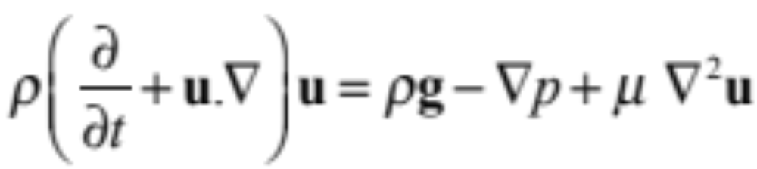
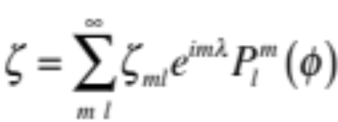
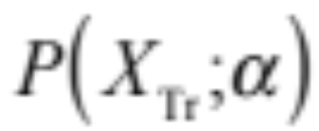
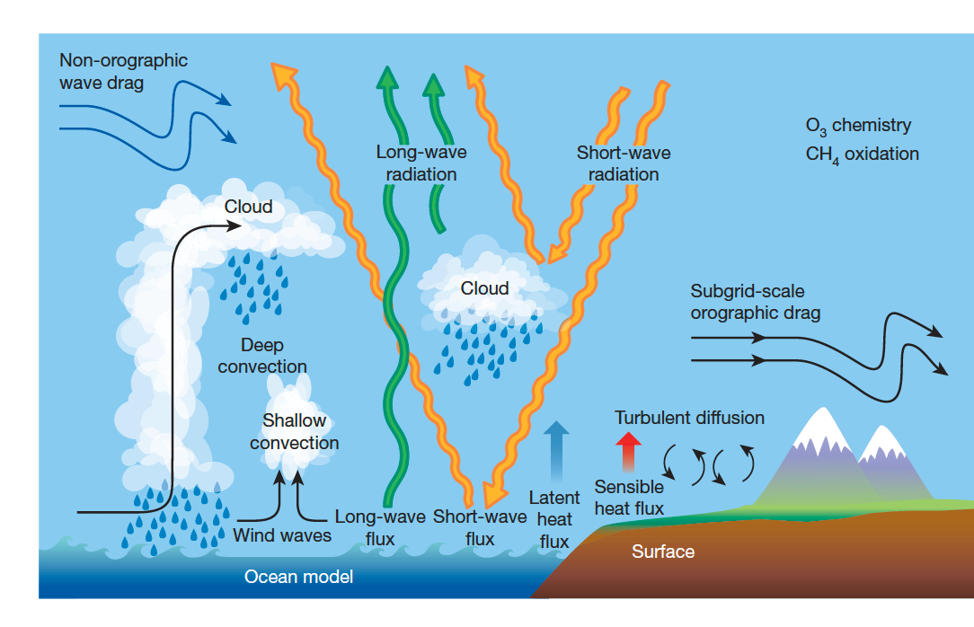
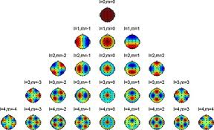
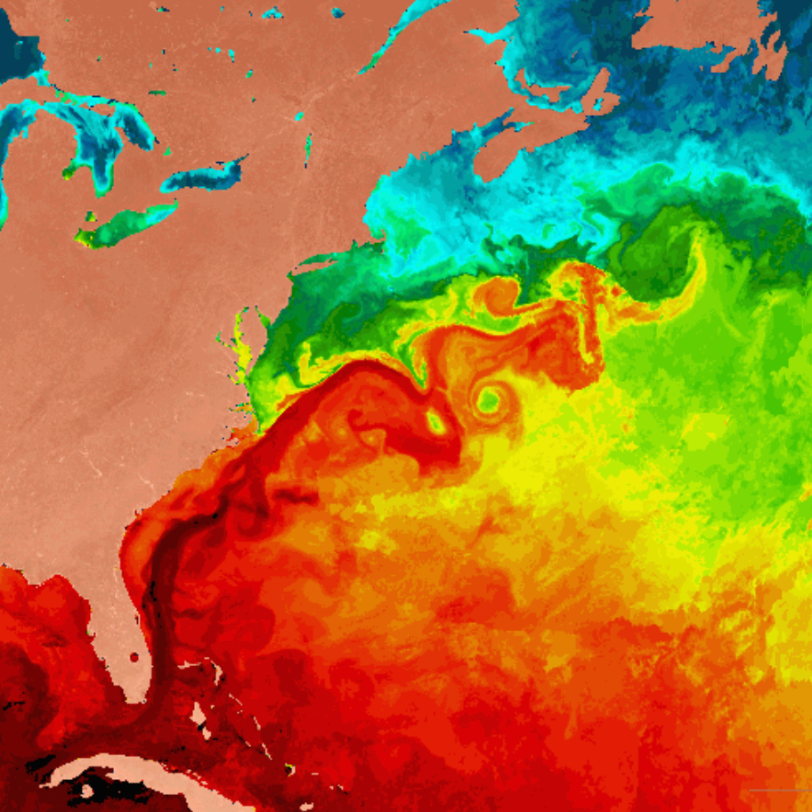

Resolved scales
Unresolved scales
Dynamical Core
Parametrisations
>50% compute time

Slide 4
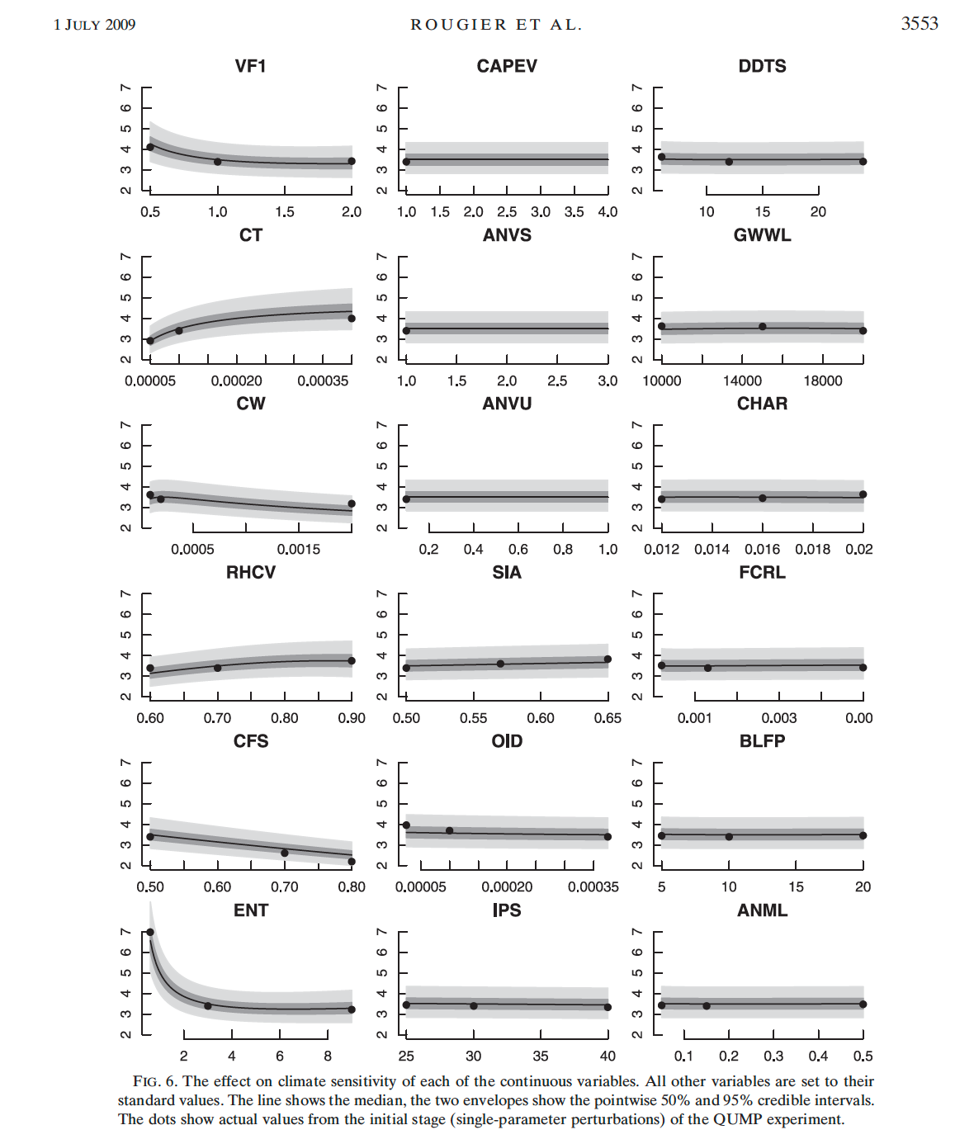
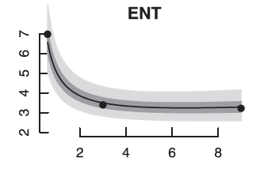
Predictions of climate change are sensitive to parameters in the sub-grid parametrisations
Climate Sensitivity
Convective entrainment parameter

Slide 5
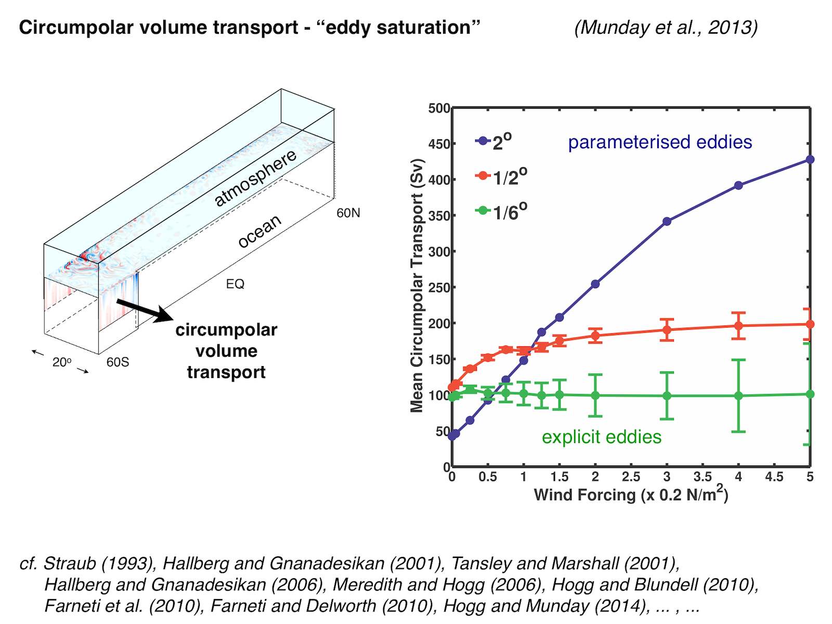
Parametrisations can give fundamentally wrong answers.

Slide 6
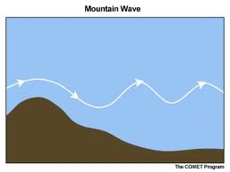

Extreme Earth (http://www.extremeearth.eu)
We have plans to develop 1km global weather/climate models (to eliminate parametrisation of key processes above). This will require next-generation exascale supercomputers.
But this will not be enough. Need further two additional orders of magnitude speed up at least. How?

Slide 7
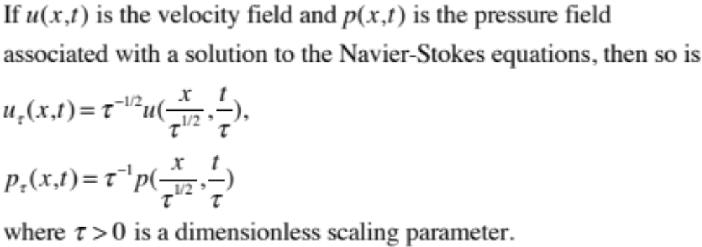
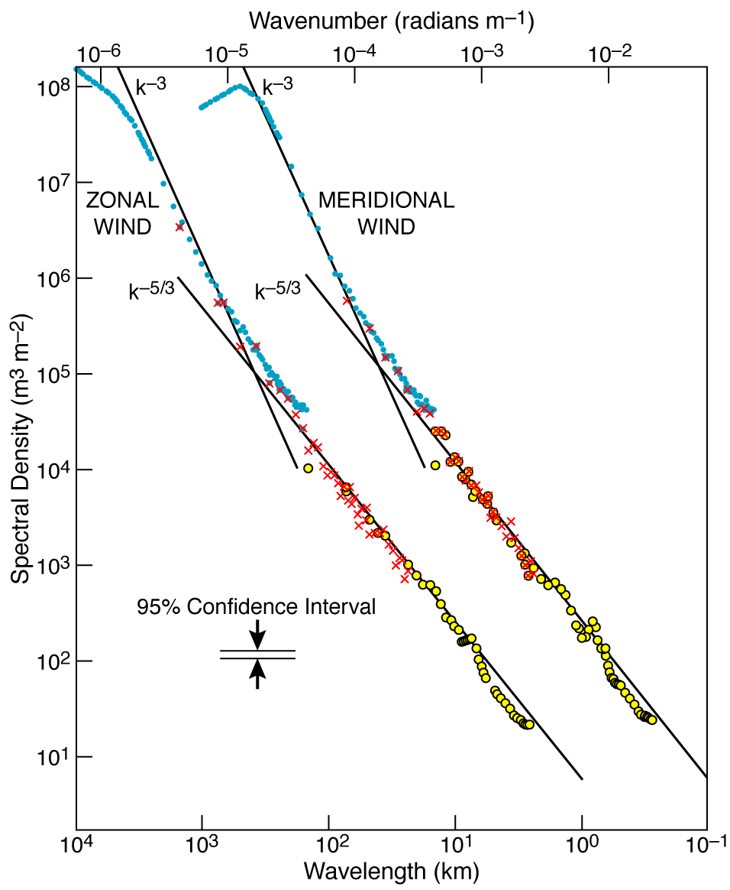

Slide 8

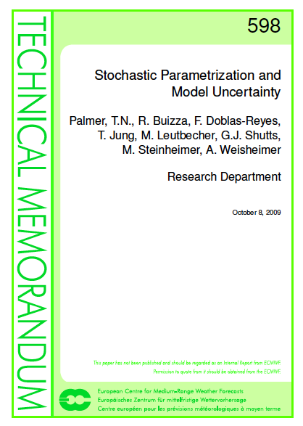
Imposing a hard truncation limit violates the scaling symmetries of the Navier-Stokes equations
In the k^{-5/3} regime, large-scale systematic errors can be very sensitive to small-scale systematic errors.
A way to mitigate this problem is to treat the parametrisation problem in stochastic terms (Palmer, 2001).
Stochastic parametrisation is now widespread in weather and climate models.

Slide 9
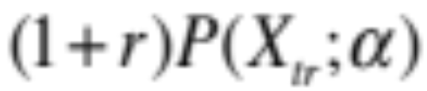
Resolved scales
Unresolved scales
Stochastic Parametrisations
Dynamical Core

Slide 10
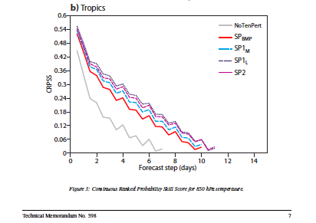
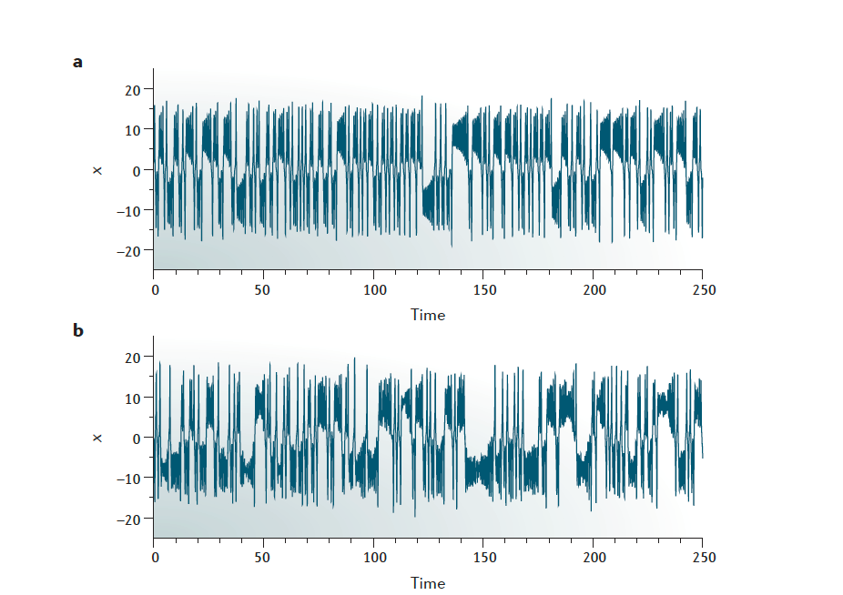
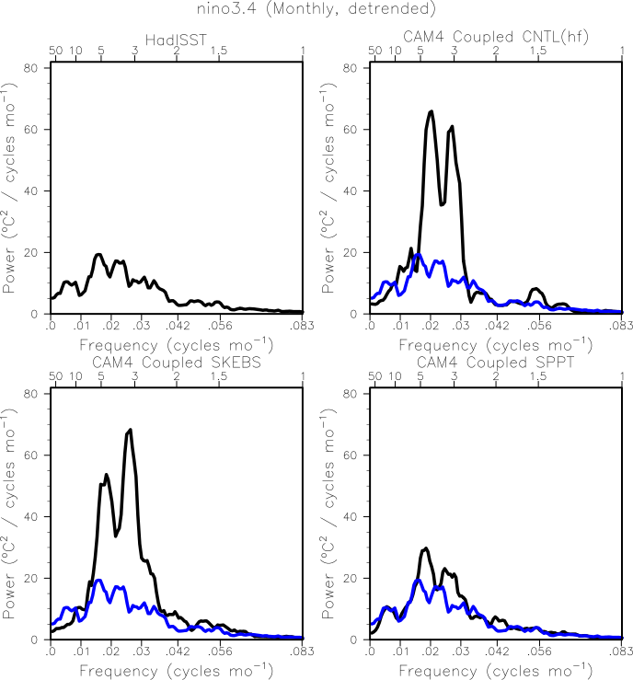
Some of the benefits of stochastic parametrisation
Weather Forecast Skill Scores without (grey) and with (colour) stochastic parametrization.
model
obs
Lorenz 63 a) normal b) with additive noise
NCAR, CAM4 ENSO without and with stochastic parametrization.
Christensen et al, 2017

Slide 11
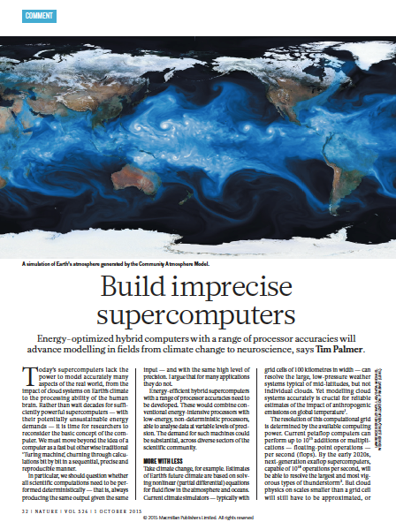

Slide 12
In the presence of stochastic parametrisations, representing all spherical harmonic coefficients with 64 bits is unnecessarily profligate. Number of mantissa bits which carry useful information likely to decrease with increasing wavenumber
Increasingly reduced precision
Stochastic parametrisation
Dawson, A., and P. D. Düben, 2017: rpe v5: An emulator for reduced floating-point precision in large numerical simulations.
Geosci. Model Dev., 10, 2221–2230, https://doi.org/10.5194/ gmd-10-2221-2017.
Düben, P. D., and T. N. Palmer, 2014: Benchmark tests for numerical weather forecasts on inexact hardware. Mon.
Wea. Rev., 142, 3809–3829, https://doi.org/10.1175/MWR-D-14-00110.1.
Thornes,T., P. D. Düben, and T. N. Palmer, 2017:On the use of scale dependent precision in earth system modelling. Quart. J. Roy.
Meteor. Soc., 143, 897–908, https://doi.org/10.1002/qj.2974.
——, ——, and ——, 2018: A power law for reduced precision at small spatial scales: Experiments with an SQG model.
Quart. J. Roy. Meteor. Soc., 144, 1179–1188, https://doi.org/10.1002/qj.3303.
Vána, F., P. D. Düben, S. Lang, T. N. Palmer, M. Leutbecher, D. Salmond, and G. Carver, 2017: Single precision in weather
forecasting models: An evaluation with the IFS. Mon. Wea.Rev., 145, 495–502, https://doi.org/10.1175/MWR-D-16-0228.1.

Slide 13
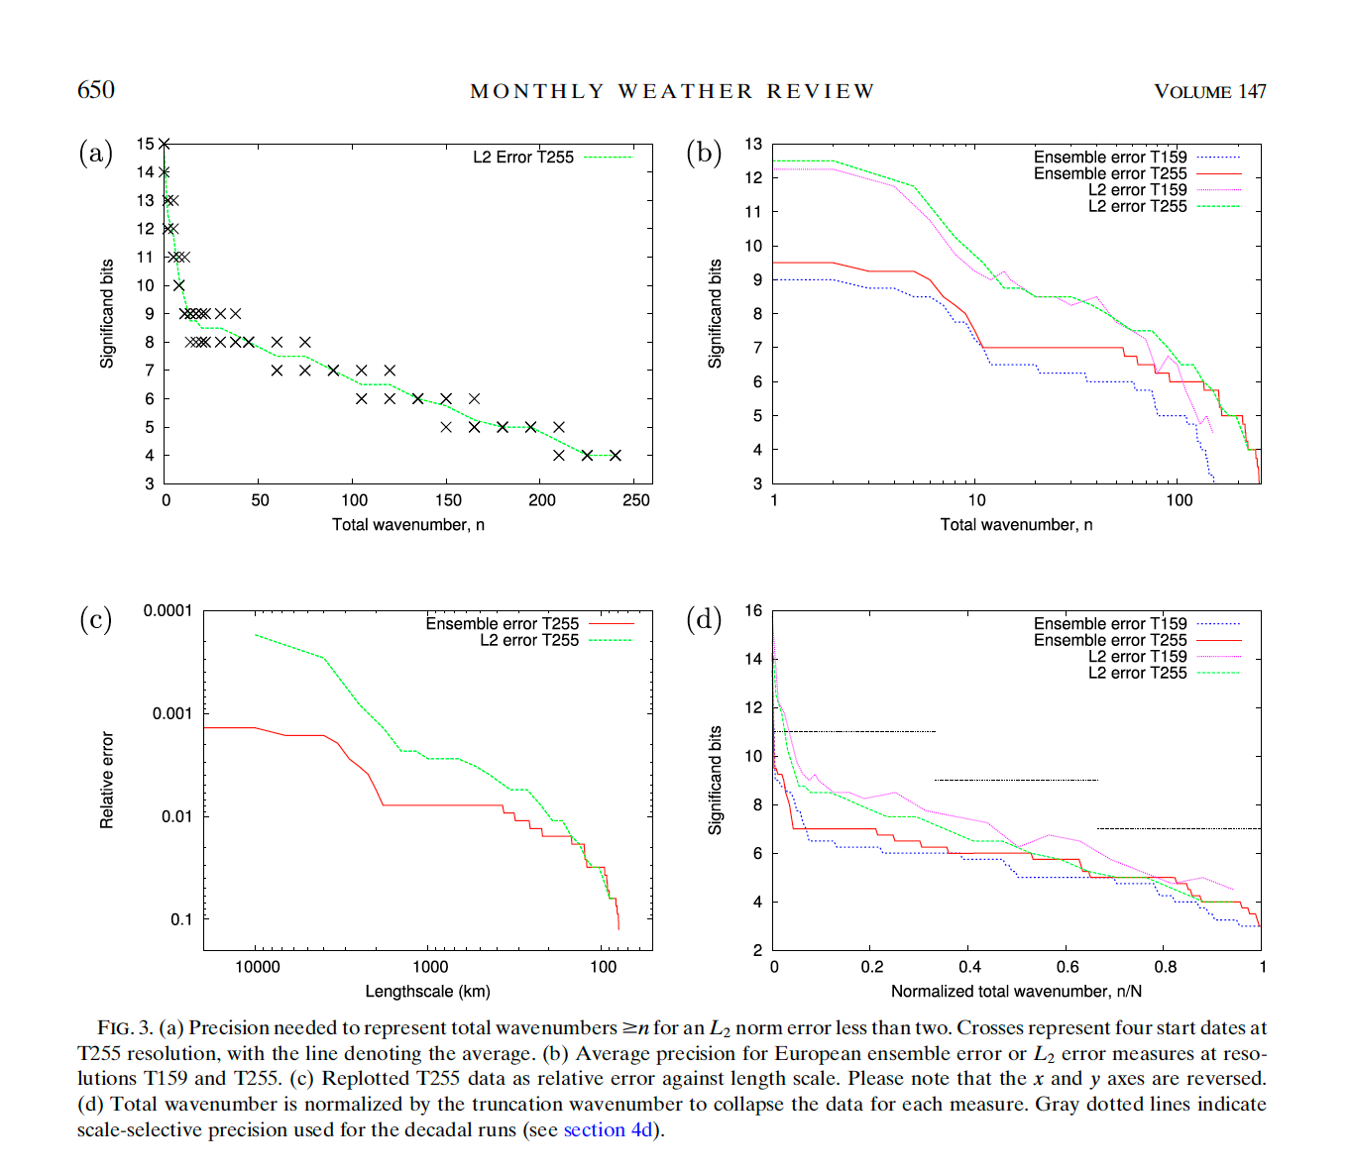
Chantry et al, Monthly Weather Review, 2019

Slide 14
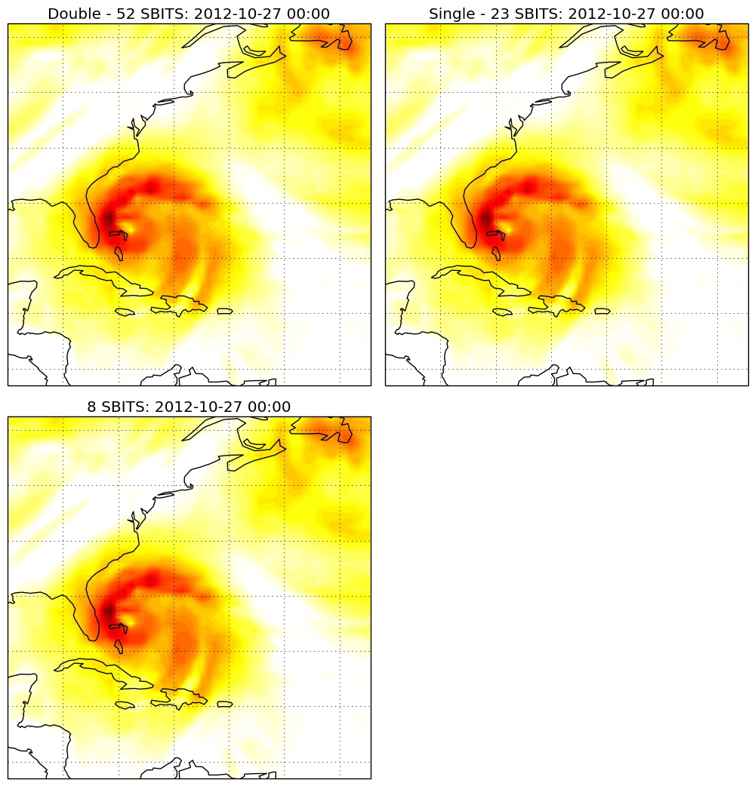

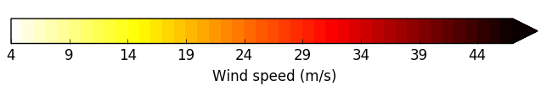
Hurricane Sandy
27/10/12 00:00
850hP wind speed
T255L91 ~ 80km

Slide 15
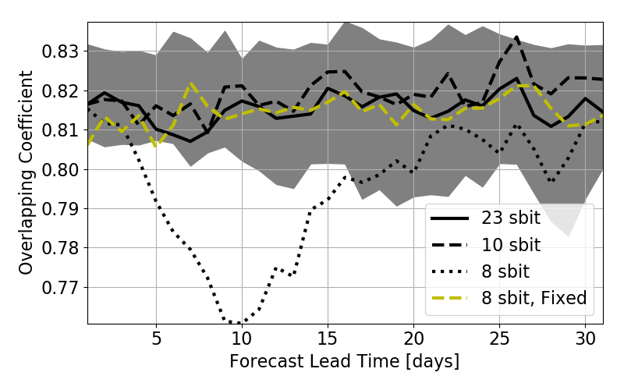

Reduced-Precision Parametrisation
Rounding errors in parametrizations are unimportant if they are masked by model stochasticity (SPPT)
Compare ensembles where the only difference is the SPPT random seed
Precision is deemed acceptable if it is indistinguishable from a double-precision ensemble
Simple fixes can improve performance of low-precision parametrizations
  Express moist static energy as an anomaly in the diagnosis of convection
  Store temperature in Celsius where possible
Overlap of 20-member ensembles with a double-precision 20-member ensemble in 500-hPa geopotential height. Grey shading shows range of overlap for randomly selected 20-member ensembles from 40 double-precision ensemble members
Overlapping Coefficient (Inman and Bradley, 1989)
Leo Saffin, 2019
+ Legendre Transforms

Slide 16
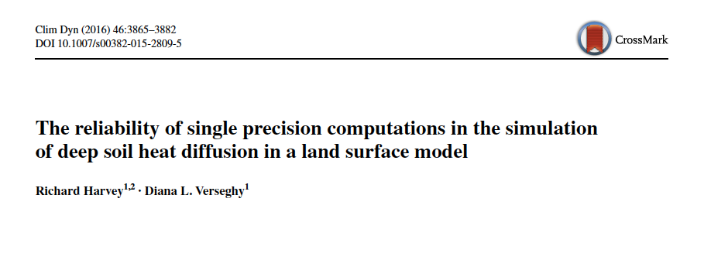
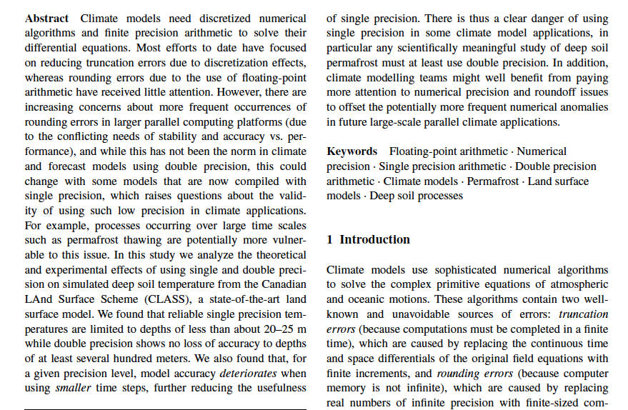

Slide 17
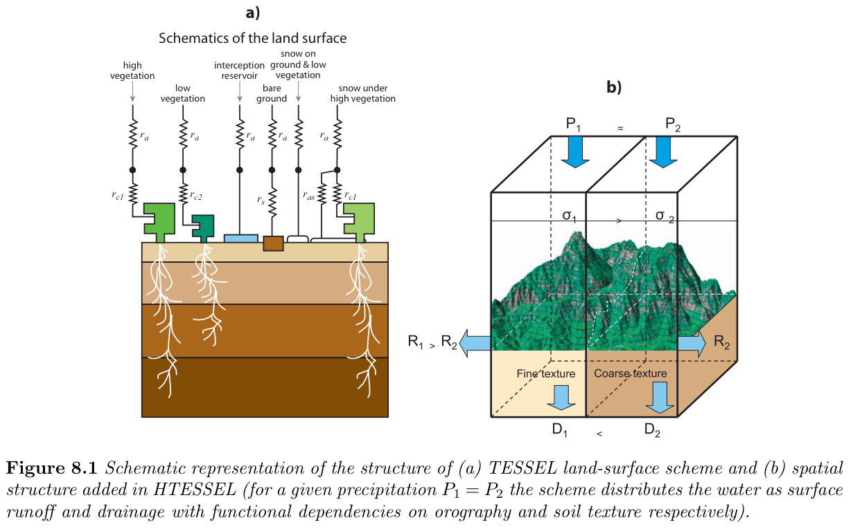
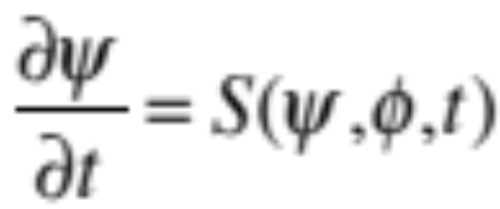
Highly uncertain
Represent at high precision
Compute (and retrieve fields from memory) at low precision

Slide 18
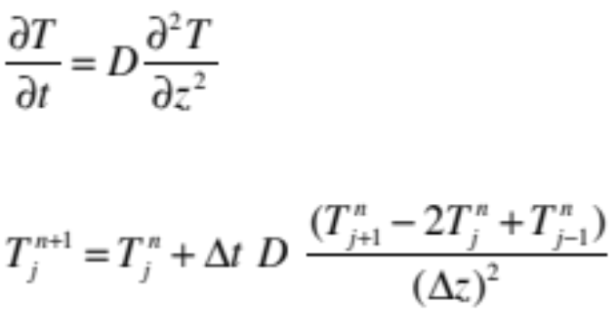
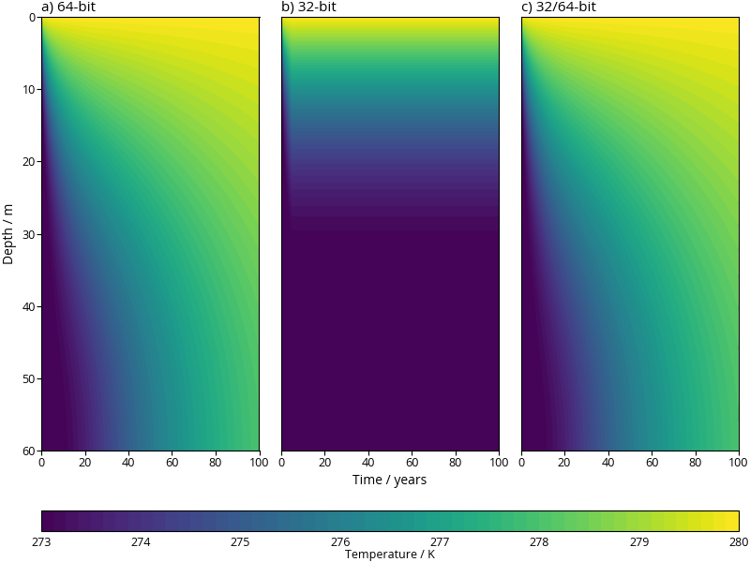
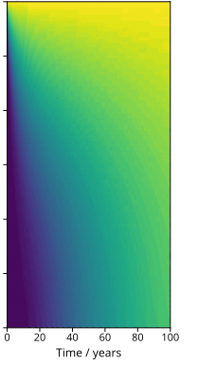
Dawson et al, 2018
64 bits
low precision
d) 16/64-bit

Slide 19
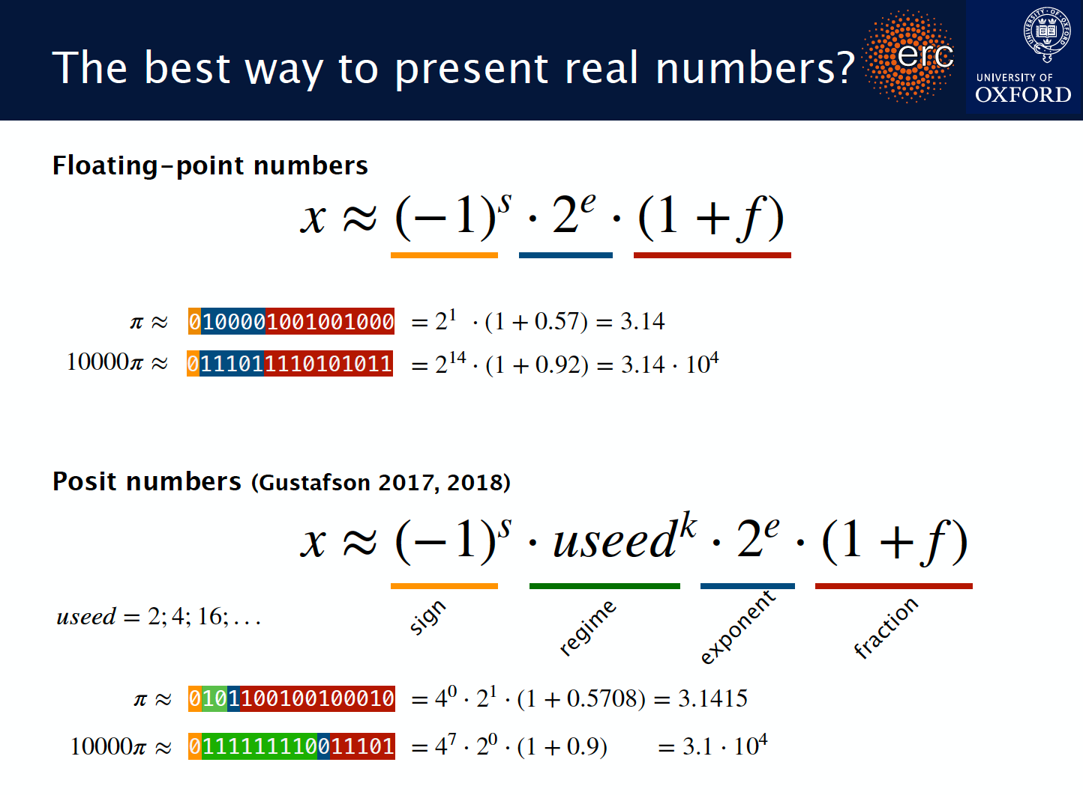

Slide 20
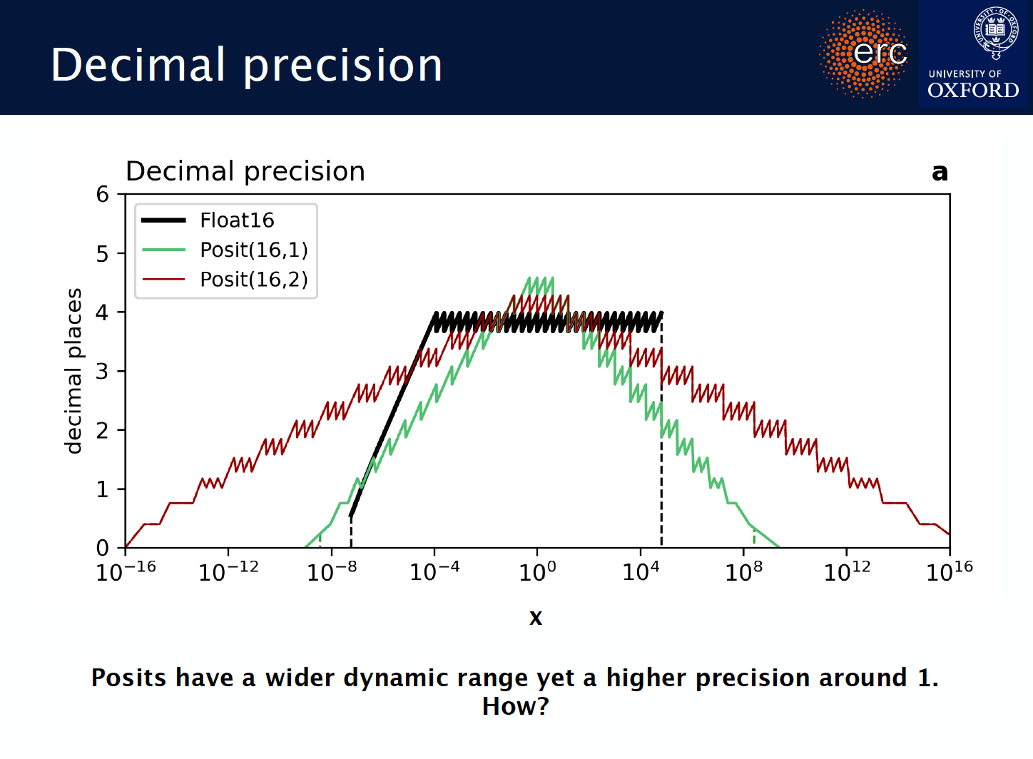

Slide 21
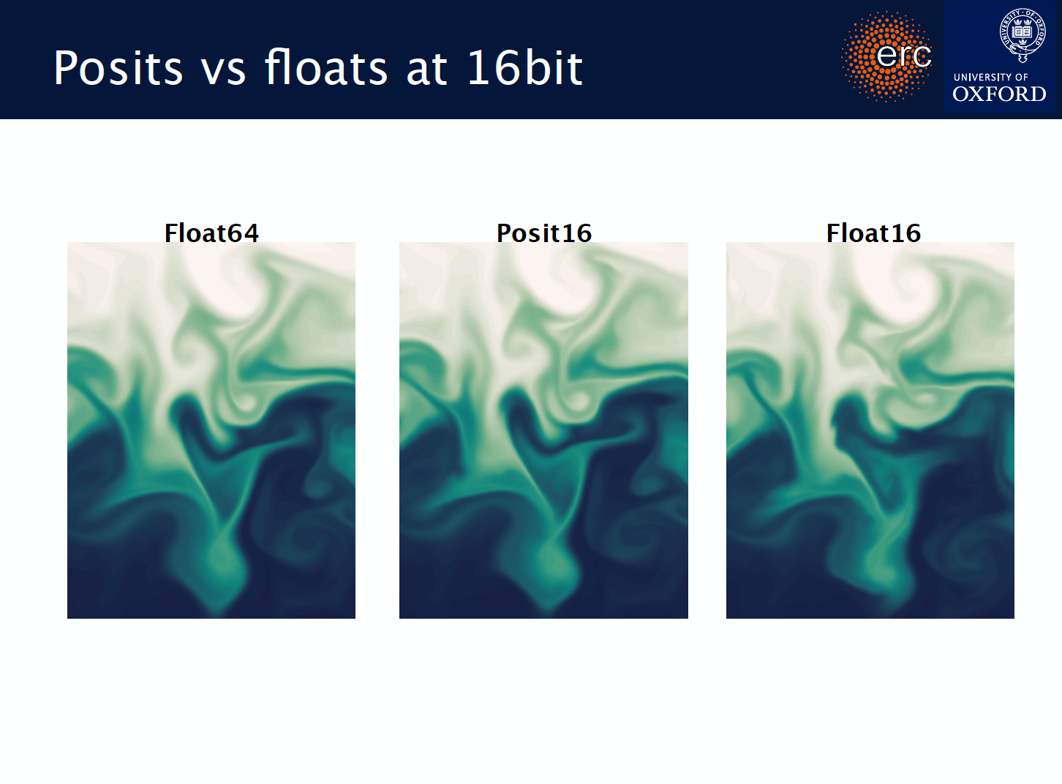
Milan Kloewer, 2019

Slide 22
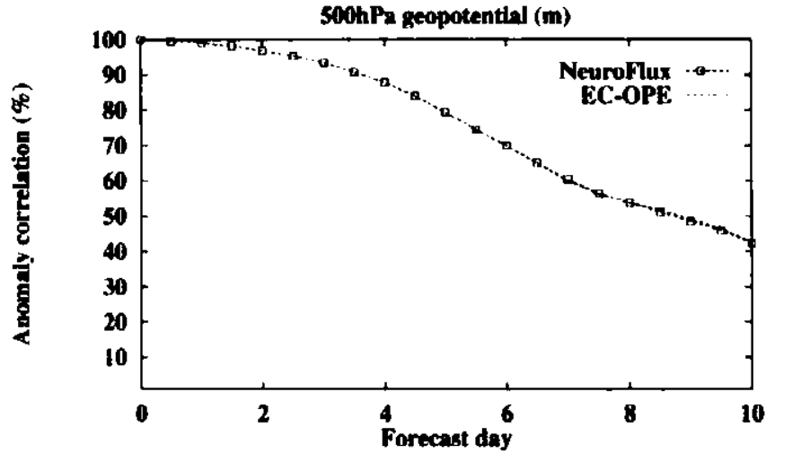


Artificial Neural Network
$$x=$$
$=𝓝𝓝(x)$
Input Layer
Hidden Layers
Output Layer
Results for a NN for long-wave radiation. Order of magnitude speed up, no loss of skill.
Apply to all parametrisations and components of Earth-System complexity??
Chevallier et al. QJRMS (2000)
Artificial Neural Networks
3

Slide 23
Conclusions
The standard paradigm in numerical analysis doesn’t work for climate prediction
Progress in designing next generation weather and climate models will need an exceptionally collaborative / interactive effort between scientists whose principal expertise is in the physics of climate and those whose expertise lies more in numerical or computer science.

