Slide 1

Numerical Computing Challenges for Deep Learning in Science
Rick Stevens
Argonne National Laboratory
The University of Chicago
Crescat scientia; vita excolatur

Slide 2
Preliminaries

Slide 3
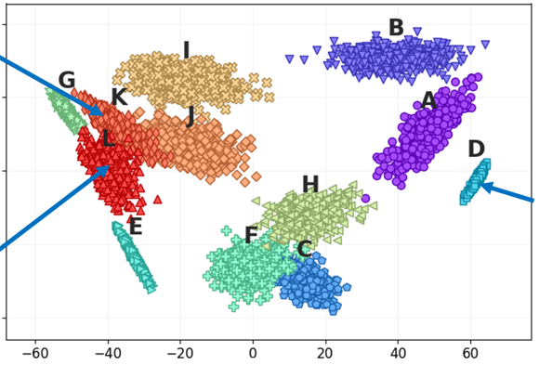
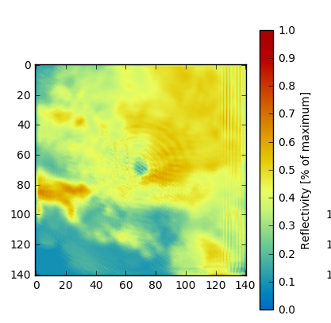
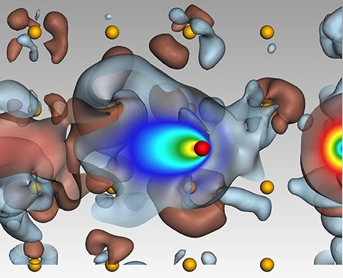
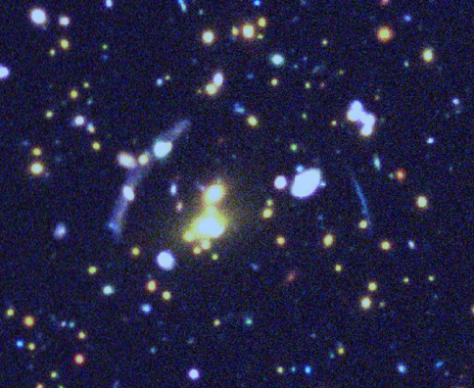
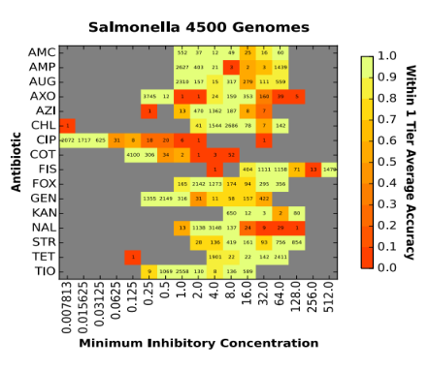
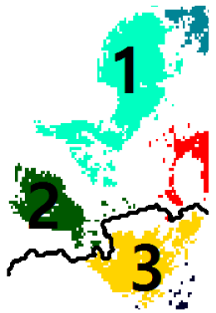

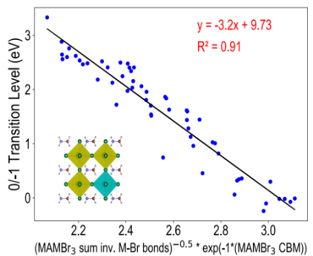
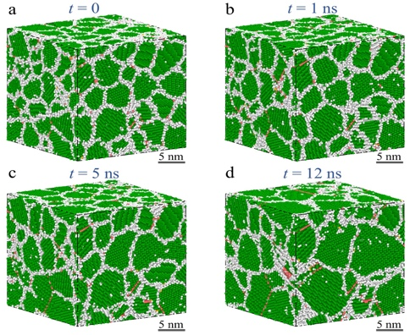
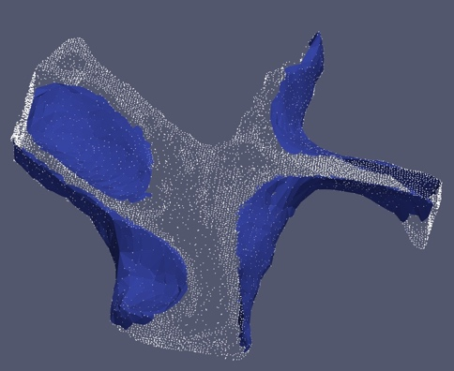
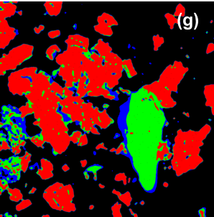
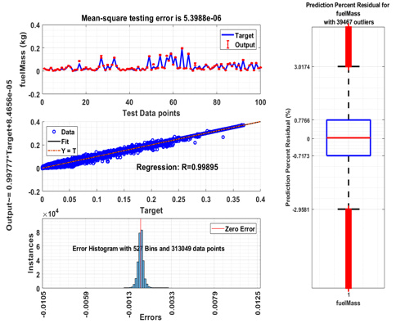
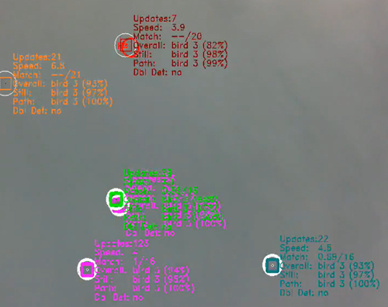
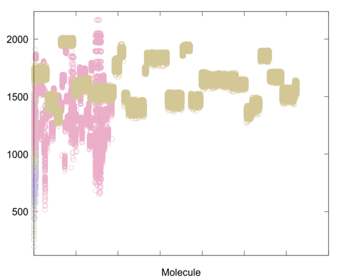
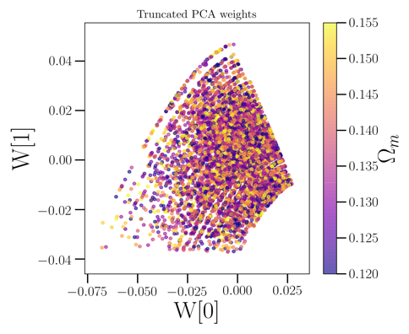
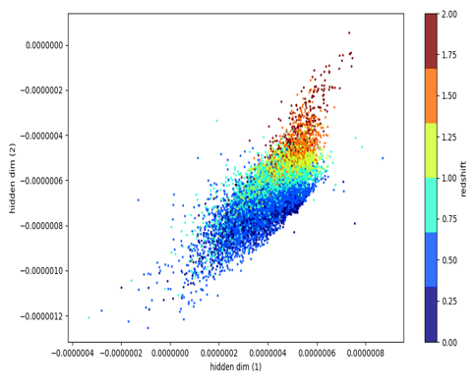
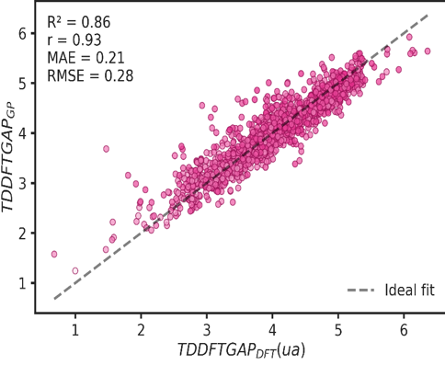
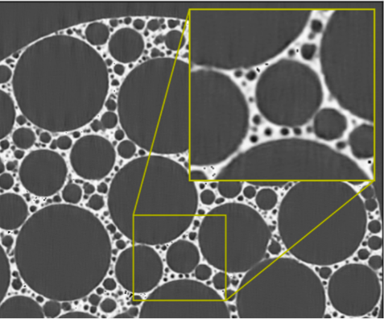
ML at Argonne: data-driven modeling
Reduced order modeling of laser sintering
Nowcasting with convolutional LSTMs
Prediction of radiation stopping power
Strong and weak lensing in sky survey data
Prediction of antimicrobial resistance phenotypes
Identification and tracking of storms
Efficient climate model emulators
Defect-level prediction in seminconductors
Structure-property-process triangle in additive manufact.
Parameter extraction in atom probe tomography
Learning for dynamic sampling in spectroscopy
Vehicle energy consumption prediction
Flying object detector for edge deployment
Discovery of new energy storage materials
Cosmic Microwave Background emulation
Photometric red shift estimation
New materials for efficient solar cells
Enhancement of noisy tomographic images

Slide 4




Aurora 2021 (A21) The Argonne Exascale System
Architecture supports three ways of computing
  Large-scale Simulation (PDEs, traditional HPC)
  Data Intensive Applications (scalable science pipelines)
  Deep Learning and Emerging Science AI (training and inferencing)

Slide 5
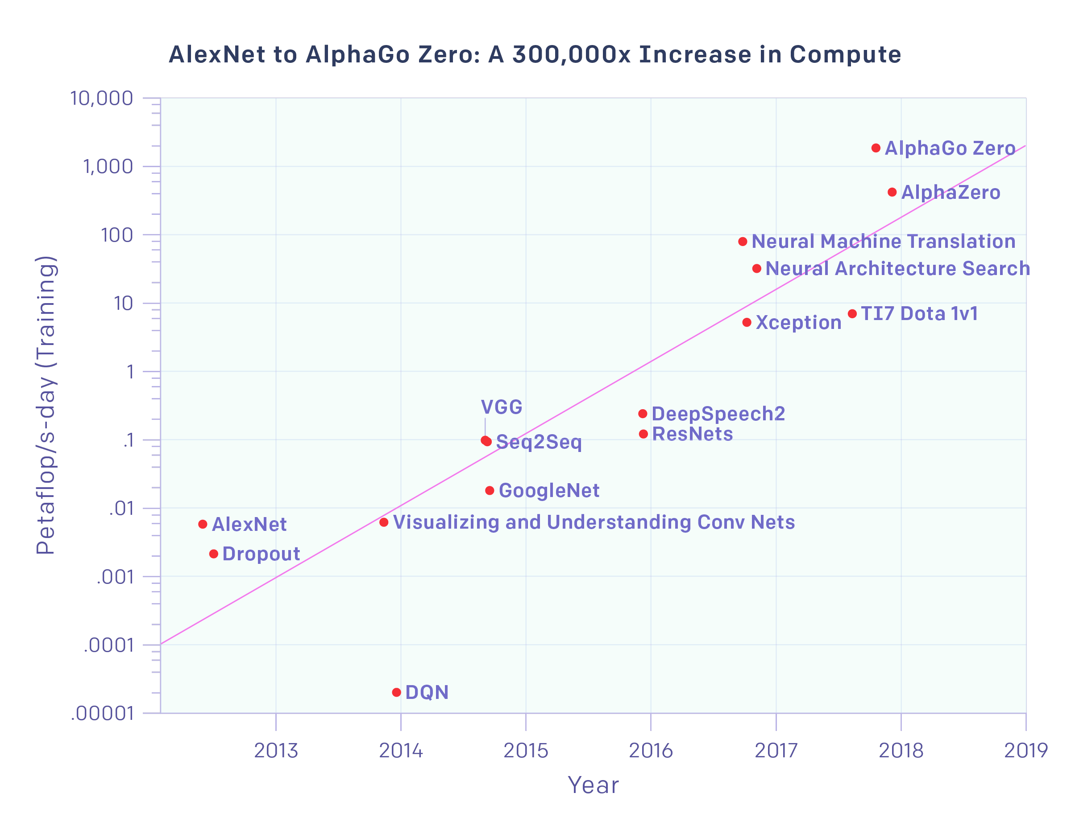
Deep Learning Meets HPC
Exascale Needs for Deep Learning
Automated Model Discovery
Hyper Parameter Optimization
Uncertainty Quantification
Flexible Ensembles
Cross-Study Model Transfer
Data Augmentation
Synthetic Data Generation
Reinforcement Learning
Exaop/s-day

Slide 6
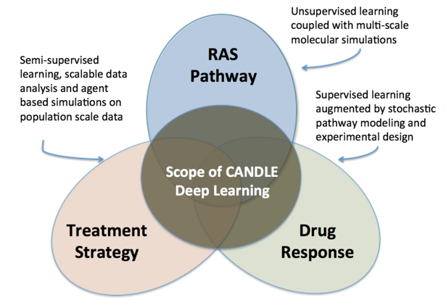








ECP-CANDLE: CANcer Distributed Learning Environment
CANDLE Goals
Develop an exscale deep learning environment for cancer and DOE mission applications
Build on open source deep learning frameworks
Optimize for CORAL and exascale platforms
Support all three Cancer pilot project needs for deep learning
Collaborate with DOE computing centers, HPC vendors and ECP co-design and software technology projects
6

Slide 7
P1 Challenge Problem Workflow(s) Specification
Data Preparation
Data Augmentation
Batch Normalization
Outlier Removal
Scaling/Quantization
Concordance Processing
Training
Inference
Ensembles
Source – Target Pairs
Drug Combinations
Domain Adaptation
Confidence Scoring
Cross-validation
Model Discovery
Residual Networks
Multitask Networks
Population Based HPO
Convolution/Attention
Transfer Learning
Outputs
UQ
Accuracy / K-rank / R²
ready
Factorial Design
Feature importance
in progress
Learning Curves
Performance Analysis
emerging

Slide 8

CANDLE MOTIVATION TO…
CANDLE
NCI – The CANDLE project aims to make the power of Exascale computing available for deep learning projects in Cancer. The initial drivers are the three Pilots, but our goal is to enable broad community of Cancer researchers access to high performance AI.
DOE – The CANDLE ECP project is driving the development of software and architectures to for large-scale deep learning. The CANDLE frameworks, and libraries are usable by broad applications, and the CANDLE benchmarks are being used in the CORAL and CORAL2 procurements.
ECP-CANDLE GitHub Organization:
https://github.com/ECP-CANDLE
ECP-CANDLE FTP Site:
The FTP site hosts all the public datasets for the benchmarks from three pilots
http://ftp.mcs.anl.gov/pub/candle/public/
8

Slide 9
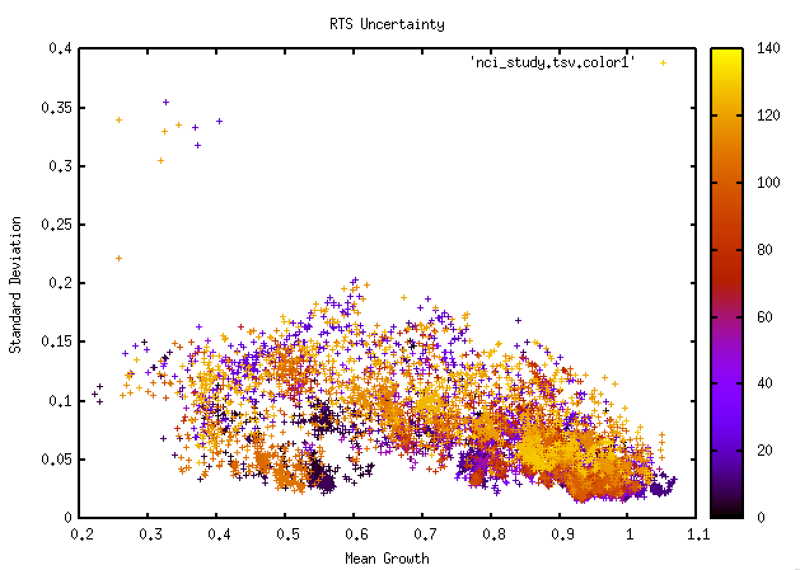
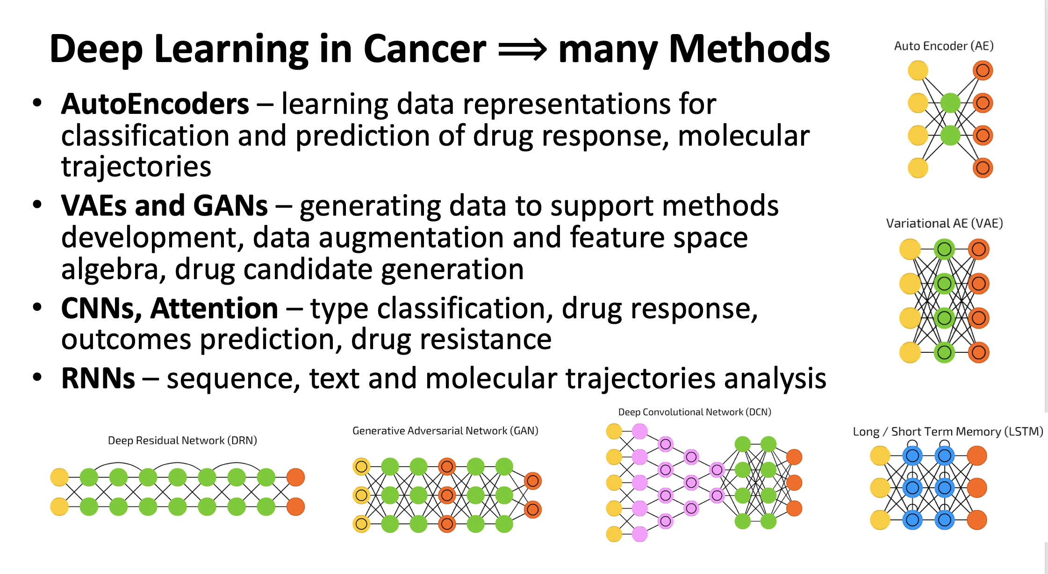
Machine Learning In Cancer Research
Cancer Susceptibility
Cancer Detection and Diagnosis
Cancer Recurrence
Cancer Prognosis and Survival
Cancer Classification and Clustering
Cancer Drug Response Prediction
Cancer Genomics Analysis
Cancer Medical Records Analysis
Cancer Biology

Slide 10
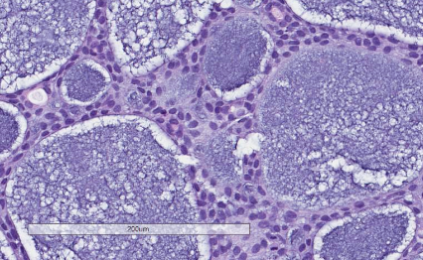
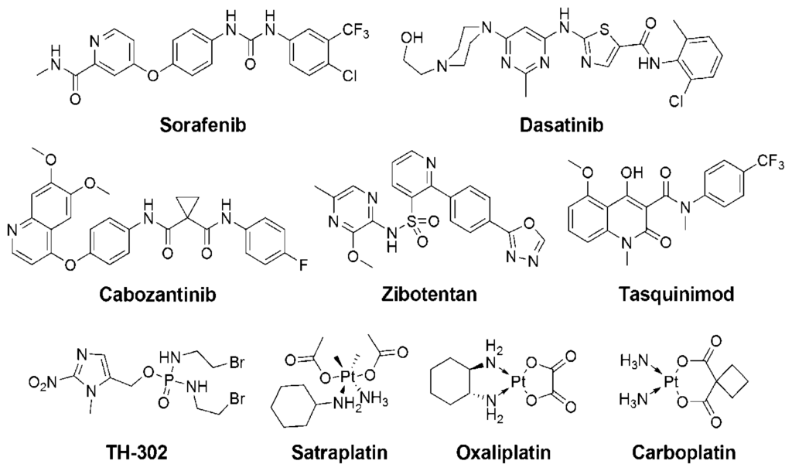
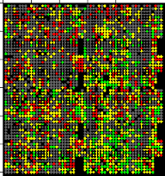
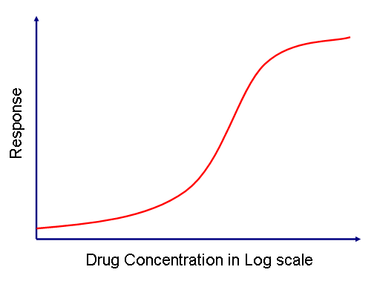
Modeling Cancer Drug Response
Drug (s)
descriptors
fingerprints
structures
SMILES
dose
→
𝓡 = 𝑓(𝓣, 𝓓)
𝓡 = 𝑓(𝓣, 𝓓₁ , 𝓓₂)
→
→
IC50
GI50
% growth
Z-score
gene expression levels
SNPs
protein abundance
microRNA
methylation
Response
Tumor

Slide 11
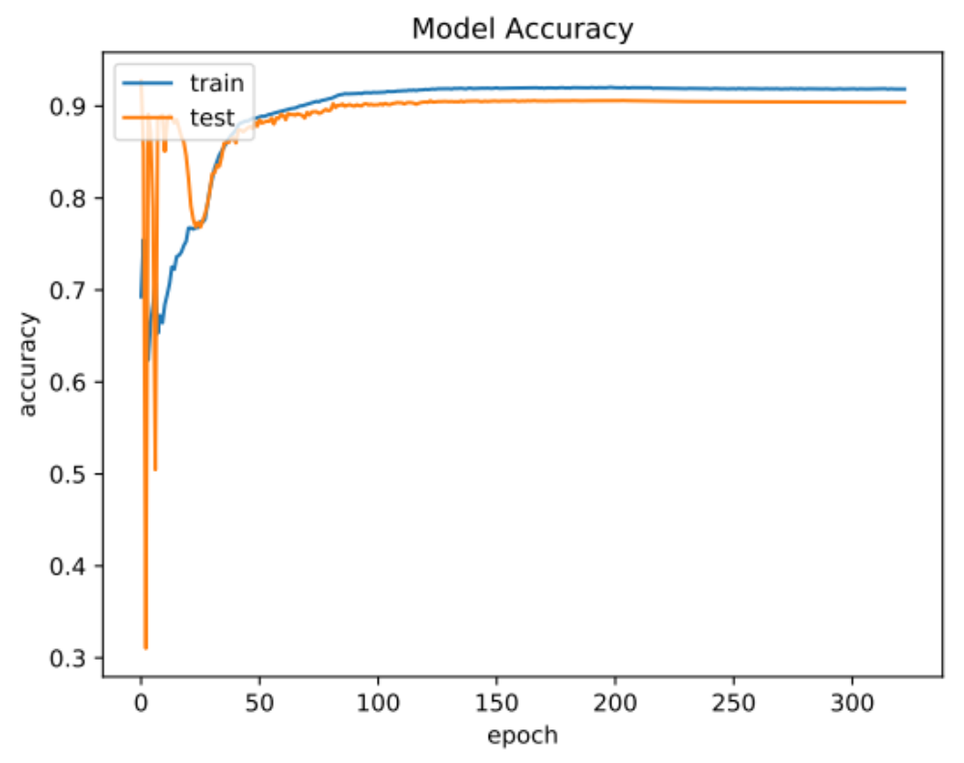
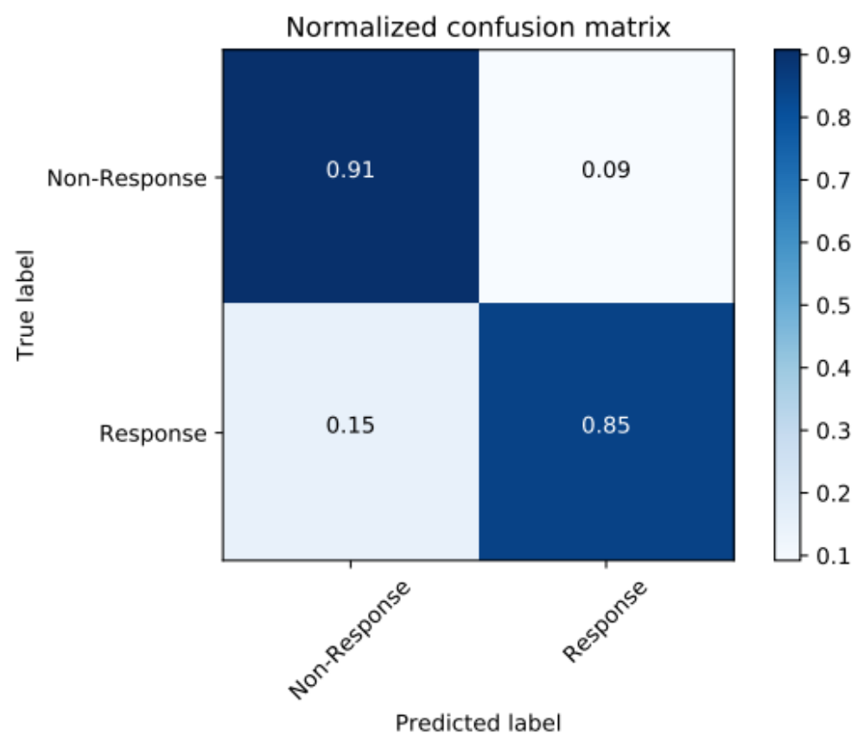
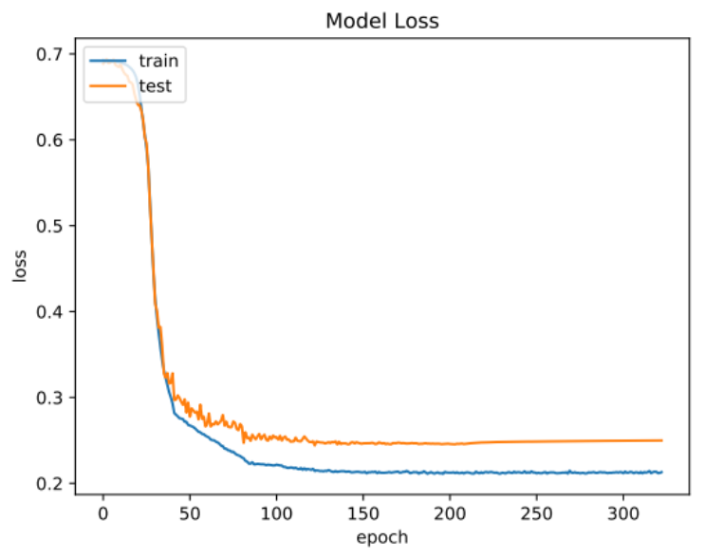
Self attention performs well on DL model of drug response for top 21 Cancer types
Pilot 1

Slide 12
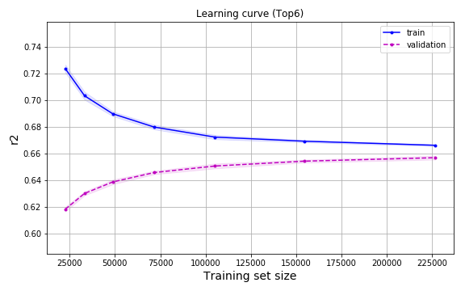
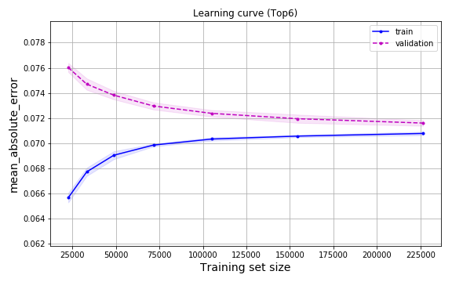
Pan Cancer Model – Learning curves
R²
MAE
Notes:
LightGBM regressor (default hyperparameters)
The shaded area represents the standard deviation computed across 5 folds.

Slide 13
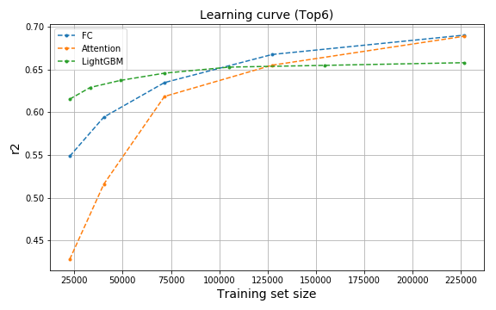
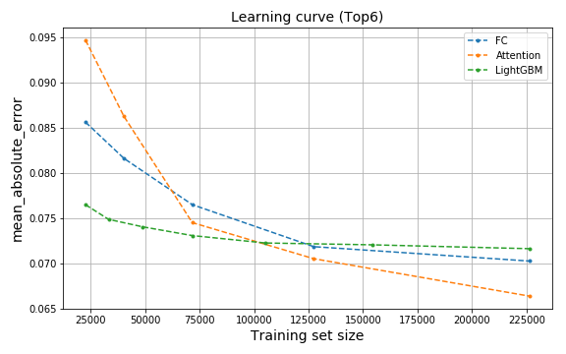
Pan Cancer Model Capacity
R²
MAE
Notes:
Comparison of:
Fully-connected (dropout=0.2, epochs=500, batch=32)
Attention (dropout=0.2, epochs=500, batch=32)
LightGBM regressor (default hyperparameters)
Each curve is a score computed for a validation set.
The curves follow the expected behavior when comparing shallow ML vs DNN.

Slide 14
Three Numerical Computing Co-Design Challenges
Sparsity
  Acceleration during training
  Compression and model reduction for inferencing
  Static and dynamics sparsity patterns in learning
Precision
  Model accuracy, training efficiency precision tradeoffs
  Accelerator design
  Power consumption
Accelerator Architectures
  Training and Inference
  What should we build that will have impact long term
  Exploiting what we know about precision and sparsity

Slide 15
Sparsity

Slide 16
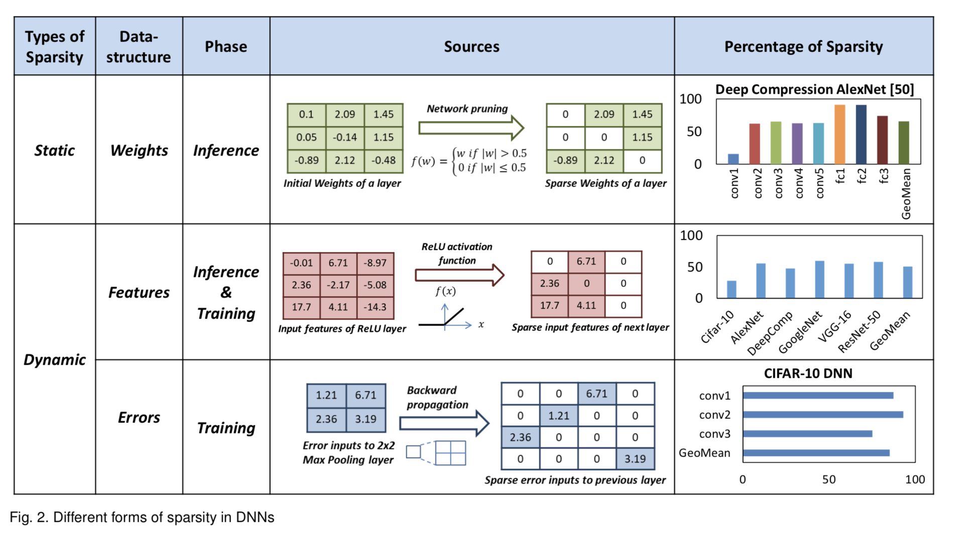

Slide 17
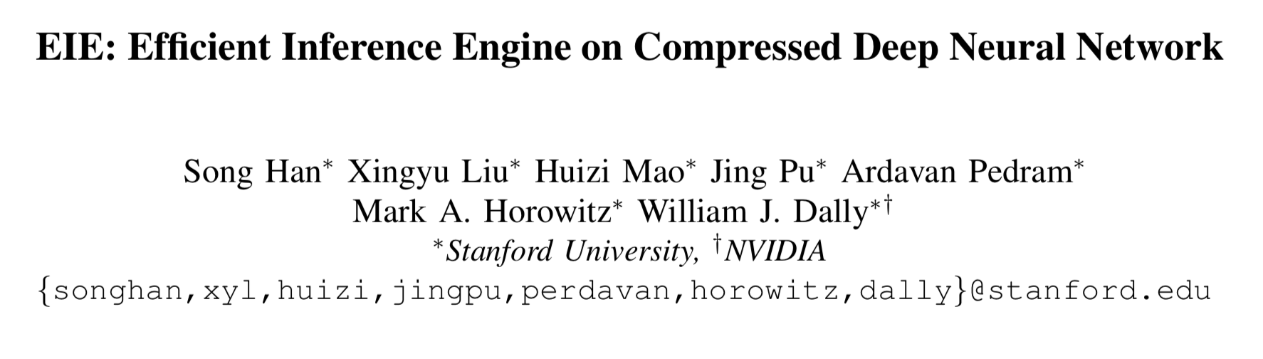
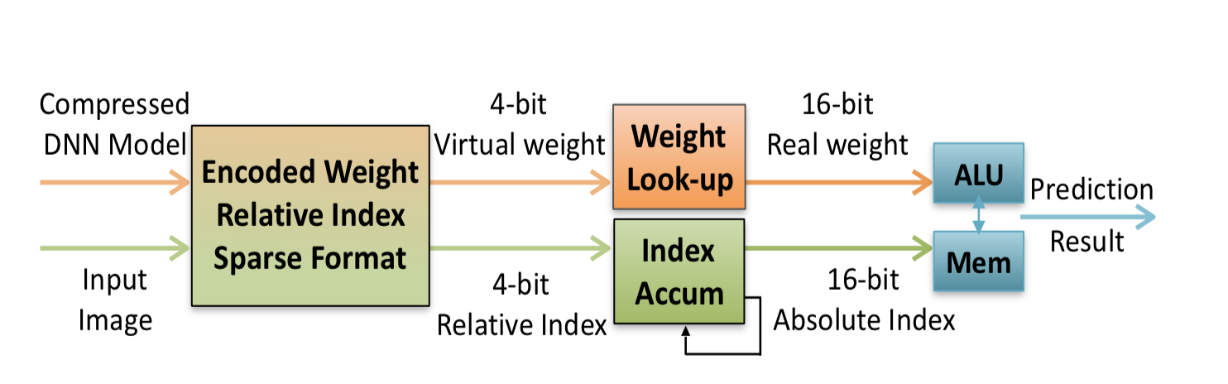
189x CPU and 13x GPU on nine DNN benchmarks

Slide 18
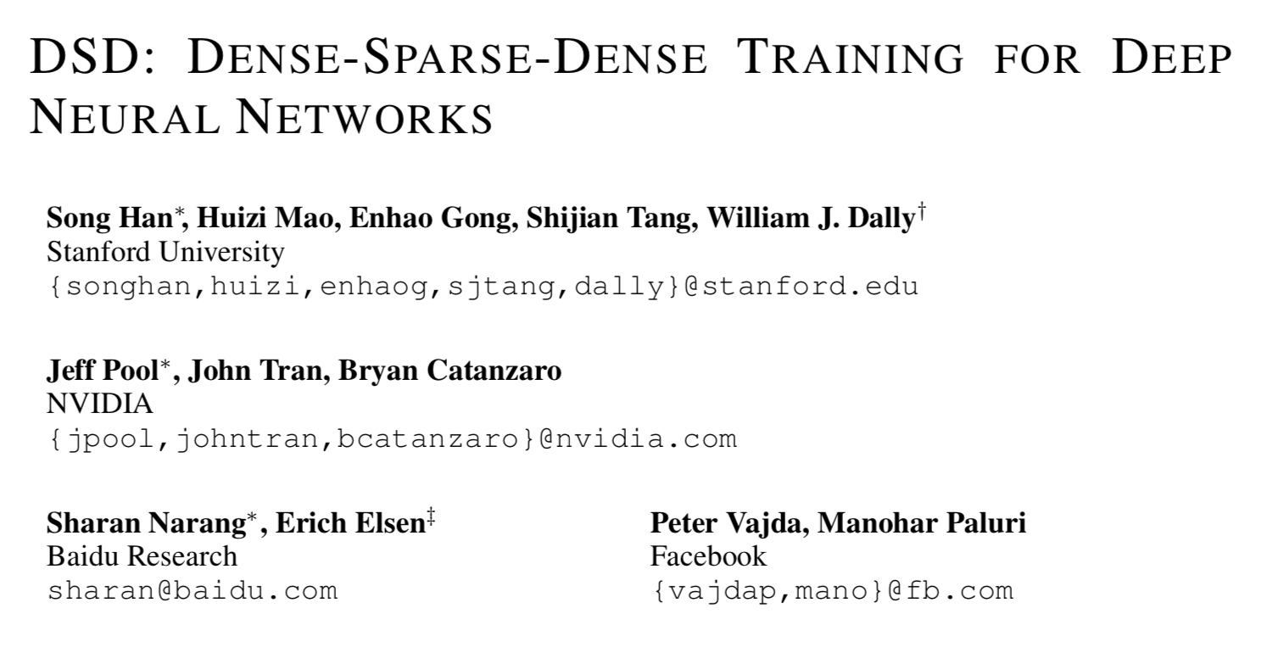
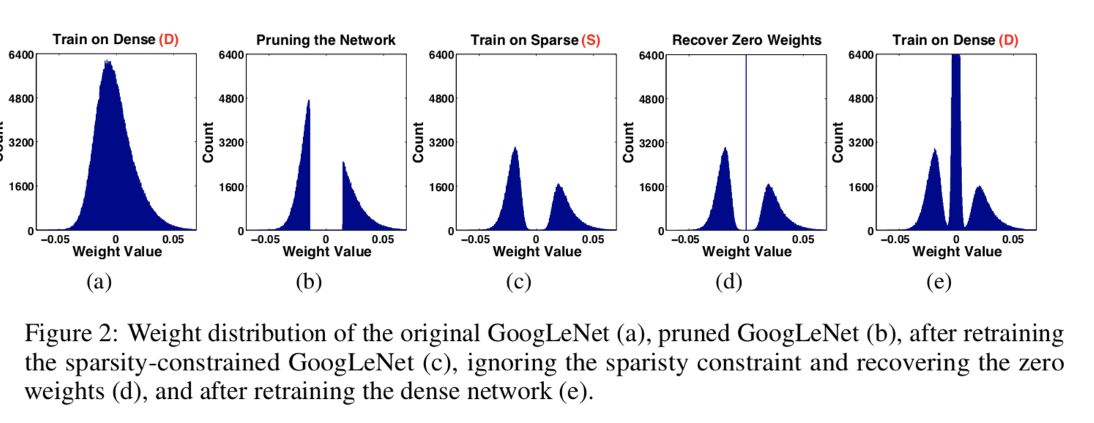
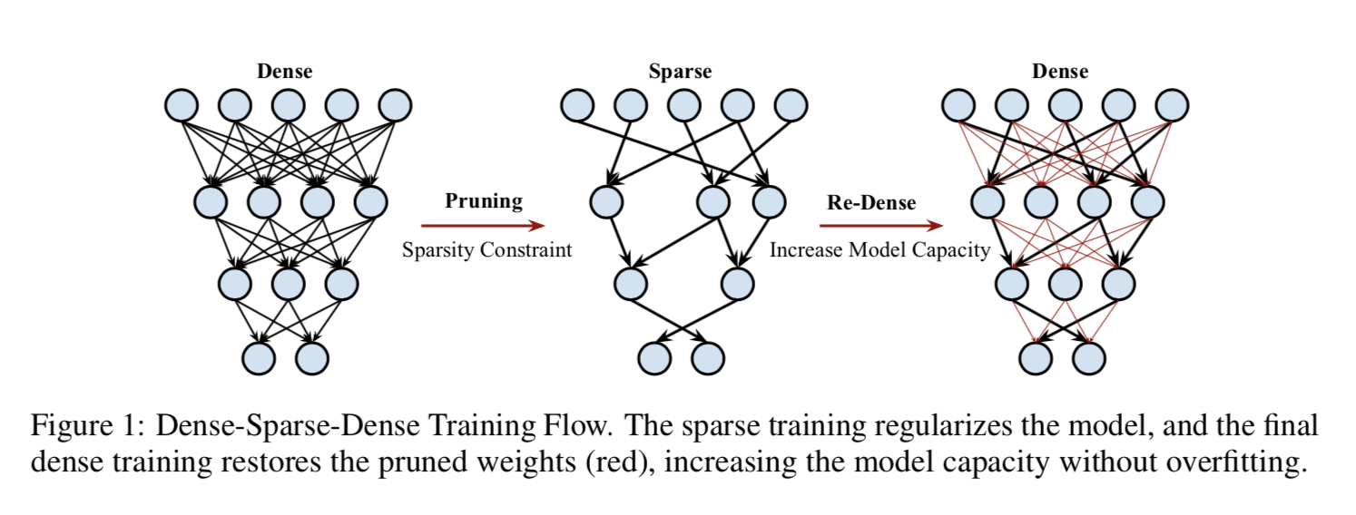
~5%-10% relative improvement on various benchmarks

Slide 19
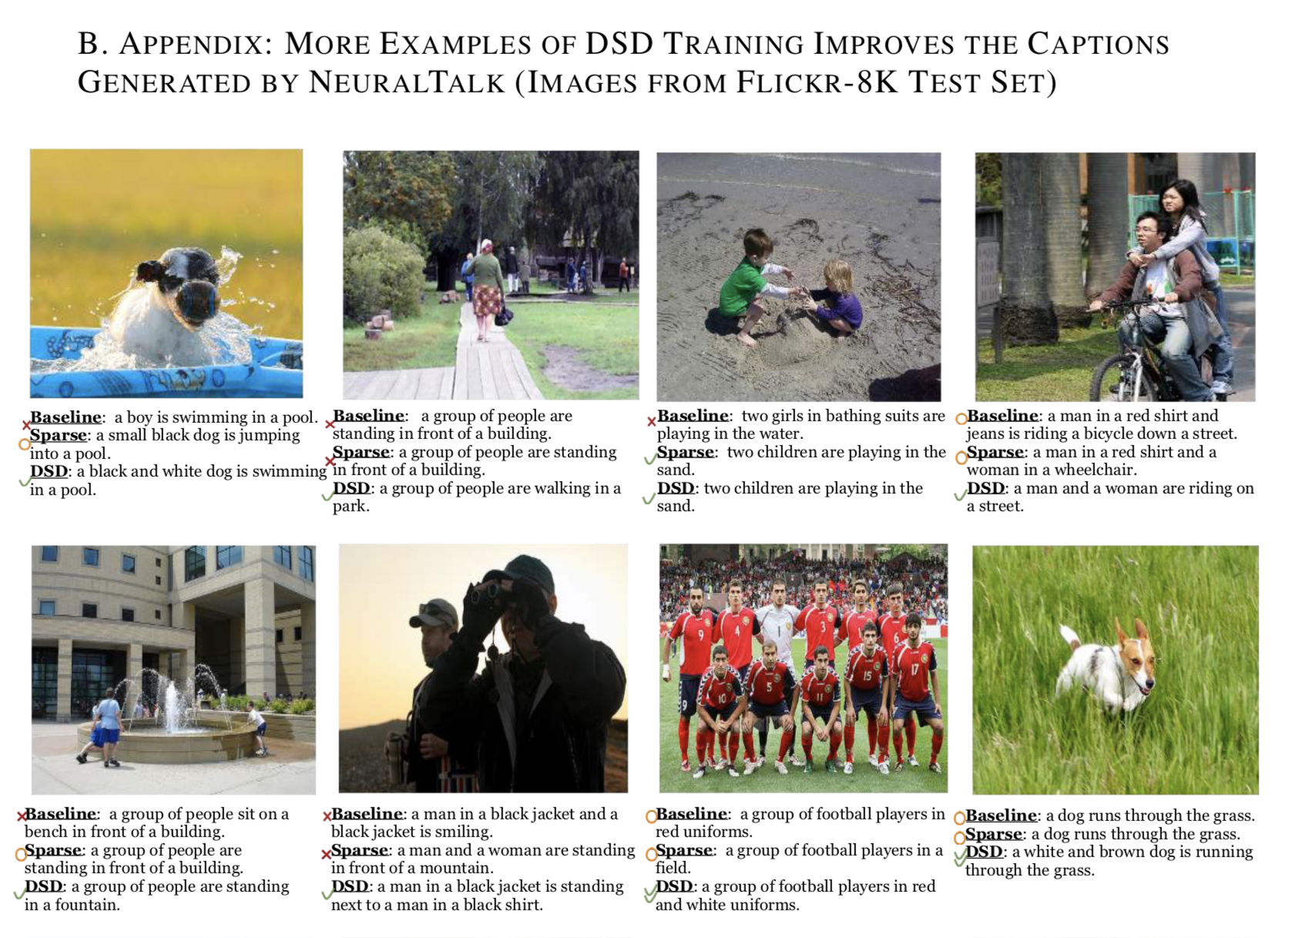

Slide 20
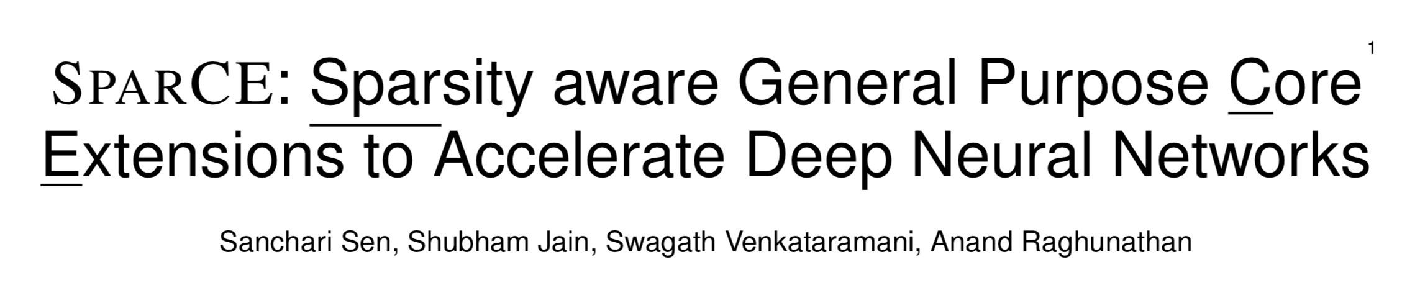
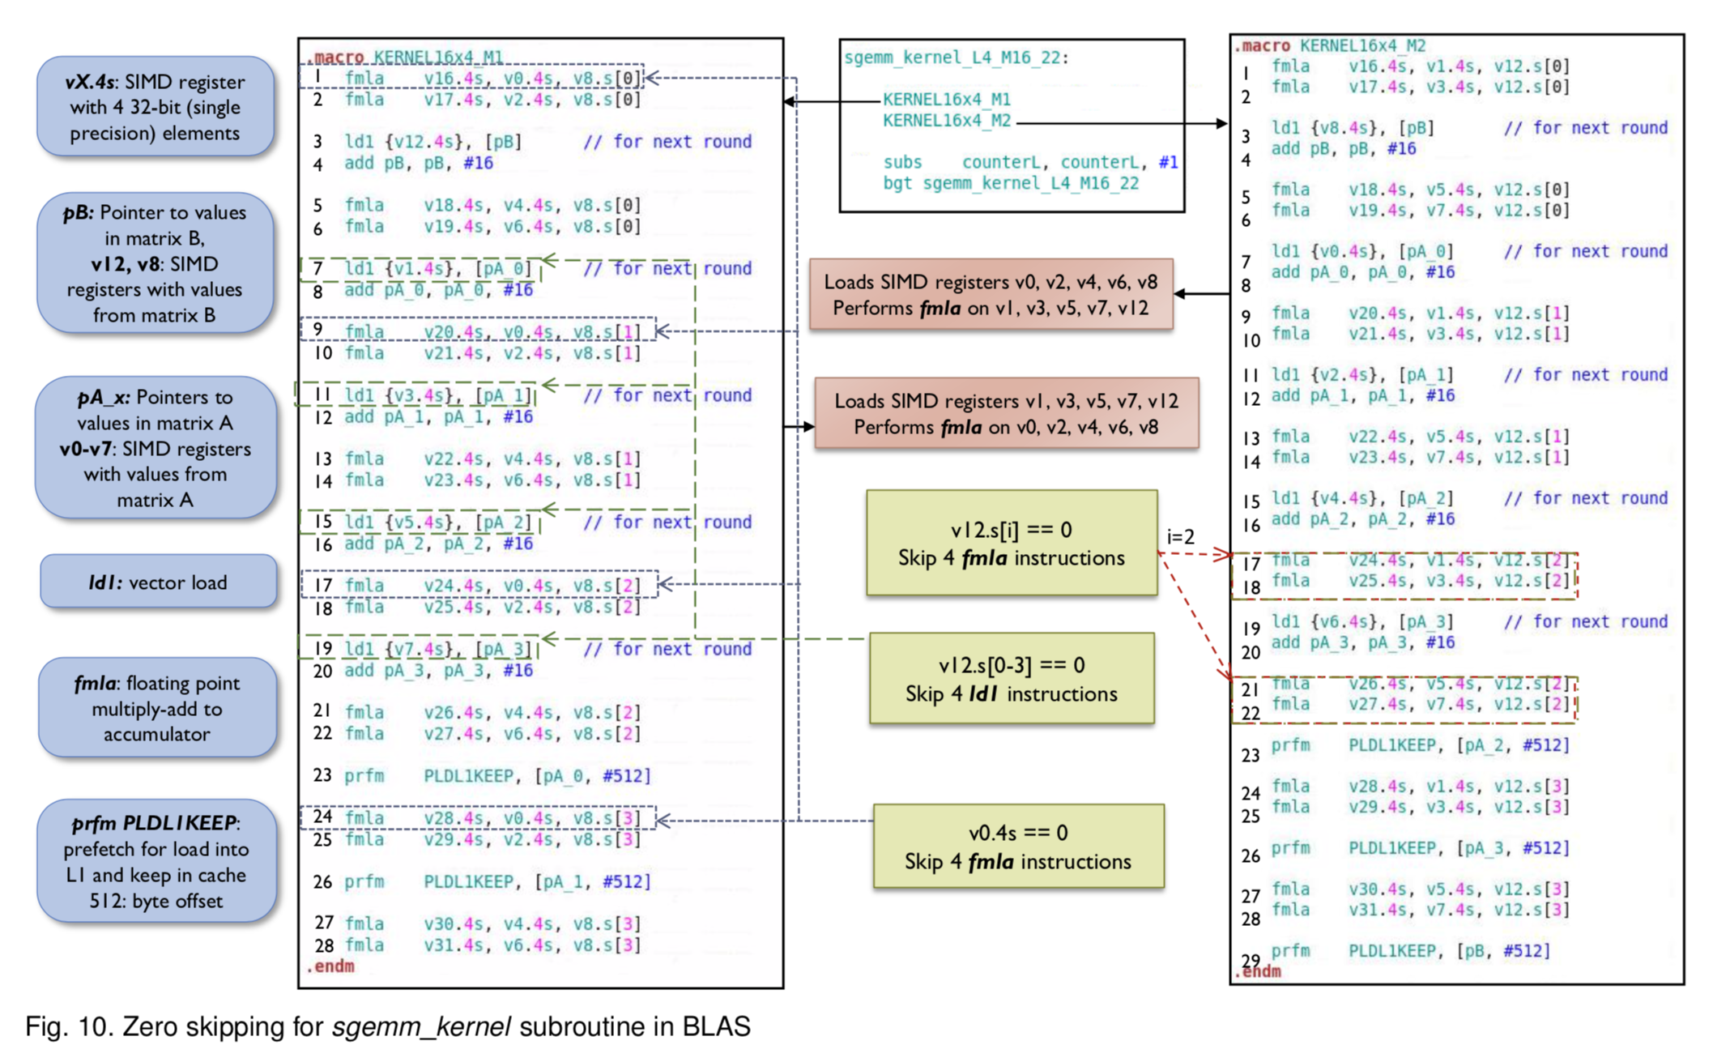
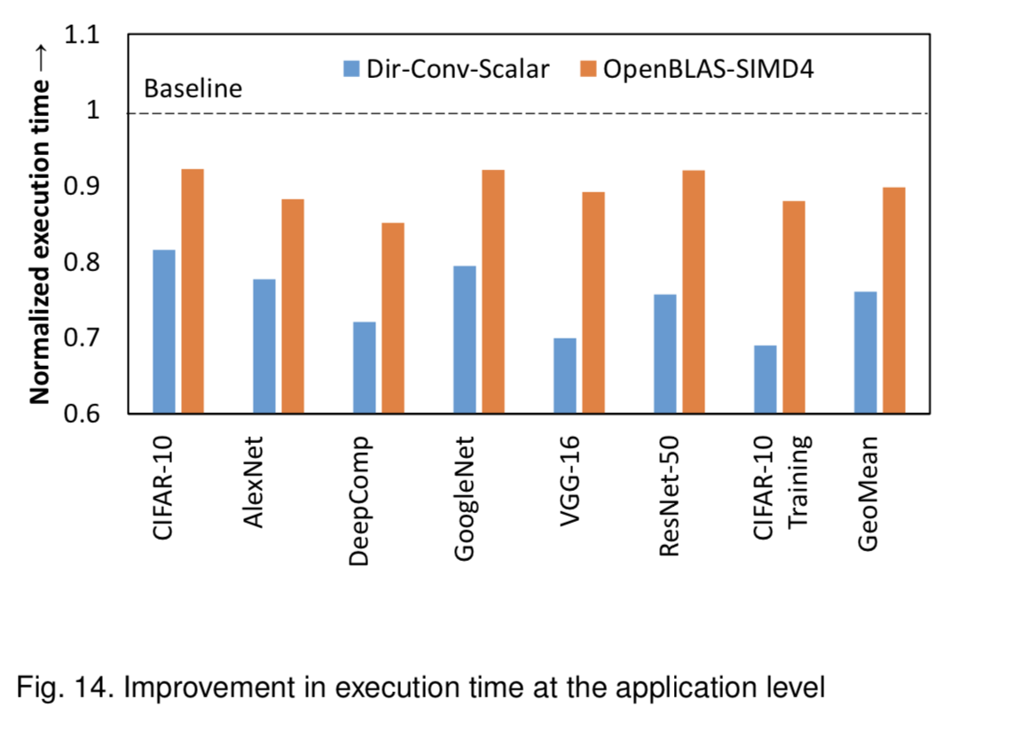
Skip as many zeros as possible but otherwise do everything the same

Slide 21
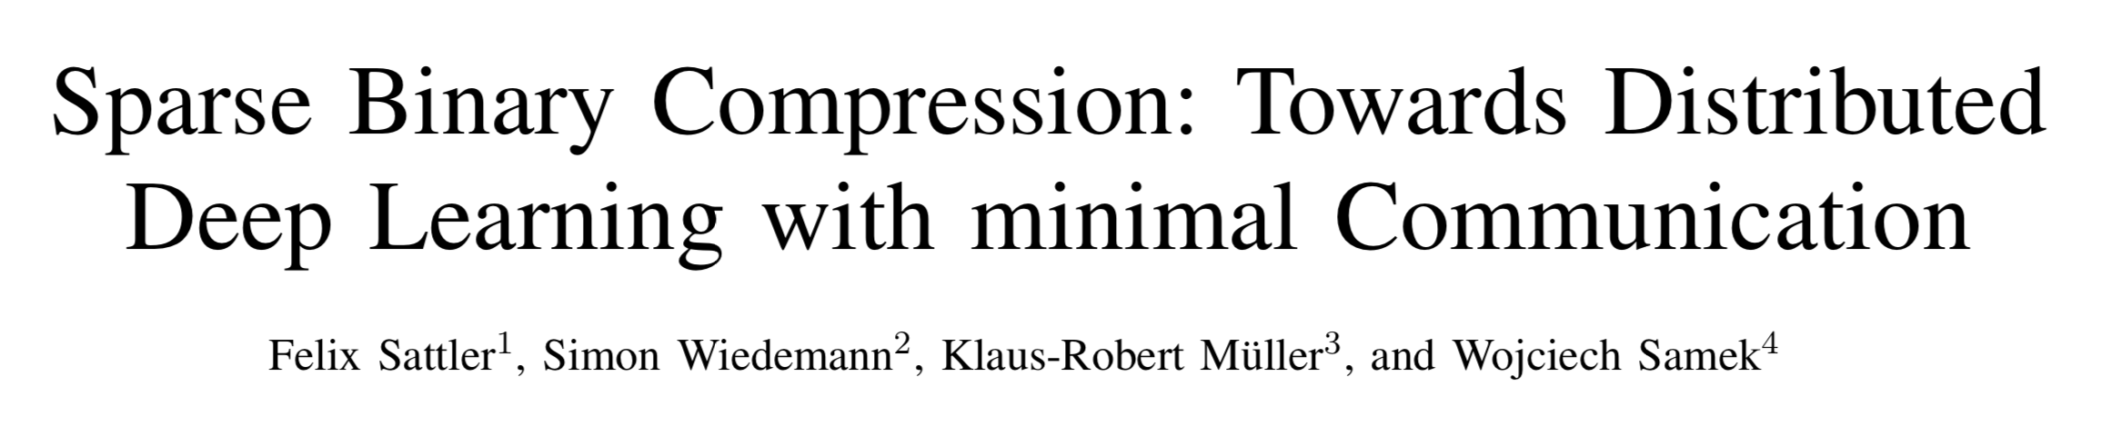
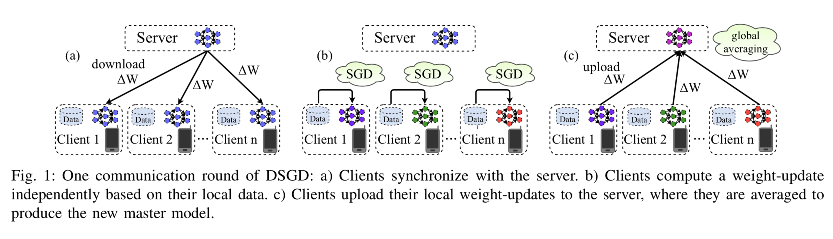
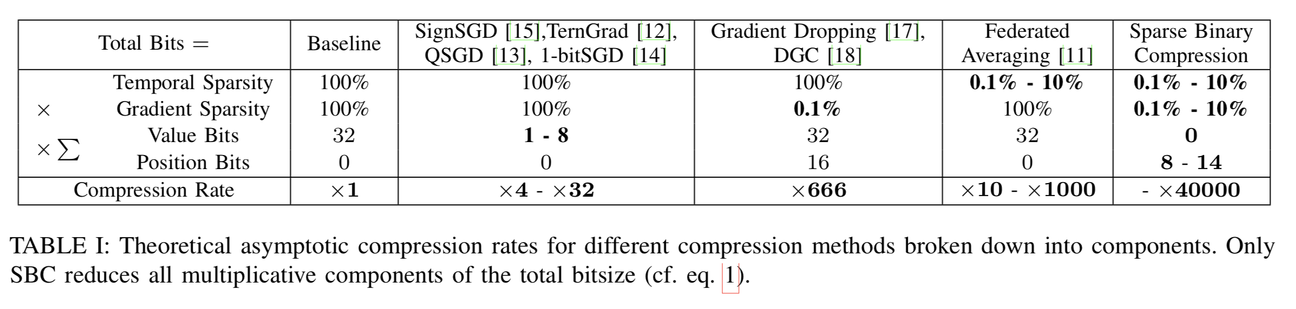
Reduce the communication in distributed training as much as possible

Slide 22
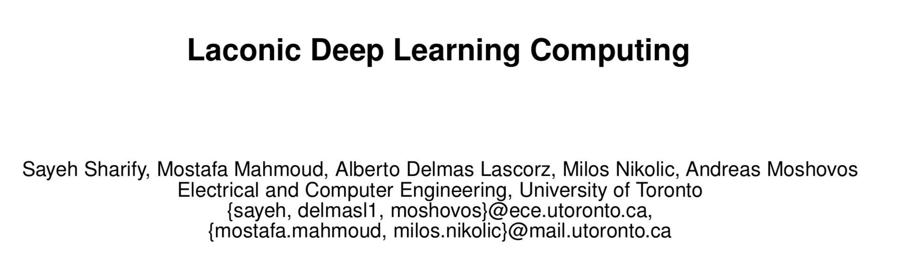
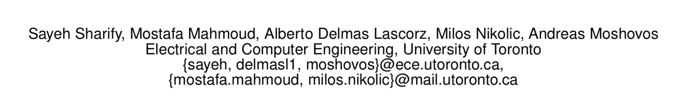
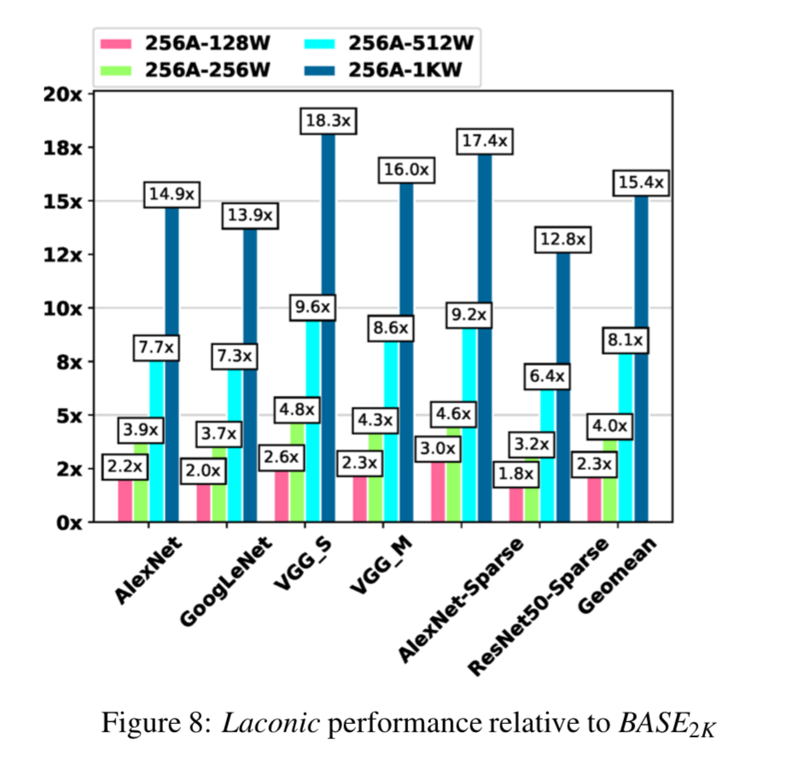
New hardware design to exploit non-zeros in multiplication
Specifically, we show that if we decompose multiplications down to the bit level the amount of work performed during inference for image classification models can be consistently reduced by two orders of magnitude. In the best case studied of a sparse variant of AlexNet, this approach can ideally reduce computation work by more than 500×. We present Laconic a hardware accelerator that implements this approach to improve execution time, and energy efficiency for inference with Deep Learning Networks.

Slide 23
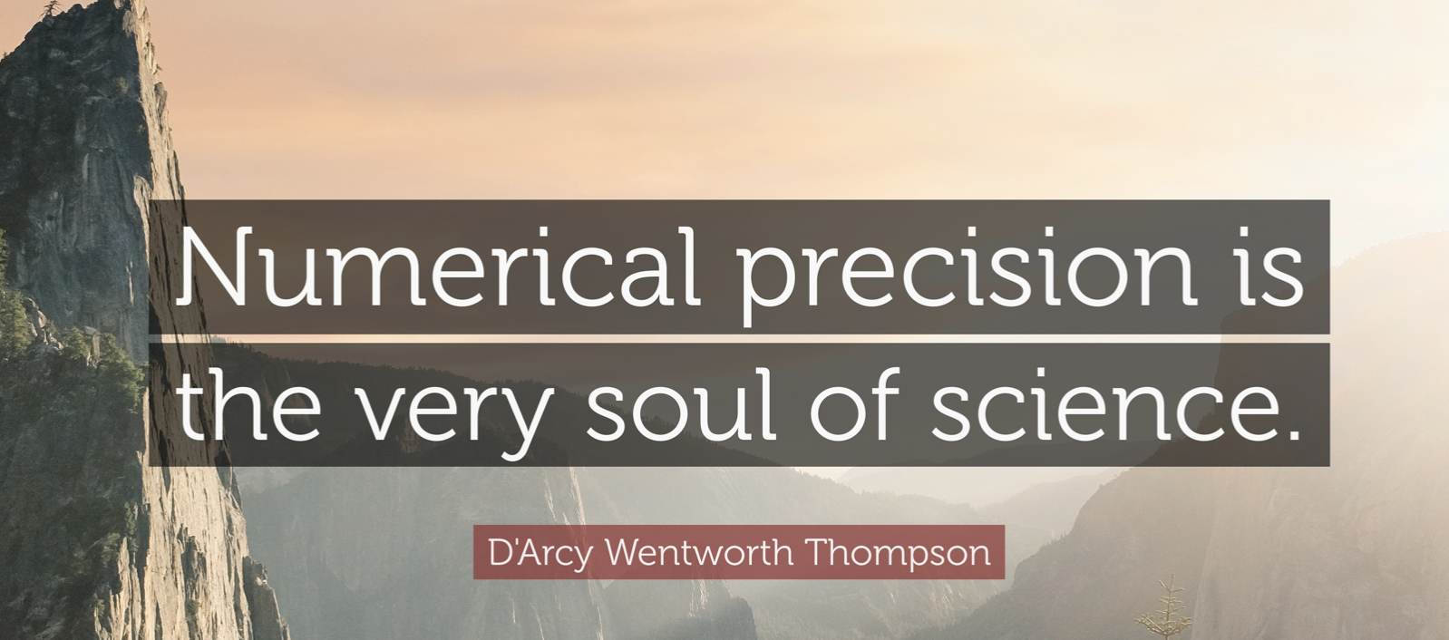
Precision

Slide 24
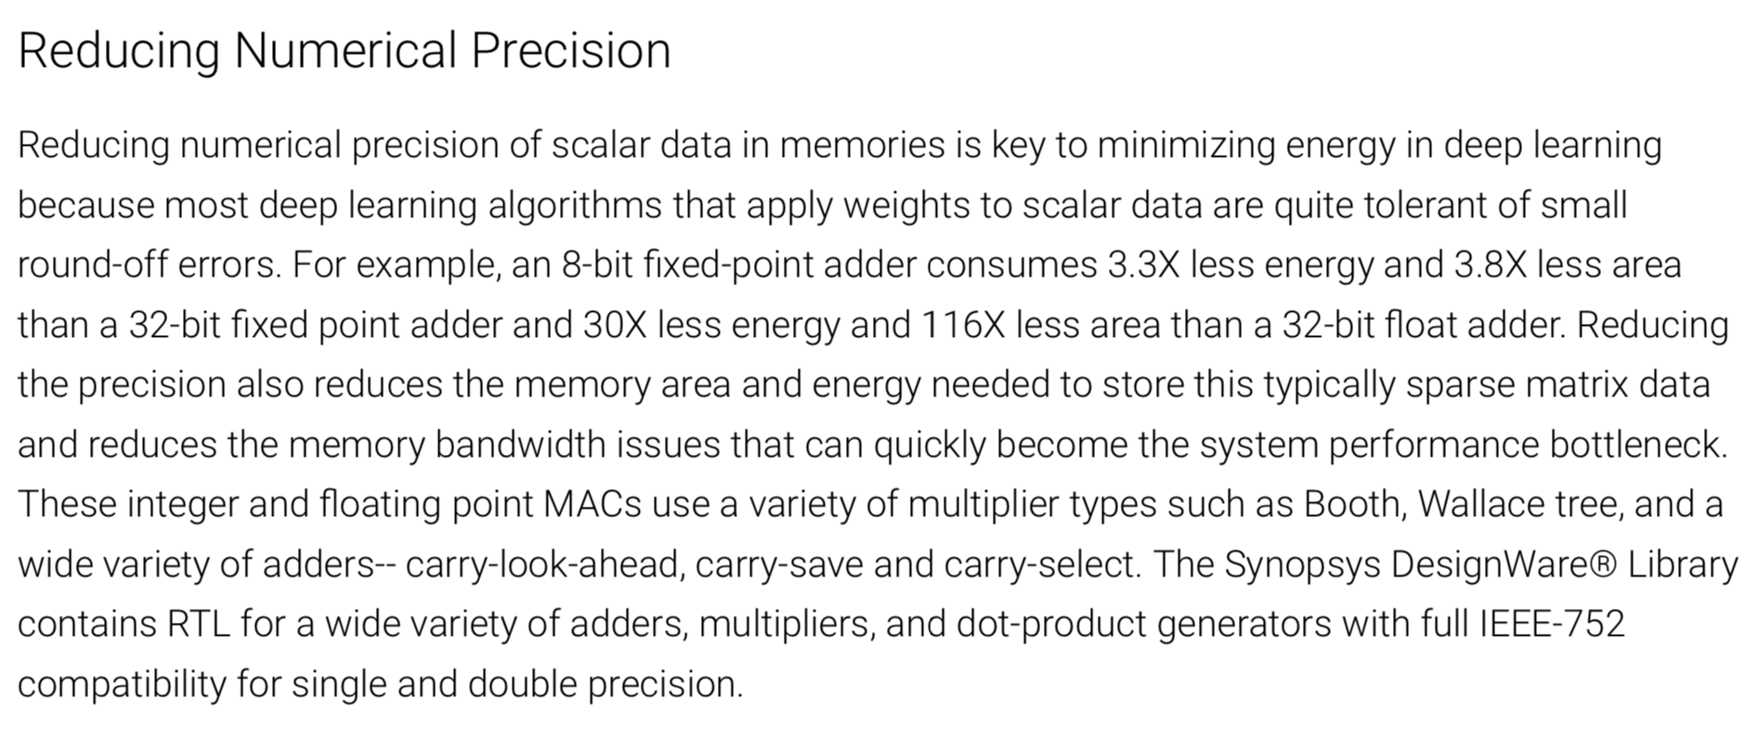

Slide 25


In our Cancer Models bfloat16 just works
With effectively no difference in training

Slide 26





8-bit training
HALP = (Low Precision Stochastic Variance-Reduced Gradient) + Bit Centering

Slide 27

Many experiments at lowering precision in both weights and activations
Vol. 105, No. 12, December 2017 | Proceedings of the IEEE 2295

Slide 28

AlexNet CNN Architecture (CNN+FC)

Slide 29

Vol. 105, No. 12, December 2017 | Proceedings of the IEEE 2295

Slide 30

Accelerator
Architectures

Slide 31

MLperf Benchmarks (Google, Intel, NVIDIA)

Slide 32
AI Hardware and Systems Startups
Cerebras
Wave Computing
KnuEdge
TensTorrent
THINCI
Knowm
Mythic
BrainChip
InnoGrit
LightMatter
SambaNova
Esperanto
Almotive
Deepscale
LeapMind
NovuMind
REM
Deep Vision
Groq
Kneron
Hailo
Think Silicon
LightIntelligence
Gyrfalcon

Slide 33


2x – 10x (CPU, GPU) in sight 100x+ possible?

Slide 34



Single instruction can drive 1M operations “Mega-SIMD” Soft NPU in FPGA

Slide 35


Slide 36


Accelerating training. 80%-90% utilization. > 200 GFLOPS/W (45nm) SGD/CP (pipelined training)

Slide 37

Accelerating training. 80%-90% utilization. > 200 GFLOPS/W (45nm) SGD/CP (pipelined training)

Slide 38

Habana
Habana, an Israeli startup, is sampling the 16nm Goya chip for inference. On the popular ResNet-50 neural network, Goya achieves 15,088 images per second (IPS) with a batch size of 10, or 7,107 IPS with batch size of 1. These measured scores are 5x and 6x faster, respectively, than Nvidia’s posted V100 test results. Goya also uses less power than the V100, having a 200W TDP and consuming only 100W when running at 15,000 IPS. The secretive startup has withheld all details of its custom architecture as well as its funding.

Slide 39
Wave Computing
Wave has spent the past two years revising its data- flow architecture. Having $117 million in funding from Dado Banatao’s Tallwood Capital and others, the startup is sampling systems based on its DPU ASIC. On the basis of simulations, Wave claims a 64-DPU system could train GoogLeNet at 420,000 IPS, or about 6,500 IPS per chip, which would be 4x better than Nvidia’s measured V100 performance.

Slide 40

Most of the performance is coming from
low precision functional units

Slide 41
Cornami
Cornami is the latest startup from Gordon Campbell, who also founded both Seeq and Chips & Technologies. At the recent Linley Processor Conference, it disclosed ambitious plans to deliver a processor with 100x the performance of Nvidia’s Titan V (Volta) card while using only 30W. The company has developed a unique architecture that can cre- ate dynamically reconfigurable systolic arrays using more than 10,000 independent cores, but it withheld further de- tails, including its funding and schedule. Cornami is already testing initial silicon, and we expect its first product in 1H19.

Slide 42
Conclusions
Deep Learning network architectures are moving extremely fast
  Whether software/method/hardware co-design approaches can keep up is unclear
Adoption of DL applications at scale at HPC Centers will put pressure on future systems designs
  Single models at extreme scale not yet common, throughput reigns
Attention mechanisms are getting lots of attention
  Attention is a simple form differentiable memory
  Can be compute and memory intensive.. But very powerful
Sparsity and Precision issues are secondary in methods development
  Model performance on the problem is still primary
Architectural approaches seem to similar with the exception of Neuromorphic designs which have not yet proven to be useful in general DL problem areas
  SNN can be much more energy efficient, but SNN abstraction not embraced yet by the ML community

Slide 43






Acknowledgements
Many thanks to DOE, NSF, NIH, DOD, ANL, UC, Moore Foundation, Sloan Foundation, Apple, Microsoft, Cray, Intel and IBM for supporting my research group over the years

